Slide 1
The Conversion Optimizer.Maximize your advertising ROI.

Slide 2
This presentation is to help you sell the Conversion Optimizer to your customers.
This presentation should be branded with your company logo and your client's company logo
Please ensure you check the statistics are correct and up-to-date before presenting to your client
For more information on the Conversion Optimizer see:
Remember to delete this slide before going to the customer
http://www.google.com/intl/en/ads/conversionoptimizer/
http://support.google.com/adwords/bin/answer.py?hl=en&answer=2471188

Slide 3
What is the Conversion Optimizer?
The Conversion Optimizer is a free AdWords automatic bid management system It's designed to get you more conversions at a lower cost
£
£
€
$
€
What?
Why?
How
Top Tips
Remember
Conclusion

Slide 4
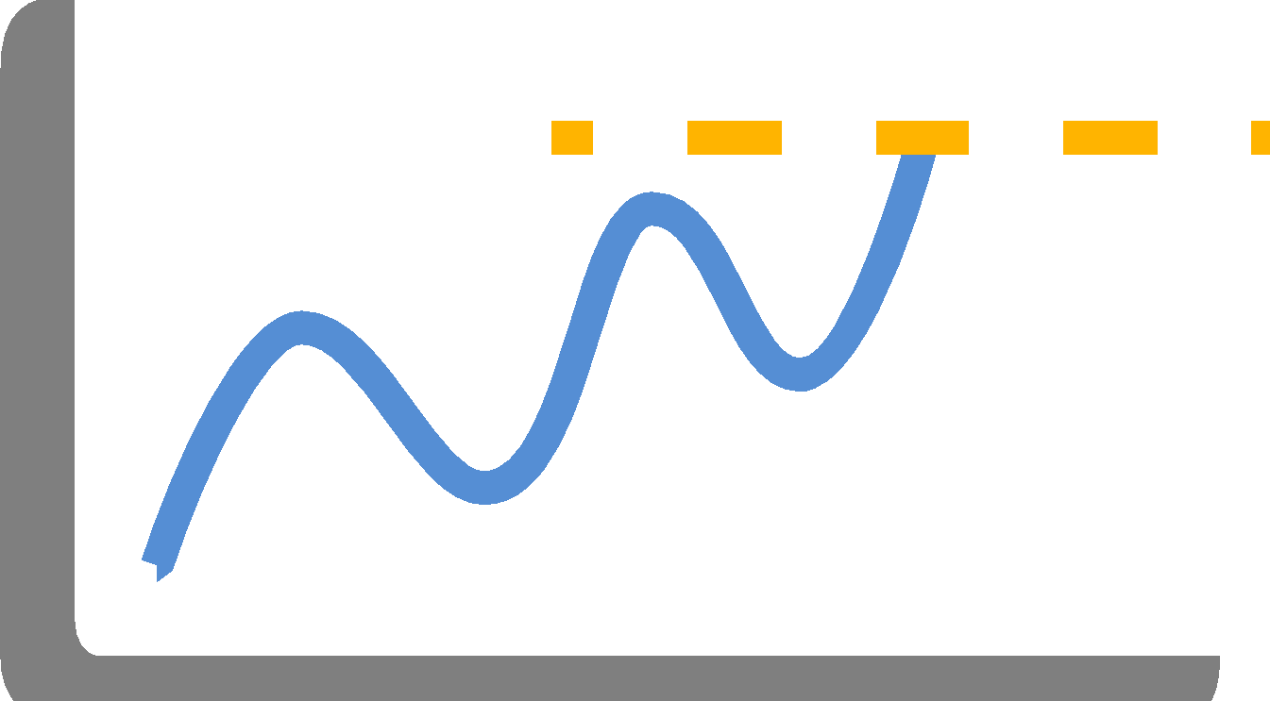
Why use the Conversion Optimizer?
The Conversion Optimizer can increase conversions whilst reducing your CPA
On average, campaigns adopting the Conversion Optimizer achieve an increase in conversions while decreasing their CPA
What?
Why?
How
Top Tips
Remember
Conclusion

Slide 5
How the Conversion Optimizer works.
It observesThe Conversion Optimizer studies your conversion tracking data to figure out how often each type of auction leads to a conversion
It buildsBased on observed past performance, the Conversion Optimizer creates a prediction model to estimate which auctions will perform best for you in the future
It optimizesThe Conversion Optimizer adjusts your bids on an ongoing basis, ensuring your money is efficiently invested in the best auctions. It generates an ad rank by your CPA bid, Quality Score, and predicted conversion rate
What?
Why?
How
Top Tips
Remember
Conclusion

Slide 6
Bidding options.
Maximum cost-per-acquisition This is based on the most you're willing to pay for each conversion
Or
Target cost-per-acquisition This is based on the average amount you're willing to pay for each conversion
What?
Why?
How
Top Tips
Remember
Conclusion

Slide 7
Benefits to using the Conversion Optimizer.
Increase your profits
Campaigns adopting the Conversion Optimizer typically achieve an increase in conversions and a decrease in their CPA
Easy to use
Spend less time managing your bids
There's no additional charge
Access Conversion Optimizer within your AdWords account with no extra fees or new interfaces to learn
What?
Why?
How
Top Tips
Remember
Conclusion

Slide 8
Testimonial.
“We've seen the campaigns we've used Conversion Optimizer on increase in ROI about 200%, the cost per acquisition go down about 40%, and our conversion percentage go from 0.5% to 2.0%.”
Tad Dooling, Online Marketing Manager, CafePress*
What?
Why?
How
Top Tips
Remember
Conclusion
*Source: Google Internal Data. Last updated: July 2012.

Slide 9
Thank you.
If you have any queries or would like help setting up the Conversion Optimizer please contact:
Account manager nameAccount manager email

