Slide 1
Global search Strategy January 11, 2011

Slide 2
Executive Summary
Search is a key pillar in Olay’s overall digital strategy, amplifying all other online efforts and producing the strongest global ROI ($3.21).
Our WHO starts her research for her skin care and beauty with an online search, giving Olay the opportunity to reach her with targeted, highly relevant information to help her move past her purchase barrier.
By leveraging both Paid and Organic search, Olay can ensure a strong presence in Where to Lead content categories and effectively capture incremental consumers.
Success in search depends on entirely on strong partnerships between the Regional Brand Team and local agencies.
Global Search Strategy provides suggested new processes for content creation, website optimization, and initiative support to ensure regions are effectively maximizing potential in this channel.
2

Slide 3
Table of Contents
Objective of the Global Search Strategy
Foundation of Search: Critical Partnerships
Understanding Your Regional Landscape: Desktop vs. Mobile Search
Getting Started: Gold Keywords
Paid Search
Campaigns and Targeting our WHO
Strategies to Gain Efficiencies
Optimizing and Measuring Success
Organic Search
Current Performance and Recommended Optimization Process
Content Creation Process
Global Search Toolkit
Paid Search Execution Instructions and Best-In-Class Examples
Organic Search Execution Instructions and Best-In-Class Examples
3

Slide 4
Objective
4

Slide 5
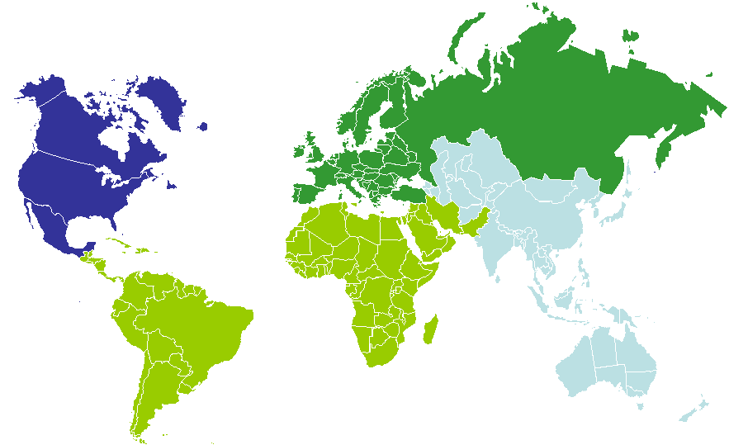
Purpose and Goal of the Global Search Strategy
Objective
Key Objectives
Consumer
Leverage search as a vehicle to enable each of the Olay segments to easily and effectively find relevant beauty and skin care information
Business
To leverage search as a tool to:
Increase Olay’s fair share of search shelf
Drive online / off line sales
Amplify the effectiveness of current Olay content
Create cost effective and scalable global Olay search strategy
Search
5

Slide 6
Search is a key pillar of Olay’s overall digital strategy
Objective
Digital Pillar Strategy Phase
iMedia Strategy
eCRM Strategy
Mobile Strategy
eCommerce Strategy
To be completed in 2011
Search Strategy
Content Strategy
Social Strategy
Assess the Digital Landscape
6

Slide 7
Search is a key complement to our global digital strategies
Objective
Offline and online marketing activities generate online searches
Initiative Toolkits
Social Media and Content Syndication
help drive interest, deliver external links (credibility) to your content, increasing your search rankings
Social Networking Strategy and Facebook Toolkit
Global Content Strategy
Digital content
meets consumers’ expectations and amplifies your gold keywords
Olay site redesign
Global Content Strategy
Framework from P&G Digital Strategy Group’s Win in Search: Search& Digital Content, by Dave Knox & Stan Joosten
7

Slide 8
Search as the strongest ROI for Olay at $3.21
Objective
Global Search Strategy offers guidance on how Regions can take advantage of this strong ROI
Source: P&G CMK Global Digital Meta-Analysis 2010
8
Notes:
Search
Paid Search
Web Content
Brand Website
Content Syndication
Google Content
CRM
E-Coupons
E-Sampling
Brand E-mails
Social Media
Social Networks
iMedia
Banner Advertising
Broadband Advertising
Mobile
Mobile Banner Ads

Slide 9
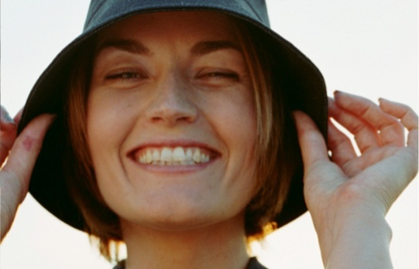
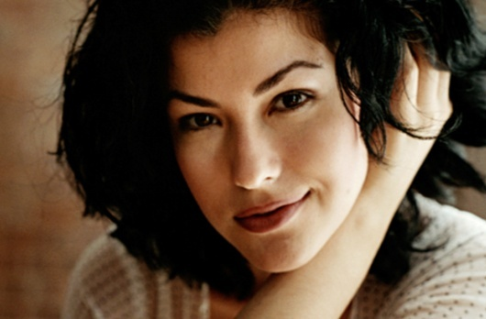
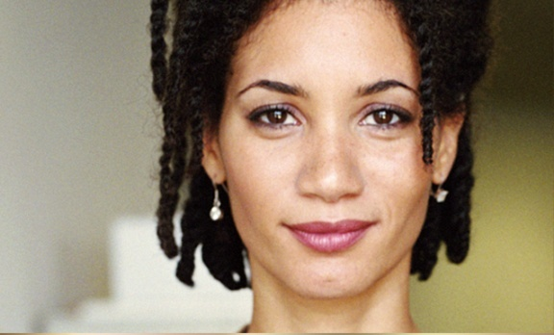
Our WHO starts her skin care and beauty research with a Search
Objective
OLAY women
facial skincare Segments
CONSULTANCY-SEEKING OBSESSED NON-MASS SHOPPER
DRAMATIC TRANSFORMATION SEEKER
STRAIGHT-FORWARD
PERFORMANCE SEEKER
SKIN ESSENTIALS SHOPPER
PATH TO PURCHASE BARRIER
General negative perception of mass brands.
PATH TO PURCHASE BARRIER
Olay is perceived as being too old.
PATH TO PURCHASE BARRIER
Olay’s product lineups are too complicated.
PATH TO PURCHASE BARRIER
Olay is perceived as not relevant to her.
search OPPORTUNITY
Engage her through skincare topics she’s most interested in and offer her ratings and reviews, expert endorsements and credible 3rd party awards she needs for proof of efficacy.
search OPPORTUNITY
Tap her interest for transformation and all over beauty by leveraging fashion, beauty and makeup to reach her. Offer her ratings and reviews, ambassador news and beauty advice to engage her.
search OPPORTUNITY
Tap into her pragmatic and straight-forward mindset by offering product ratings and reviews and tips. Reach her through special incentives and skin consultation opportunities.
search OPPORTUNITY
Align Olay with her interests in celebrity, fashion, hair and makeup. Offer her rich and interactive content and opportunities to engage in the social space wherever possible.
Source: Forrester Consumer Technographics, Olay Face and Body Proxies, Q2010
9

Slide 10
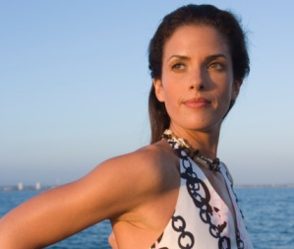
Our WHO starts her skin care and beauty research with a Search
Objective
OLAY women
body skincare Segments
Sophisticated perfectionist shopper
Confident experientialist shopper
Essential well-being Seeker
PATH TO PURCHASE BARRIER
Olay’s claims aren’t believable enough to convince her to try.
Search OPPORTUNITY
Give her the ratings, reviews and deals that convince her to buy. Feature product innovations to persuade her, and reach her with relevant lifestyle interests.
PATH TO PURCHASE BARRIER
Olay is not new and intriguing enough to spark her interest.
Search OPPORTUNITY
Reach her by leveraging her interests in fashion, beauty, art, and home. Offer her incentives and celebrity endorsements that motivate her to engage with the brand.
PATH TO PURCHASE BARRIER
Olay’s body product products are unfamiliar to her.
Search OPPORTUNITY
Tap into her pragmatic and straight-forward mindset by offering product ratings and reviews and tips, and align with her interest for health & wellness.
Source: Forrester Consumer Technographics, Olay Face and Body Proxies, Q2010
10

Slide 11
See Search Toolkit for Additional Reference
Objective
Search 101 (click here)
Search and the Beauty Category (click here)
11

Slide 12
Foundation of search: Critical partnerships
12

Slide 13
Partnership is Critical to the Execution of a Successful Search Strategy
Critical Partnerships
Search is a digital channel that requires close partnerships due to its ability to amplify other digital efforts and extremely technical nature. The Regional Brand Manager is the hub of the search strategy.
Search Agency
ER/PR
Digital Agency
Regional Brand Manager
DMM
Tech Agency
Media Agency
13

Slide 14
Regional Brand Team: Roles and Responsibilities
Critical Partnerships
Brand Manager
DMM
ER/PR
Own vision for Regional Search Strategy and overall execution and performance
Provide strategic guidance to Search Agency in Keyword and Ad Copy development
Facilitate information sharing between search, digital, and media agencies, particularly for initiatives
Ensure Search Agency is employing strategies to maximize budget efficiency and continuously optimize
Oversee Organic Search Optimization efforts by Search Agency, Digital Agency and Technical Agency
Ensure ER agency evaluates all opportunities in ER/PR initiatives that drive Organic Search
Create Content that adheres to Organic Search Best Practices
Identify opportunities for Linking Partnerships between Olay.com and relevant 3rd party sites
14

Slide 15
Regional Agencies: Roles and Responsibilities
Critical Partnerships
Search Agency
Digital Agency
Technical Agency
Media Agency
Partner with Brand Manager to develop Gold Keywords
Develop and Implement Paid Search Campaigns
Design and Execute Test and Learn Agenda
Provide Guidance and Recommendations on Organic Search Optimization to Olay Content Assets and Olay.com
Utilize SearchMart to Monitor and Improve Olay.com Organic Search Performance
Develop Content Assets that Adhere to Organic Search Best Practices
Partner with Search Agency to Create
Implement Technical Requirements to Support Organic Search Best Practices on Olay.com
Partner with Search Agency to amplify iMedia campaigns with Paid Search
15

Slide 16
Getting started in search: gold keywords
16

Slide 17
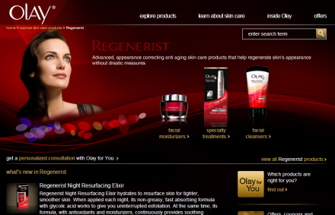
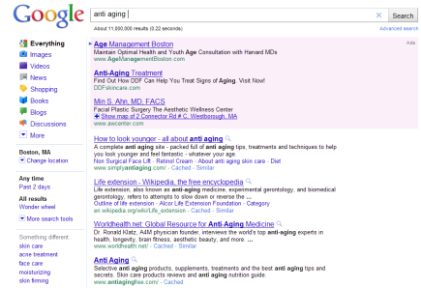
Understanding the Search Journey…
Gold Keywords
She starts with a Search
(81% of consumer do this globally)
2. She chooses Olay content
Is Olay present, either in organic or paid search?
Is this the content she was expecting?
Test landing pages to provide the most relevant experience
4. Olay Measures and Optimizes
3. She engages with Olay content
Olay continues to optimize content in order to rank in natural search
Are we making it easy for her to achieve her goal?
Read Reviews
Buy Now/Where to Buy
OlayForYou Consultation
Consumer Journey is the same for Desktop and Mobile Search, but the content experience will be different
17

Slide 18
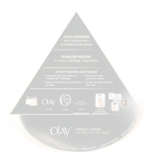
Gold Keywords are the foundation of the Search Strategy
Gold Keywords
Purpose: Drive incremental upper funnel awareness and consideration
Terms are: non-branded, high interest to our WHOs , aligned to brand equity, and supported by Olay content
Importance: Search impact is measured against these keywords
Supported with both Paid and Organic Search
Content
18
Notes:
The gold keyword list represents the most appropriate and relevant keyword phrases to optimize for and track, based on the Olay site content, equity pyramid, and consumer interest.

Slide 19
Developing Gold Keywords starts with the Content Strategy
Gold Keywords
Focus on Gold Keywords that support the Skin Care pillar, in themes where Olay can lead
From Olay Global Content Strategy:
19

Slide 20
Each region should develop a core list of Gold Keywords to support their priority content themes
Gold Keywords
The following is a sampling of the U.S. Gold Keyword list* that can serve as a starting point for other regions:
Content Theme | Keyword
 | anti aging
 | anti aging skin treatment
 | wrinkle creams
 | anti wrinkle creams
 | anti aging products
 | dry skin care
 | oily skin care
 | sensitive skin care
 | dark circles under eyes
 | skin care
 | eye cream
 | facial cleansers
 | skin care products
 | face wash
 | facial moisturizers
 | night cream
Aging / Anti-Aging / Age Prevention
Key Considerations:
Avoid category ambiguous terms, such as “wrinkle”
Refine terms for the Beauty and Skin Care category
Consider nuances for Desktop vs. Mobile Search (Mobile tends to be more lower funnel terms)
Common Skin Issues
Skin Basics & Routine
*U.S has 40 keywords in total
Source: Olay U.S. 2011 Gold Keyword List
20
Notes:
Only top volume keywords in each theme are represented, at least 50K searches per month
Consumers not actively searching for Skin Care science and innovations. This theme will come into play for initiative based paid search
Add skin care

Slide 21
Number of Gold Keywords Depends on Content and Resources
Gold Keywords
Each region should have a unique set of Gold Keywords customized based on regional nuances
Highly Connected Markets
Developing Media Markets
Existing search strategy
Most assets are optimized for search
Regions include: US, UK, and China
Nascent or non existing search strategy
Still working to optimize content
Regions include: Russia, Mexico, and India
Aim to develop a robust set of 30-40 Gold Keywords that encompasses most of your content
Start with a list of 15-20 Gold Keywords and expand your list accordingly
Priority regions as defined in Global Digital Landscape Assessment
21
Notes:
Add other qualifiers

Slide 22
Example Gold Keyword Decision Tree:
Gold Keywords
“anti-aging skin products”
High volume, high/medium competition
Low volume, low competition
Is the keyword on equity?
Do Not Pursue
(may rank organically)
Yes
No
Do Not Pursue
Select & Utilize Gold Keyword
Is Keyword converting cost effectively?
Yes
Run Keyword Test in Paid Search
Do we have the content to support it?
Yes
No
Do Not Pursue
No
Create Supporting Content
22
Notes:
Is it valuable?

Slide 23
Validate Gold Keywords in Paid Search
Gold Keywords
Once you have defined your initial Gold Keyword List, design Paid Search Test to measure effectiveness and potential
Keyword
“body lotion”
 | Pages/Visit | Average Time on Site | Bounce Rate | Cost per Click
“body lotion” | 3.75 | 03:30 | 35.38% | $4.87
Non-branded Paid Search Average* | 2.89 | 02:19 | 44.67% | $4.95
Paid Search Average* | 4.29 | 03:58 | 29.58% | -
Based on the results, “body lotion” outperforms non-branded and general paid search averages, and therefore has great potential as a Gold Keyword
From Google Analytics, time period November 1, 2010 to December 31, 2010
23

Slide 24
Gold Keyword Diagnostic Tool available in Toolkit
Gold Keywords
1. Begin keyword research based off of Where to Lead Skin Care themes in the Content Strategy
Identify themes for individual pages from the content on Olay’s website or existing content
Create a list of the most relevant keyword phrases based off of the content themes
Use the Google Keyword Tool to find keywords related to the content themes
Choose the keywords with the highest search volume and most relevance
Look at Google Analytics profile for your regional website (www.google.com/analytics) and find the top organic traffic driving keywords. Are they related to your initial Gold Keyword list? Do they have high search volume?
Look at Competition
What keywords are they ranking on? Are the keywords relevant to Olay? Are they supported by the content on the Olay Website? Do they have search volume?
Use the sample Gold Keyword spreadsheet to analyze each keyword (next slide)
Create a final list of all relevant, high volume keyword phrases
24

Slide 25
Sample Gold Keyword Analysis
Gold Keywords
Content Theme | Keyword | Monthly Search Volume | Top ranking sites in line with the Olay site? (ie are competitors ranking on this term) | Where does Olay rank on this term in Organic Search? | Does Olay have the content that supports these search queries?
Aging / Anti-Aging / Age Prevention | anti aging | 450,000 | N | n/a | Y
 | anti aging skin treatment | 165,000 | Y (Murad) | n/a (Not on first 3 pages) | Y
 | wrinkle creams | 165,000 | N | n/a (Not on first 3 pages) | Y
 | anti wrinkle creams | 60,500 | N | n/a (Not on first 3 pages) | Y
 | anti aging products | 49,500 | Y (Murad) | Y (Page 2) | Y
Common Skin Issues | dry skin | 301,000 | N | n/a | Y
 | oily skin | 110,000 | N | n/a | Y
 | sensitive skin | 90,500 | N | n/a | Y
 | dark circles under eyes | 49,500 | N | n/a | Y
Skin Basics & Routine | skin care | 1,220,000 | Y (Elizabeth Grady, Kiehls) | n/a | Y
 | eye cream | 201,000 | Y (Avon, Channel, Kiehls) | n/a | Y
 | facial cleansers | 165,000 | Y (Cetaphil, Burts Bees, Kiehls) | 10 (Page 1) | N
 | skin care products | 135,000 | Y (Neutrogena, Aveeno) | 8 (Page 1) | Y
 | face wash | 74,000 | Y (Kiehls, Clean and Clear, Cetaphil) | n/a | Y
 | facial moisturizers | 49,500 | Y (Burts Bees, Kiehls) | 8 (Page 1) | N
 | night cream | 49,500 | Y (Lancome, Avon, Clinique, Murad) | n/a | N
25

Slide 26
See Search Toolkit for Additional Reference
Gold Keywords
Gold Keyword Best Practices and Development Tool (click here)
26

Slide 27
Paid Search: Campaigns and targeting our who
27

Slide 28
Paid Search should support Always-On and Initiative Campaigns
Paid Search: Campaigns
Paid search is critical in amplifying all digital efforts and capturing incremental consumer interest, Olay should bid on the following types of terms:
Recommended Budget Allocation
ALWAYS-ON:
Contains all high priority terms. Campaign is live year round
Gold Keywords (e.g. “anti-aging products”)
Non-branded product terms (e.g. facial moisturizers)
Non-branded, category interest terms relevant to WHOs (e.g. “wedding skin care”)
Branded Product Awareness and Trial terms (e.g. “olay total effects”)
75%
INITIATIVE:
Short term campaigns used to support new product launches or PR initiatives*
Brand Ambassador terms (e.g. “carrie underwood”)
Boutique/Product Campaign terms (e.g. “olay pro-x offer”)
25%
*Ensure search agency is aware of all online and offline initiatives that should be supported with search.
28

Slide 29
Campaign Keywords and Ad Copy should reflect Content Themes
Paid Search: Campaigns
Always On
Initiative
Path to Purchase
Category
Interest
THEME: Lifestyle, Health & Beauty
Special Occasions
*
*
Fashion, Hair and Makeup
Tips/Tricks for Beautiful Skin
†
Health, Wellness & Your Skin
*
*
Expert Beauty Advice
Cosmetic Procedures
THEME: Skin Care
Aging / Anti-Aging / Age Prevention
Skin Basics & Routine
†
Whitening
Skin Care Science
& Innovations
Common Skin Issues
†
Men’s
THEME: Unbranded Products
All products
Brand
Awareness
THEME: Branded Products & Brand Content
All boutiques
Product information and images
Skin Consultation
News, Events, Awards
Clinical Information & Results
Ratings, Reviews & Testimonials
Skin Care Experts
Innovation & Research
Trial
THEME: Purchase Intent & Incentives
Rewards and incentives
*Partner with other P&G brands for customized landing pages/content (such as Rouge Magazine, Pantene, Secret, Max Factor)
†Soft Points: where regionally relevant, create content against “lead” categories
Where to Lead Content Category
Where to Partner Content Category
29
Notes:
Some gold keywords
Initiative added in

Slide 30
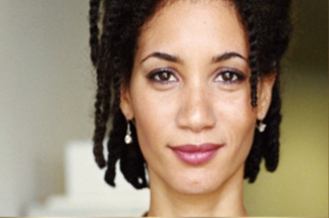
Target WHOs with Relevant Content and Messaging Strategy
Paid Search: WHO
Regions should encourage local search agencies to develop Keywords and Search Copy that will to reach each WHO with targeted, relevant content that helps her move past her trial barriers
PRIORITY
Slide 36 and 37 show an example of Relevant Content Themes and Messaging Strategy for the CSO
30

Slide 31
Consultancy Seeking Obsessed Non-Mass Shopper: Relevant Content Themes
Paid Search: WHO
Relevant Boutiques
Pro-X
Always On
Sample Initiative
Path to Purchase
Category
Interest
THEME: Lifestyle, Health & Beauty
Special Occasions
Expert Beauty Advice
THEME: Skin Care
Aging, Anti-Aging
Whitening
Angie Harmon
Science & Innovations
THEME: Products
Brand
Awareness
THEME: Branded Products
Clinical Information & Results
Ratings, Reviews & Testimonials
Skin Care Experts
Angie Harmon and Olay ProX
News, Events, Awards
Innovation & Research
Skin Consultation
Trial
THEME: Purchase Intent & Incentives
Angie Harmon Special Offer
Where to Lead Content Category
Where to Partner Content Category
31

Slide 32
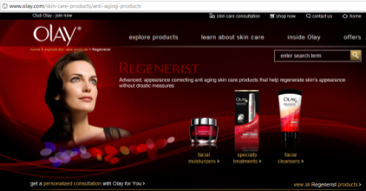
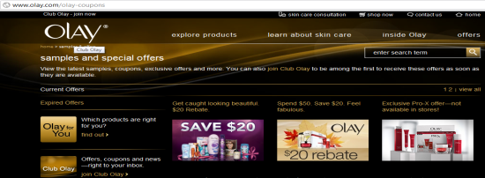
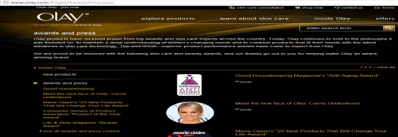
Consultancy Seeking Obsessed Non-Mass Shopper: Messaging Strategy
Paid Search: WHO
Messaging Strategy
Path to Purchase Barrier: General negative perception of mass brands
Engage with her by offering skincare topics she’s most interested in, ratings and reviews, expert endorsements and the credible 3rd party awards she needs for proof of efficacy.
Topics
Example Keyword Phrases
Example Search Copy
(title + text)
Example Content
(landing page)
Special Occasions
Expert Beauty Advice
Wedding Skin
Beauty tips
Fashion Advice
Wedding Day Skin
Use Olay® Eye Roller To Reduce Wrinkles on Your Big Day!
Olay.com/Eye-Roller
Anti-aging
Science & Innovations
Whitening
Anti-aging products
Skin whitening products
Skin Care Science
Olay® Eye Wrinkle Cream
Use Top-Rated Olay® Anti Aging Products to Reduce Fine Lines.
Olay.com/Eye-Cream
Ratings and Reviews
Clinical Information & Results
News, Events, Awards
Innovation & Research
Skin Care Experts
Skin Consultation
Skin Care routine
New Olay Products
Olay Products
Pro-x Products
Regenerist skin care
Award Winning Skin Care
Olay® Pro-X Wrinkle Protocol Improves Results in just 28 Days!
Olay.com/ProX
32

Slide 33
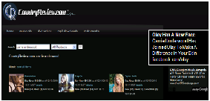
Maximize Your Paid Search Budget by Managing Overlapping Terms
Paid Search: Efficiencies
Issue: Multiple Boutiques may be appropriate for a non-branded product term such as “anti-aging”
Strategies:
Prioritize Boutique with initiatives in-market and allow Boutique to own the term during campaign timeframe
Otherwise, use Site Links search ads (where available) to give all relevant Boutiques priority real estate
If Site Links are not available, rotate ad copy so multiple Boutiques can share the overlapping keyword
Test Search Copy, Links, and Landing Pages to determine optimal consumer experience and conversion to key site goals
Issue: e-Retailers are actively bidding on the same terms as Olay.
Strategies:
Partner with e-retailers at the regional level to determine a bidding strategy that maximizes budget efficiency and conversion to sales. Partnership recommendations will be further developed in the Global e-Commerce Strategy (March 2011)
Consider having only e-retailers bid on lower funnel terms that contain specific product names (i.e. “buy olay regenerist microsculpting serum”)
Issue: e-Retailers are actively bidding on the same terms as Olay.
Strategies:
Partner with e-retailers at the regional level to determine a bidding strategy that maximizes budget efficiency and conversion to sales. Partnership recommendations will be further developed in the Global e-Commerce Strategy (March 2011)
Consider having only e-retailers bid on lower funnel terms that contain specific product names (i.e. “buy olay regenerist microsculpting serum”)
Olay Has A New Face
Carrie Underwood Has Joined Olay To Make A Difference In Your Skin
facebook.com/olay
Olay’s Anti-Aging Solutions
Browse the Latest and Greatest Anti-Aging Skincare Products at Olay.com Today
www.olay.com
Regenerist Total Effects
Pro X Try a skin care consultation
SITE LINKS AD - MOST COST EFFECTIVE
A single Paid Search ad, with multiple site links, deep-linking to particular Boutiques
33

Slide 34
Paid Search: Optimize and measure success
34

Slide 35
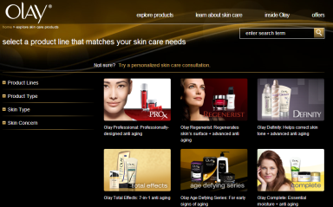
Always Optimize and Measure Paid Search Campaigns
Paid Search: Optimization
Local Search Agency should design and implement Test and Learn Agenda for Landing Pages and Ad Copy:
Test Landing Pages
Rotate Ad Copy
Gauge which landing page is most effective
Determine which ad copy generates the most interest and site engagement
Olay® Eye Wrinkle Cream
Look Younger Easier With Regenerist
From Olay. Try Regenerist Today!
Olay.com/Anti -Aging
Anti wrinkle
Landing Page A:
All Boutiques
Landing Page B: Specific Anti-Aging Boutique
Ad Copy A
Ad Copy B
Olay Anti-Wrinkle
Reduce the look of wrinkles instantly with Regenerist.
www.Olay.com/Regenerist
Official Olay Site
Read reviews and see how Regenerist relaxes wrinkles instantly.
www.Olay.com/Regenerist
Evaluate success by looking at Click Through Rate, Bounce Rate, Time on Site and Conversions
35

Slide 36
Use Key Success Metrics as Benchmarks for Regional Performance
Paid Search: Optimization
Establish engagement benchmarks by tracking priority metrics over time
Metrics
Rationale/Method
Volume and Reach
Traffic to site by paid vs. organic or by keyword
Share of Shelf
% of key phrase searches where brand is present on results page 1 (Google)
Share of Clicks
% of search result clicks to brand content (comScore)
Helps determine success of paid search campaign or rank keyword performance
NA Benchmark: 30-70%
NA Benchmark: 1-3%
Click through rate
Total clicks divided by the total amount of impressions
Bounce rate
# of visits in which the user exits site from a landing page divided by the total # of site visits
Time on Site
Average amount of time visitors spend on the site
Pages per visit
Amount of pages a user navigates to per visit
Engagement rate: Conversion to buy now/where to buy, Club Olay sign up or Olay For You
CTR benchmarks are typically set between 1-3% on the Search Network and between .02-.1% on the Content Network
Average bounce rate for US paid search: 29.41%
Time on Site translates to how engaging users find the site content; average benchmarks set between 1:30 – 2 minutes
Pages per visit indicates how much a user navigates through the site; average benchmark for pages per visit is 3.5
Set up benchmarks based on regional site and conversion activities
Quality and Conversion
Value
Cost per click
Total cost divided by total clicks
Cost per conversion
Total cost divided by conversions
CPC can be calculated by keyword, ad group and/or account level to gauge efficacy
* Benchmarks based on US site activity
36

Slide 37
Common Issues and Proposed Solutions
Paid Search: Optimization
Issue
Cause
Solution
Volume and Reach
Low Share of Shelf
Low Share of Clicks
High competition for your Keywords
or…
Consumers do not think your Keywords are relevant to Olay
Re-evaluate Keyword List
Quality and Conversion
High Bounce Rate
Low Time on Site
Low Pages per Visit
Disconnect between Search Ad Copy and Landing Page Content
or…
Landing Page Content does not strongly reflect searcher intent
Test alternate Landing Pages
and/or…
Develop new Landing Pages to support searcher interests
Value
High Cost per Click
High Cost per Conversion
Low Quality Score on Landing Pages
or…
High competition for your Keywords
Test alternate Landing Pages
and/or…
Re-evaluate Keyword List
37

Slide 38
For More Information on Paid Search:
Paid Search
Paid Search Global Toolkit (click here):
Account Structure
Campaign Structure
Ad Group Structure
Keyword Generation
Global Keywords
Match Types
Content Network
Ad Copy
Landing Pages
Budgeting
Bidding
Success Metrics
Optimization
Olay Best Practices
38

Slide 39
Organic Search: Current Performance and Optimization Recommendations
39

Slide 40
Current Performance: Olay.com US leads in SEO due to Global site redesign
Organic Search
Other regions are scoring in the “needs improvement” category
Regional Olay.com SearchMart Audit Scores as of 11/30/10:
SearchMart Scores | P&G Norm | US | Germany | Nether-lands | Australia | UK | Spain | Italy | Philippines
Overall Audit | 50 | 89 | 62 | 60 | 53 | 49 | 49 | 48 | 37
Technical Audit | 85 | 96 | 95 | 100 | 100 | 100 | 100 | 100 | 90
Content Audit | 58 | 82 | 58 | 55 | 68 | 46 | 56 | 52 | 55
Link Audit | 3 | 7 | 4 | 4 | 3 | 4 | 4 | 4 | 3
The Search Mart audit score acts as a summary around the site’s overall SEO health
Technical Audit Score: A measurement of how well search engine spiders are able to crawl and index pages on a website.
Content Audit Score: A measurement of the incorporation of a gold keyword in the content, meta data, URL, and headers on each page of a website.
Link Audit Score: A measurement of the number and anchor text of links pointing to each page of a website.
Source: SearchMart
40
Notes:
The US Website has impressive audit scores due to the websites compliance with Search Mart standards. The factors below play a large role in the success of the Olay US Search Mart audit scores:
There are over 29,699 links (external and internal) to pages in the Olay Website
Almost 50% of external links to pages in the Olay Website use the gold keyword in the anchor text of the link
Olay.com has 4 listings in the Yahoo! Directory and 1 listing in the DMOZ Directory
Each gold keyword is assigned a preferred landing page that is relevant to the theme of the keyword
The Olay US Website incorporates all requirements in the Content Audit Summary and almost all requirements in the Technical Audit Summary

Slide 41
Critical Next Steps to Improve Regional Organic Search Performance
Organic Search
Action Item
Owner
Link to Toolbox
Evaluating gold keywords
Brand manager, DMM, ER/PR, Search Agency, Digital Agency
TBD
Updating site map
Search Agency loads to SearchMart
Technical agency submits to search engines
TBD
Optimizing current content
Brand manager, DMM, ER/PR, Search Agency, Digital Agency
TBD
Improve technical audit score by increasing external linking
Search Agency, Technical agency, ER/PR (to identify partnerships)
TBD
Optimize new content (developed based on brand needs and searcher intent)
Brand manager, DDM, ER/PR, Search Agency, Digital Agency
TBD

Slide 42
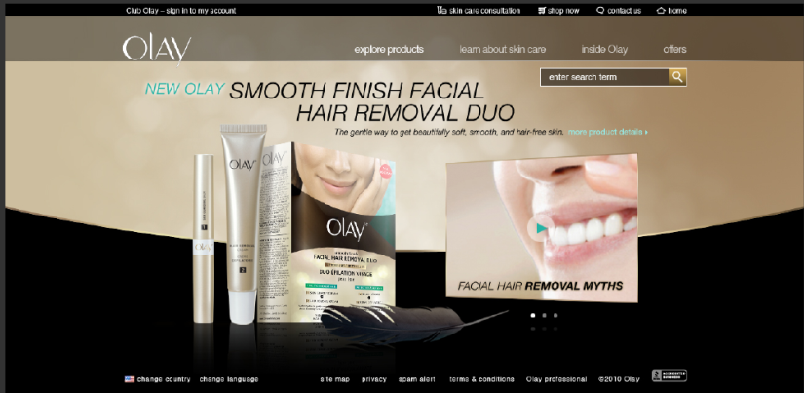
New Process for Content Development
Organic Search
When creating new content, consider the following:
Engage search agency along with other agencies during initial brainstorms
Make sure the page is a good balance of product and skin care content using key phrases that reflect searcher intent
Work with search agency to ensure the digital assets are all optimized for search (including copy, images, video, navigation, etc.)
Adopting this process will ensure new content adheres to best practices and ultimately maximize its impact

Slide 43
Activation plan
43

Slide 44
RBU Activation Plan Checklist
Activation Plan
The below checklist will ensure that the appropriate steps are being taken while activating new site or page strategies.
Load your sitemap into SearchMart (Partner with your regional IPM).
Engage with your search agency to see where they are with organic optimization and paid search strategies. Share the new search strategy with them.
Use Gold Keyword Development Tool to understand where Olay site is in terms of organic optimization and create your Gold Keyword list.
Use exercise to identify potential content needs based on relevant high volume terms.
Challenge your search agency to develop tests to measure effectiveness of Gold Keywords and establish benchmarks for both paid search and organic search.
Regularly review your profile in SearchMart and Paid Search Efforts with your search agency. Optimize accordingly.
Share learnings with BFO.
44

Slide 45
Search Toolkit: Search 101
45

Slide 46
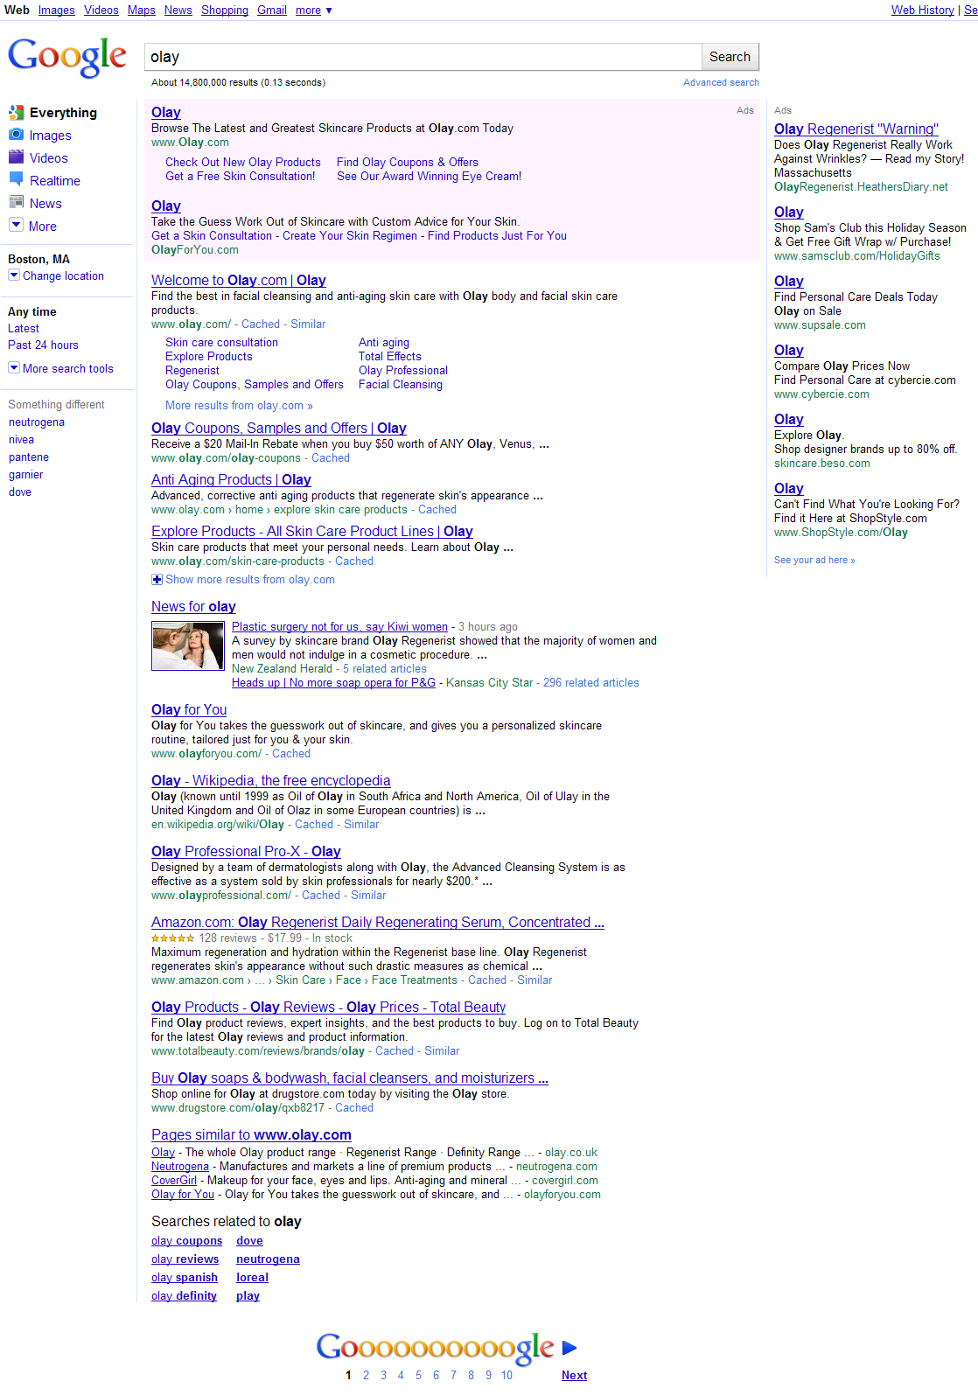
Overview of Organic Search
Search 101
Similar to PR, but in the digital world
Search engines crawl website content and rank sites according to an algorithm
Easiest to win (rank highly) on branded terms (i.e. “olay”)
Optimize sites according to “gold keywords” which are generally high volume and relevant non-branded phrases
Improving organic ranking can require technical changes, content creation, and patience
Use SearchMart to identify areas of optimization on Olay.com
Gold Keywords gold keywords are generally lifestyle and category terms since Olay will naturally rank for branded terms
46

Slide 47
Overview of Paid Search
Search 101
Advertising on search engines
Run PPC campaigns on keywords relevant to initiatives or general branding
Complements brand presence for more category interest-focused terms where Olay might not win organically
Can determine which “gold keywords” drive the highest site engagement and conversion to buy
Requires agility and testing to optimize
47

Slide 48
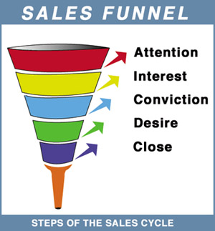
Content vs. Search Network
Search 101
Users in search are actively searching for a product or service
Users in the content network are conducting research
Search Network:
Purchase Funnel
Consumers become aware of Olay
Consumers relate Olay to the product/service
they’re researching
Content Network:
Consumers can find Olay products when they’re ready to convert
Higher conversion rate
Steps in the Purchase Cycle

Slide 49
Search Toolkit: Search and the beauty category
49

Slide 50
Beauty Searchers are primed to shop and buy
Search & Beauty Category
Compared to beauty shoppers who don’t use search, Beauty searchers are:
64% more likely to make an online beauty purchase
4x more likely to spend >$50/month on beauty products
70% more likely to try new beauty products
2x more likely to tell friends about products they use
Beauty Searchers are also Younger and More Affluent, 160% more likely to be viewed by peers as knowledgeable about beauty products, 25% more likely to use social networks and return 60% more often
Source: Compete and Google Present: Searching for Beauty Shoppers, May 5, 2009
50

Slide 51
Search is a crucial step in the shopping process
Search & Beauty Category
Search is utilized throughout the path to purchase, helping beauty shoppers conduct research and ultimately reach a decision
Source: Compete and Google Present: Searching for Beauty Shoppers, May 5, 2009
51

Slide 52
They are looking for a mix of Branded and Non-Branded Terms
Search & Beauty Category
Depending on where she is in the purchase funnel, a beauty searcher will search for branded terms like “olay face cream ” or non-branded terms like “facial moisturizer”
Olay needs to have a mix of both branded and non-branded keywords to capture incremental interest in the brand
Term type composition of click-throughs, Q3 2008
From: Compete and Google Present: Searching for Beauty Shoppers, May 5, 2009
52

Slide 53
Search Toolkit: Growth of Mobile Search
53

Slide 54
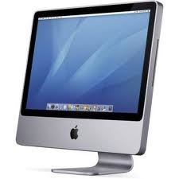
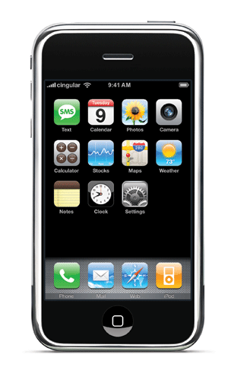
Desktop Search and Mobile Search Behaviors Are Distinct
Desktop vs. Mobile
Desktop Searchers
Mobile Searchers
Likely at home or work
UPDATE
Likely “on the go”
Browsing for local content and “I need/want it now” searches
Enter shorter queries (50% contain 3 words or less)
Do not navigate past Page 1
2x likely to search for a brand name
May be further along the purchase funnel
Use Search as shortcut to entering URLs
54

Slide 55
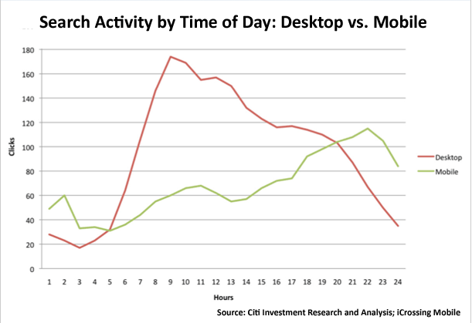
Mobile Search peaks on weekends and weeknights
Desktop vs. Mobile
Mobile Search peaks on the weekends, versus desktop search, which peaks during the work week. Further evidence that mobile search is for on the go, active searches.
55

Slide 56
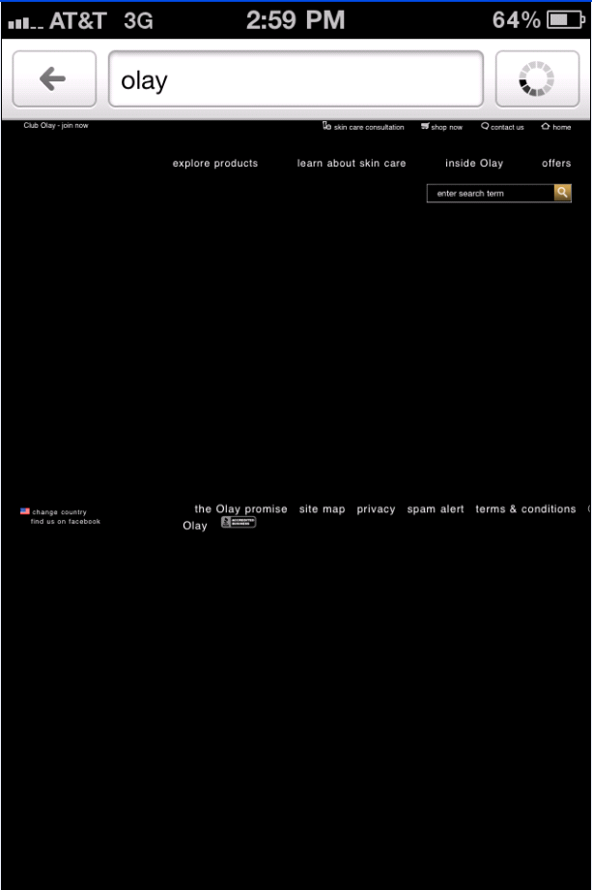
Mobile Search Needs Landing Pages that are Optimized for Mobile
Current Olay.com US Mobile Landing Page
Best-In-Class* P&G Mobile Landing Pages
Not Optimized for Search
*Google has named Pantene and Duracell SmartPower “best-in-class” for P&G Mobile Pages
56

Slide 57
Implications for a Mobile Search Strategy
Desktop vs. Mobile
Local results more likely in mobile
Google places listings sometimes appears higher in results than they do in desktop
Limited number of organic search results displayed, so listing on Page 1 is critical
Different benchmarks for success
Click-through rate and bounce rate will likely vary in mobile smartphones, and will depend on user engagement and optimized mobile landing pages
57

Slide 58
Search Toolkit: Paid Search and targeting our who
58

Slide 59
Consultancy Seeking Obsessed Non-Mass Shopper: Relevant Content Themes
Paid Search: WHO
Relevant Boutiques
Pro-X
Always On
Sample Initiative
Path to Purchase
Category
Interest
THEME: Lifestyle, Health & Beauty
Special Occasions
Expert Beauty Advice
THEME: Skin Care
Aging, Anti-Aging
Whitening
Angie Harmon
Science & Innovations
THEME: Products
Brand
Awareness
THEME: Branded Products
Clinical Information & Results
Ratings, Reviews & Testimonials
Skin Care Experts
Angie Harmon and Olay ProX
News, Events, Awards
Innovation & Research
Skin Consultation
Trial
THEME: Purchase Intent & Incentives
Angie Harmon Special Offer
Where to Lead Content Category
Where to Partner Content Category
59

Slide 60
Consultancy Seeking Obsessed Non-Mass Shopper: Messaging Strategy
Paid Search: WHO
Messaging Strategy
Path to Purchase Barrier: General negative perception of mass brands
Engage with her by offering skincare topics she’s most interested in, ratings and reviews, expert endorsements and the credible 3rd party awards she needs for proof of efficacy.
Topics
Example Keyword Phrases
Example Search Copy
(title + text)
Example Content
(landing page)
Special Occasions
Expert Beauty Advice
Wedding Skin
Beauty tips
Fashion Advice
Wedding Day Skin
Use Olay® Eye Roller To Reduce Wrinkles on Your Big Day!
Olay.com/Eye-Roller
Anti-aging
Science & Innovations
Whitening
Anti-aging products
Skin whitening products
Skin Care Science
Olay® Eye Wrinkle Cream
Use Top-Rated Olay® Anti Aging Products to Reduce Fine Lines.
Olay.com/Eye-Cream
Ratings and Reviews
Clinical Information & Results
News, Events, Awards
Innovation & Research
Skin Care Experts
Skin Consultation
Skin Care routine
New Olay Products
Olay Products
Pro-x Products
Regenerist skin care
Award Winning Skin Care
Olay® Pro-X Wrinkle Protocol Improves Results in just 28 Days!
Olay.com/ProX
60

Slide 61
Dramatic Transformation Seeker: Relevant Content Themes
Paid Search: WHO
Paid Search:
WHO
Relevant Boutiques
Regenerist, White Radiance
Always On
Sample Initiative
Path to Purchase
Category
Interest
THEME: Lifestyle, Health & Beauty
Expert Beauty Advice
Fashion, Hair and Makeup
Cosmetic Procedures
THEME: Skin Care
Aging, Anti-Aging
Whitening
THEME: Products
Brand
Awareness
THEME: Branded Products
Ratings, Reviews & Testimonials
Skin Care Experts
Rewards and Incentives
Trial
THEME: Purchase Intent & Incentives
Rewards and Incentives
Where to Lead Content Category
Where to Partner Content Category
61

Slide 62
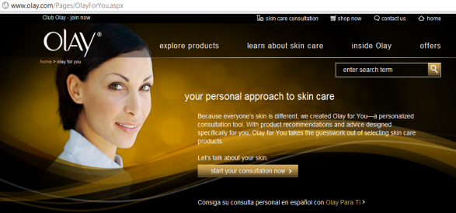
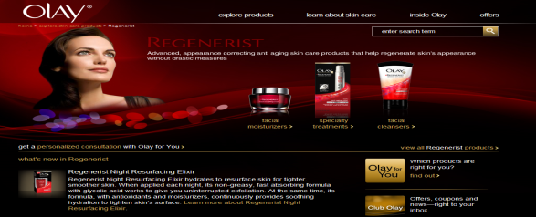
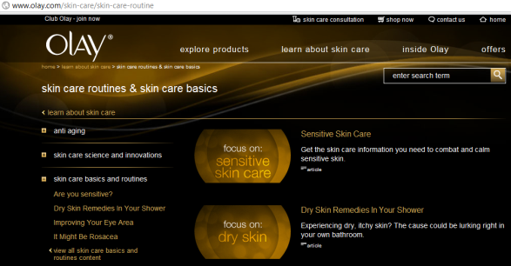
Dramatic Transformation Seeker: Messaging Strategy
Paid Search: WHO
Messaging Strategy
Path to purchase barrier: Olay is perceived as being too old
Tap her interest for transformation and all over beauty by leveraging fashion, beauty and makeup to reach her. Offer her ratings and reviews, ambassador news and beauty advice to engage her.
Topics
Example Keyword Phrases
Example Search Copy
(title + text)
Example Content
(landing page)
Expert Beauty Advice
Fashion, Hair and Makeup
Cosmetic Procedures
Makeup Tips
Makeup Advice
Best Foundation for Dry Skin
Olay® Skin Care
Get Expert Makeup and Skin
Care Advice at Olay.com!
Olay.com/Skin-Care
Anti-aging
Whitening
Eye Cream
Eye Wrinkles
Age Defying Lotion
Olay® Regenerist Cream
Try Olay’s Regenerist Cream Voted Best by Marie Claire!
Olay.com/Regenerist
Ratings and Reviews
Skin Care Experts
Rewards and Incentives
Skin Care Advice
Oily Skin Advice
Dark Under Eye Circles
Dry skin Treatment
Olay® Skincare Experts
Learn About New Skincare
Products from Experts at Olay.
Olay.com/Advice
62

Slide 63
Straight-Forward Performance Seeker: Relevant Content
Paid Search: WHO
Relevant Boutiques
Total Effects, Natural White, Anti-wrinkle
Always On
Sample Initiative
Path to Purchase
Category
Interest
THEME: Lifestyle, Health & Beauty
Tips & Tricks for Beautiful Skin
Special Occasions
Health, Wellness & Skin
THEME: Skin Care
Basics & Routines
Common Skin Issues
THEME: Products
Brand
Awareness
THEME: Branded Products
Skin Consultation
Rewards and Incentives
Trial
THEME: Purchase Intent & Incentives
Rewards and Incentives
Where to Lead Content Category
Where to Partner Content Category
63

Slide 64
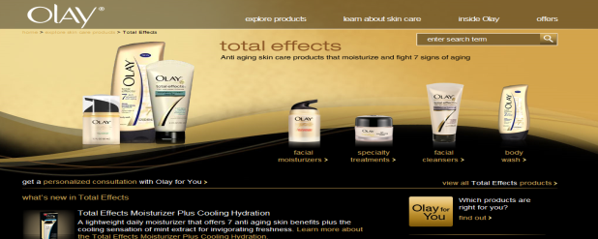
Straight-Forward Performance Seeker: Messaging Strategy
Paid Search: WHO
Messaging Strategy
Path to purchase barrier: Olay’s product lineups are too complicated
Tap into her pragmatic, straight-forward mindset through product ratings, reviews and tips. Drive trial by offering her special incentives and skin consultation opportunities.
Topics
Example Keyword Phrases
Example Search Copy
(title + text)
Example Content
(landing page)
Tips & Tricks for Beautiful Skin
Special Occasions
Health, Wellness, and Skin
Clear Skin
Dry Skin Treatment
Tips for glowing skin
Olay® Skin Care
Learn How to get Healthy Skin
From the Experts at Olay.com!
Olay.com/SkinCare
Basics & Routines
Common Skin Issues
Younger Looking Skin
Anti Aging
Wrinkle Cream
Olay® Eye Wrinkle Cream
Try Total Effects for younger-looking, more radiant skin from Olay now!
Olay.com/TotalEffects
Skin Consultation
Rewards and Incentives
Skin Care Reviews
Dry Remedies
Olay Coupons
Skin Care Tips
Best Skin Care Products
Personal Skin Care Tips
Get your Olay Skin Care Regimen today and receive exclusive offers at Olay.com!
Olay.com/Advice
64

Slide 65
Skin Essentials Shopper: Relevant Content Themes
Paid Search: WHO
Relevant Boutiques
Complete, Aqua Action, Cleansing
Always On
Sample Initiative
Path to Purchase
Category
Interest
THEME: Lifestyle, Health & Beauty
Fashion, Hair & Makeup
THEME: Skin Care
Basics & Routines
Common Skin Issues
THEME: Products
Brand
Awareness
THEME: Branded Products
Skin Consultation
Ambassadors
Rewards and Incentives
Ratings, Reviews & Testimonials
Trial
THEME: Purchase Intent & Incentives
Rewards and Incentives
Where to Lead Content Category
Where to Partner Content Category
65

Slide 66
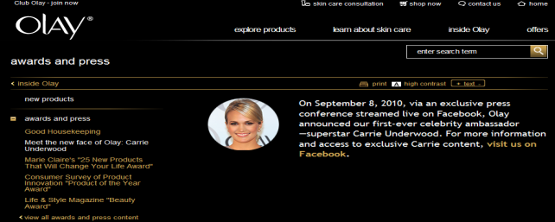
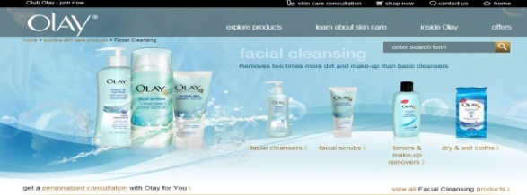
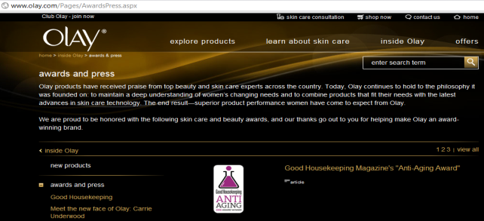
Skin Essentials Shopper: Messaging Strategy
Paid Search: WHO
Messaging Strategy
Path to purchase barrier: Olay is perceived as not relevant to her
Align Olay with her interests in celebrity, fashion, hair and makeup. Offer her rich and interactive content and opportunities to engage in the social space wherever possible.
Topics
Example Keyword Phrases
Example Search Copy
(title + text)
Example Content
(landing page)
Fashion, Hair & Makeup
Hollywood Skin Care
Beauty Tips of the Stars
Carrie Underwood Skin Care
Celebrity Makeup
Olay® Skin Care
Find out the latest from Olay’s first-ever celebrity ambassador at Olay.com.
Olay.com/Celebrity
Basics & Routines
Common Skin Issues
Face Wash
Clear Skin
Younger Looking Skin
Olay® Face Wash
Skin Remedies Fit for a
Queen. Get Yours Today at Olay.com!
Olay.com/FaceWash
Skin Consultation
Ambassadors
Ratings, Reviews & Testimonials
Rewards and Incentives
Expert Skin Care Advice
Skin Care Product Reviews
Beauty Product Reviews
Olay Celebrity
Olay® Skincare Experts
Product Testimonials and Skin Care
Advice From the Experts at Olay.
Olay.com
66

Slide 67
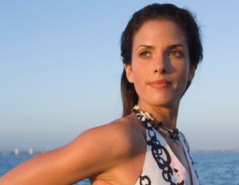
Sophisticated Perfectionist Shopper: Relevant Content Themes
Paid Search: WHO
Relevant Boutiques
Regenerist, White Radiance, Total Effects
Always On
Sample Initiative
Path to Purchase
Category
Interest
THEME: Lifestyle, Health & Beauty
Special Occasions
Expert Beauty Advice
THEME: Skin Care
Aging, Anti-Aging
Whitening
Science & Innovations
THEME: Products
Brand
Awareness
THEME: Branded Products
Clinical Information & Results
Ratings, Reviews & Testimonials
Skin Care Experts
News, Events, Awards
Innovation & Research
Skin Consultation
Trial
THEME: Purchase Intent & Incentives
Where to Lead Content Category
Where to Partner Content Category
67

Slide 68
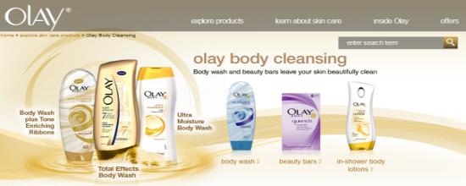
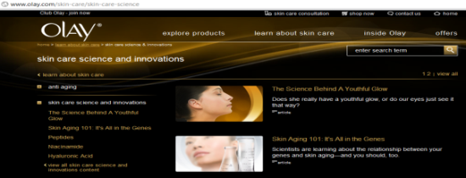
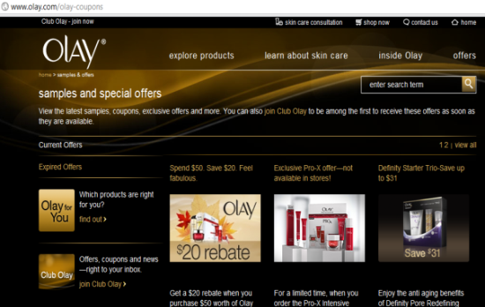
Sophisticated Perfectionist Shopper: Messaging Strategy
Paid Search: WHO
Messaging Strategy
Path to purchase barrier: Olay’s claims aren’t believable enough to convince her to try
Give her the ratings, reviews and deals that convince her to buy, feature product innovations to persuade her, and leverage her lifestyle interests to reach her.
Topics
Example Key Phrases
Example Search Copy
(title + text)
Example Content
(landing page)
Special Occasions
Expert Beauty Advice
Wedding Skin
Bridal Beauty Tips
Skin Care Emergencies
Wedding Day Perfection
Get Bridal Ready Skin for your
Special Day. Learn More!
Olay.com/Skin-Care
Anti-Aging
Science & Innovations
Whitening
Skin Care Science
New in Skin Care
Olay® Anti Aging
Get the latest in Olay Products, science & research at Olay.com.
Olay.com/Science&Innovation
Ratings and Reviews
Clinical Information & Results
News, Events, Awards
Innovation & Research
Skin Care Experts
Skin Consultation
Skin Care Coupons
Anti Aging Coupons
Skin Care Product Reviews
Olay® Skincare Deals
Get Olay Coupons Read Reviews & Try Samples of Your Favorite Products.
Olay.com/Deals
68

Slide 69
Confident Experiential Shopper: Relevant Content Themes
Paid Search: WHO
Relevant Boutiques
Beauty Rituals Collections
Always On
Sample Initiative
Path to Purchase
Category
Interest
THEME: Lifestyle, Health & Beauty
Fashion, Hair and Makeup
Special Occasions
Tips & Tricks for Beautiful Skin
THEME: Skin Care
Basics & Routines
THEME: Products
Brand
Awareness
THEME: Branded Products
Ratings, Reviews & Testimonials
News, Events, Awards
Ambassadors
Trial
THEME: Purchase Intent & Incentives
Where to Lead Content Category
Where to Partner Content Category
69

Slide 70
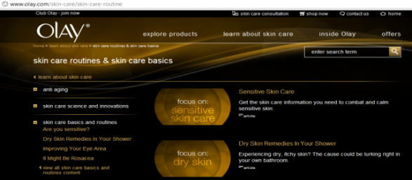
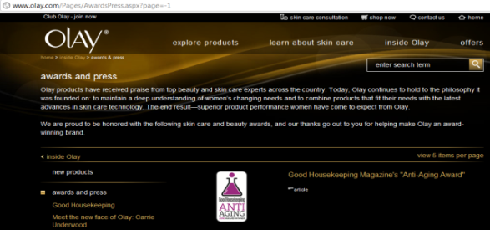
Confident Experiential Shopper: Messaging Strategy
Paid Search: WHO
Messaging Strategy
Path to purchase barrier: Olay is not new and intriguing enough to spark her interest
Leverage her interests in fashion, beauty, art and home to reach her. Offer her incentives and celebrity endorsements that motivate her to engage with the brand.
Topics
Example Key Phrases
Example Search Copy
(title + text)
Content
(landing page)
Fashion, Hair and Makeup
Special Occasions
Tips & Tricks for Beautiful Skin
Carrie Underwood Skin Care
Carrie Underwood and Olay
Carrie Underwood Skin
Olay® & Carrie Underwood
Read about Carrie’s favorite Olay
Skin Care Products at Olay.com Today!
Olay.com/Carrie-Underwood
Build a Page that is focused on the relationship between the Brand Ambassador (Carrie Underwood; US) and Olay. Carrie’s Skin care Preferences, regimen, and the like.
Basics and Routines
Skin Care Basics
Dry Skin Care
Skin Care for Oily Skin
Skin Care Help
Olay® Skin Care
Get the Basics for Beautiful Skin
At Olay.com. Learn More Today!
Olay.com/Skin-Care
Ratings and Reviews
News, Events, Awards
Ambassadors
Olay Ratings
Beauty Product Rewards
Skin Care Reviews
Olay® in the News
Find Olay® Articles and Awards
And More at Olay.com Today!
Olay.com/Awards
70

Slide 71
Essential Well-Being Seeker: Relevant Content Themes
Paid Search: WHO
Relevant Boutiques
Pink Moisture, Firming Natural White, Seasonal Offerings
Always On
Sample Initiative
Path to Purchase
Category
Interest
THEME: Lifestyle, Health & Beauty
Fashion, Hair and Makeup
Special Occasions
Tips & Tricks for Beautiful Skin
THEME: Skin Care
Basics & Routines
Common Skin Issues
Health, Wellness & Skin
THEME: Products
Seasonal Offerings
Brand
Awareness
THEME: Branded Products
Ratings, Reviews & Testimonials
Cause-related initiatives
Trial
THEME: Purchase Intent & Incentives
Where to Lead Content Category
Where to Partner Content Category
71

Slide 72
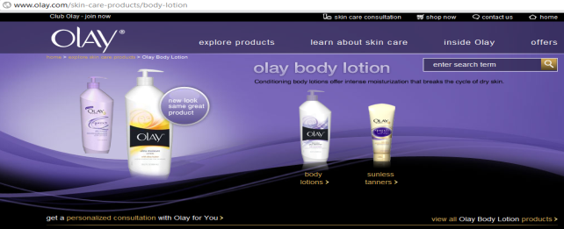
Essential Well-Being Seeker: Messaging Strategy
Paid Search: WHO
Messaging Strategy
Path to purchase barrier: Olay’s body products are unfamiliar to her
Tap into her pragmatic and straight-forward mindset by offering product ratings and reviews and tips, and align with her interest for health & wellness.
Topics
Example Key Phrases
Example Search Copy
(title + text)
Example Content
(landing page)
Fashion, Hair and Makeup
Special Occasions
Tips & Tricks for Beautiful Skin
Clear Skin
Skin Care Tips and Tricks
Olay® Daily Moisturizer
Get Clearer Skin with Olay Daily Moisturizer! Try Now!
iwww.Olay.com/Daily-Moisturizer
Basics and Routines
Common Skin Issues
Health, Wellness & Skin
Oily Skin Treatments
Dry Skin Products
Olay® Skin Care
Treatment for Common Skin Issues
and Much More at Olay.com. Try Now!
www.olay.com/SkinCare
Ratings and Reviews
Cause-related Initiatives
Skin Care Reviews
Best Skin Care Products
Olay® Reviews and Awards
Try One of Olay®’s Award Winning
Products for Healthy Beautiful Skin!
www.olay.com/Awards
72

Slide 73
Global Search Toolkit

Slide 74
Olay Global Toolkit Table of Contents
PAID SEARCH BEST PRACTICES
Account Structure: The levels of a paid search account and the impact each level has on the account.
Campaign Structure: How to break out campaigns in the paid search account.
Ad Group Structure: Factors to consider when building out ad groups.
Keyword Generation: Outlines the process of researching and deciding keywords in the paid account.
Global Keywords: Example of how keywords have different meanings depending on the country.
Match Types: Descriptions of each match type and how they affect keyword performance.
Content Network: How to opt into the content network and how to leverage it to reach the WHO.
Ad Copy: Best practices for writing targeted ad copy and examples of Olay US ad copy tests.
Landing Pages: Best practices and tips for page selection and examples of Olay US landing page tests.
Budgeting: How to determine budgets and how to allocate sufficient budget to each campaign.
Bidding: How to determine and monitor bids for optimal keyword performance.
Success Metrics: What metrics to look at, and how to analyze them when measuring paid search success.
Optimization: Best practices and tips for optimizing, and how to optimizing success metrics.
Olay Best Practices: Details paid search best practices that are specific to the Olay brand.
Notes:
Beauty Searcher – a consumer who used search to navigate to a beauty
related website

Slide 75
Olay Global Toolkit Table of Contents
ORGANIC SEARCH BEST PRACTICES
SEO Process: High level list of all that is involved in the SEO process.
Gold Keywords: Best practices for selecting gold keywords, tools to use and detailed keyword selection steps.
Preferred Landing Pages (PLPs): Best practices for PLP selection and example PLP mapping process.
Website Content: Best practices, content creation strategies, and examples of optimized content.
Meta Data: Best Practices and a checklist for writing and implementing meta data.
URL Naming: Best practices for naming and leveraging an optimized global template hierarchy.
Global URLs: Best practices for In-Country extensions, Olay examples and recommendations.
Internal Linking: Best practices, types of internal links, formats, Olay examples and recommendations.
Technical Best Practices: Best practices for all crawlability and navigation issues on the Global Template.
Olay Global Template Recommendations: Recommendations for optimization of the Global Template.
Digital Assets: Best practices for on-site and off-site image and video hosting.
SearchMart: Detailed steps for using SearchMart to monitor, track and optimize the Olay SEO campaign.
Olay Helpful Tools: Detailed steps for using Google Analytics, Google Keyword Tool, Google Insights and Xenu
for SEO campaign monitoring, tracking and optimizing.
Olay US Baseline: Measure of success metrics for Olay US and benchmarks for Olay Global Websites.
Appendix: Further information on all SEO topics not applicable to the toolkit.
Notes:
Beauty Searcher – a consumer who used search to navigate to a beauty
related website

Slide 76
Technical Agency: Global Toolkit Important Topics
Technical Agency: Important Topics
Meta Data: The technical agency is responsible for implementing optimized Meta Data and understanding best practices for Meta Data placement within the HTML code of each Olay Web page.
URL Naming: The technical agency is responsible for implementing the optimized URLs for each Olay Web page and understanding URL Naming best practices.
Global URLs: The technical agency is responsible for implementing optimized Olay in-country extensions and understanding Global URL writing best practices.
Internal Linking: The technical agency is responsible for implementing internal linking recommendations and understanding internal linking best practices.
Technical Best Practices: The technical agency is responsible for implementing recommendations for all technical issues that impact the Olay SEO campaign. These slides outline the most prevalent technical issues and best practices for ensuring search engine spiders can crawl and index the Olay Website content.
Global Template Recommendations: The technical agency is responsible for implementing agency recommendations for the Olay Global Template. These slides outline current issues that are impeding search engine spiders from crawling and indexing content on the Olay Global Template.
Digital Assets: The technical agency is responsible for implementing and understanding on-the-page and off-the-page video and image recommendations for Olay digital assets.
Workarounds: The technical agency is responsible for implementing workarounds for content that lives within rich media. These slides provide overviews for each workaround, implementation directions, and links to helpful resources .
Notes:
Beauty Searcher – a consumer who used search to navigate to a beauty
related website

Slide 77
Search Agency: Global Toolkit Important Topics
Search Agency: Important Topics
Account Structure: The search agency is responsible for creating the paid search account structure. This includes the Campaign Structure and the Ad Group Structure, and the placement of keywords within the structure.
Keyword Generation: The search agency is responsible for researching and implementing paid search keywords. The search agency should also be aware of why localized keywords, compared to Global Keywords, are important.
Match Types: The search agency is responsible for understanding keyword match types and how they affect paid search performance.
Success Metrics: It is imperative that the search agency understand each success metric, what each metric means, how each metric applies to paid and organic search, why each metric is important, and how to optimize for each individual metric.
Content Network: The search agency is responsible for understanding what the content network is, how to build campaigns for the content network, how to target the WHO with placements, how to upload content campaigns, and how to optimize content network campaigns,
Ad Copy & Landing Pages: The search agency is responsible for understanding ad copy and landing page best practices , how to reach the WHO with targeted ad copy and relevant landing pages, and how to test both ad copy and landing pages to gain insight into how users react to different messages and how they interact with different content.
Budgeting & Bidding: The search agency is responsible for understanding how to allocate the paid search budget by campaign and how to implement a strategic keyword bidding strategy.
Notes:
Beauty Searcher – a consumer who used search to navigate to a beauty
related website

Slide 78
Search Agency: Global Toolkit Important Topics
Search Agency: Important Topics
Gold Keywords & PLPs: The search agency is responsible for researching and defining gold keywords as well as mapping the gold keywords to relevant preferred landing pages on the Olay Website.
Website Content: The search agency is responsible for providing Preferred Landing Page content analysis and content optimization recommendations to ensure that each PLP is optimized for the mapped gold keyword.
Meta Data: The search agency is responsible for understanding Meta Data best practices and for writing Meta Data optimized for gold keyword Preferred Landing Pages.
URL Naming: The search agency is responsible understanding URL naming best practices and for providing recommendations for URLs optimized for gold keyword Preferred Landing Pages. The search agency should also understand Global URL best practices.
Internal Linking: The search agency is responsible for understanding Internal Linking best practices and for providing an optimized Internal Linking Strategy with a focus on gold keyword Preferred Landing Pages.
Technical Best Practices: The search agency is responsible for understanding Technical Best Practices and for providing recommendations for optimization of technical issues on the Olay Website. iProspect Global Template Recommendations.
Digital Assets: The search agency is responsible for understanding Digital Asset best practices and for providing on-the-page and off-the-page recommendations for digital asset optimization.
SearchMart: The search agency is responsible for managing the Olay SearchMart account, understanding how to upload Gold Keywords and Sitemap.gz files, and how to use SearchMart as tool for reporting and optimizing the Olay organic search campaign.
Olay Helpful Tools: The search agency is responsible for understanding how to use Google AdWords, AdCenter Google Analytics, Google Insights, Google WebMaster Tools, and Xenu for managing, reporting, and optimizing the paid and organic search campaigns.
Olay US Baseline: The US Baseline is a benchmark for all Olay search agencies to measure the success of the paid and organic search campaigns.
Notes:
Beauty Searcher – a consumer who used search to navigate to a beauty
related website

Slide 79
Marketing: Global Toolkit Important Topics
Marketing: Important Topics
Content Network: The content network is important to marketing because it present the opportunity to target each Olay WHO individually on related Web pages that she visits, with ad copy that is written just for her.
Success Metrics: Understanding success metrics will provide the marketing team with insight into who is finding the Olay Website relevant, what content on the Olay Website they are finding relevant, how they interact with the Olay Website, and how the Olay Website performs in comparison to direct and indirect competitors.
Olay Best Practices: The marketing team should be cognizant of Olay best practices because they present insight into how new products and initiatives perform, how each Olay boutique performs, the difference in performance for each Olay Website, how Olay and e-retailers compete, breakthrough ways for Olay to use paid and organic search, and insight into user search seasonality, including historical user search trends
Gold Keywords: Gold keywords are important to marketing because they represent the Olay Website equity and Olay priorities. These are the keywords that the Olay WHOs are searching, seeking helpful information and products. The marketing team should understand the importance of gold keywords selection and be aware that the gold keyword list defines the success of the Olay organic search campaign.
Preferred Landing Pages: The marketing team should understand the best practices for mapping gold keywords to preferred landing pages and the importance of providing supportive, relevant content on the Olay Website that fulfills a users search intent.
Notes:
Beauty Searcher – a consumer who used search to navigate to a beauty
related website

Slide 80
Creative Agency: Global Toolkit Important Topics
Creative Agency: Important Topics
Gold Keywords: The creative agency should understand what gold keyword are, best practices, and how they are used within the content of each Preferred Landing Page
Preferred Landing Pages: The creative agency should understand the importance of Preferred Landing Page content optimization in relation to the mapped gold keyword.
Website Content: It is imperative that the creative agency understand content creation best practices, where to incorporate the gold keyword for each Olay Web page, and how to write content for the Olay WHO.
Meta Data: The creative agency should understand what each Meta tag is, where the tag appears, either on-the-page or off-the-page, how optimized Meta Data affects the SEO campaign, and best practices for writing Meta Data.
URL Naming: The creative agency should understand the best practices for URL Naming, why optimized URLs are important, and how the Olay hierarchy influences the URL naming convention.
Global URLs: The creative agency should understand the SEO benefits of implementing in-country extensions and how to write optimized Global URLs.
Internal Linking: The internal linking strategy is one the most important factors in an SEO campaign. It is imperative that the creative agency understand the SEO benefits and best practices for Internal Link Naming optimization and incorporating optimized Embedded Links.
Global Template Recommendations: The creative agency is responsible for implementing the recommendations in the Global Template, specifically the navigation and hierarchy Link Naming recommendations and the Embedded Links recommendation for Olay Article pages.
Digital Assets: The creative agency is responsible for writing optimized content, on and off-the-page, for Olay videos and images. The creative agency should understand video and image optimization best practices and the SEO benefits.
Notes:
Beauty Searcher – a consumer who used search to navigate to a beauty
related website

Slide 81
ER: Global Toolkit Important Topics
ER: Important Topics
Digital Assets: ER should understand the importance of optimizing Olay images and videos, best practices for optimization, and third-party websites for optimized video and image submission.
Notes:
Beauty Searcher – a consumer who used search to navigate to a beauty
related website

Slide 82
ER: Global Toolkit Important Topics
P&G ABM/DMM: Important Topics
Paid Search Best Practices: The ABM/DMM should be aware of the best practices for paid search and what search metrics help to define paid search success. Paid Search involves The Olay Search Agency.
Content Network Best Practices: The ABM/DMM should understand what the content network is, how to leverage it for paid search, and why the content network is a great tool for targeting the Olay WHO. Content Network involves The Olay Search Agency & Marketing.
Olay Best Practices: The ABM/DMM should be aware of Olay best practices and understand why optimizing for best practices is important to the success of the Olay paid search campaign. Olay Best Practices involve The Olay Search Agency and Marketing.
Organic Best Practices: The ABM/DMM should understand what organic search is and what each step in the SEO process involves. The ABM/DMM should also be aware of how SEO affects Olay brand awareness, what agencies are involved in the SEO process, and what search metrics define success for the Olay organic search campaign. Organic Best Practices involve The Olay Search Agency, Technical Agency, Creative Agency, Marketing & ER.
Global Template Recommendations: The ABM/DMM should be aware of the current technical issues on the Olay Global Template that have a negative impact on what content user experience and search engine spider accessibility and crawlability. The Global Template Recommendations involve The Olay Search Agency, Technical Agency, and Creative Agency.
SearchMart: The ABM/DMM should understand why SearchMart is important, what reporting metrics come from SearchMart and how they apply to Olay, and what value SearchMart provides to the Olay organic search campaign success. SearchMart involves The Olay Search Agency.
Olay Helpful Tools: The ABM/DMM should understand what each helpful tool is and what value each tool provides for the Olay paid and organic search campaigns. Olay Helpful Tools involves The Olay Search Agency.
Olay US Baseline: The ABM/DMM should be aware of the Olay US baseline and hold their respective search agencies responsible for reaching or exceeding the Olay US benchmarks. Olay US Baseline involves The Olay Search Agency.
Notes:
Beauty Searcher – a consumer who used search to navigate to a beauty
related website

Slide 83
Paid Search Best Practices

Slide 84
Who Should Know About Paid Search?
The Search Agency: It is imperative that the Search Agency understands all factors that go into creating, optimizing, and providing reports for a paid search campaign.
P&G ABM/DMM: The P&G brand contacts should be aware of the best practices for paid search and what defines paid search success.
Notes:
Beauty Searcher – a consumer who used search to navigate to a beauty
related website

Slide 85
Olay Paid Search Best Practices
Account Structure: The levels of a paid search account and the impact each level has on the account.
Campaign Structure: Structuring a paid search campaign with Path to Purchase in mind.
Ad Group Structure: Best practices for structuring ad groups within the paid search campaign.
Keyword Generation: Best practices and tools to use for building out paid keyword lists.
Global Keywords: Example of how keywords have different meanings depending on the country.
Match Types: Descriptions of each match type and how each affects keyword performance.
Notes:
Beauty Searcher – a consumer who used search to navigate to a beauty
related website

Slide 86
Account Structure
Olay Account Structure
Olay Paid Search Account
Branded Campaigns
Non-Branded Campaigns
Product Type Ad Group
Product Type Ad Group
Skin Concern Ad Group
Skin Concern Ad Group
Account Level: All campaigns and ad groups are in the account level
Campaign Level: Separated by branded or non branded and search or content. Budgets are set at the campaign level
Ad Group Level: Contains collection of keywords and ad group that are grouped together by theme
Notes:
Beauty Searcher – a consumer who used search to navigate to a beauty
related website

Slide 87
Account Structure
Campaign Structure
Campaigns are organized by the Path to Purchase
Category Interest
Brand Awareness
Trial
Information Seekers. These users can not be sent to a specific product but would prefer being sent to a page with content surrounding their skin care concerns.
Skin Care Solutions
Brand Specific Searches. Users looking for particular products or boutiques. These users can easily be paired with product or boutique landing pages.
Olay Products
Users ready and looking to purchase Olay products. Strong calls to action are used and users are easily sent to the product of interest.
Buy Olay
Notes:
Beauty Searcher – a consumer who used search to navigate to a beauty
related website

Slide 88
Account Structure
Ad Group Structure
Keywords are put in tightly related groups
For example, Anti Aging Lotion is separate from Anti Aging Cream
Ad groups are created based on what the user is looking for when they search. People searching for problems (ex. Dark circles) are separated from people searching for solutions (ex. Anti aging products)
A user searching for “dark circles” may be looking for more information about how or why dark circles appear
A user searching for “anti aging cream” is more likely to be looking for a product to solve effects of aging
These are two different searches and the results should give two different corresponding messages
Ad Groups are built out so ad copy and landing pages can relevant to all keywords in the Ad Groups
Notes:
Beauty Searcher – a consumer who used search to navigate to a beauty
related website

Slide 89
Account Structure
Ad Group Structure
Factors in Creating ad Groups
Problem
1
Problem Path:
Olay Non Branded Informational
1
2
Ad Group:
Aging Skin
Ad Group:
Dark Circles
2
Ad Copy Message Based on the “WHO”:
{KeyWord:Anti-Aging Information}
Learn the Facts About Aging Skin &
Products for Skin at Olay.com
www.Olay.com/Aging-Skin
Keywords:
Aging Skin
Ageing Skin
Skin & Aging
3
4
Keywords:
Dark Circles Under Eyes
Dark Under Eye Circles
Causes Dark Circles Under Eyes
3
Ad Copy Message Based on the “WHO”:
{KeyWord:Olay® Skincare Advice}
Get Tips & Advice on How to
Treat Dark Circles at Olay.com!
www.Olay.com/Info
4
Notes:
Beauty Searcher – a consumer who used search to navigate to a beauty
related website

Slide 90
Account Structure
Ad Group Structure
Factors in Creating ad Groups
Solution
1
Solution Path:
Olay Branded Products
1
Ad Group:
Age Defying Products
2
Ad Group:
Olay Face Lotion
Ad Copy Message Based on the “WHO”:
Olay® Anti-Aging Skincare
Fight Your Natural Age with Olay®
Advanced Anti-Aging Skincare System
www.olay.com/Age-Defying
2
3
Keywords:
Olay Face Lotion
Olay Face Lotion with SPF
Olay Face Lotion for Dry Skin
4
Keywords:
Olay Age Defying
Olay Age Defying Cleanser
Olay Age Defying Moisturizer
Ad Copy Message Based on the “WHO”:
{KeyWord:Try Olay® Face Lotion}
Find an Olay Face Lotion that is
Designed for Your Skin Concern.
www.Olay.com/Face-Lotion
3
4
Notes:
Beauty Searcher – a consumer who used search to navigate to a beauty
related website

Slide 91
Keyword Generation
Building out Keyword Lists
Reach out to the search agency to build out keywords for new initiatives or product launches
Use the Google Keyword Tool to find misspelling, plurals and iterations of relevant search terms
Use Broad Match to capture more keyword queries within a smaller keyword set
Allow at least two weeks for enough traffic to come in before making optimizations to the keyword list
Monitor and Optimize the keyword list
Pull a Search Query Report from Adwords to find undesirable queries that the keywords are matching. For example, “whip cream” might match to the “eye cream” ad group. “Whip” would need to be added as a negative in order to improve CTR and quality of visitor
Pause, delete or change bids on any keywords with low volume or low CTR or conversion performance
Notes:
Beauty Searcher – a consumer who used search to navigate to a beauty
related website

Slide 92
Olay Global Keywords
Due to the importance of keyword phrases appearing in URLs, it is imperative that keyword phrases are localized and specific to a country’s target audience.
Clean Skin
United States
Audience interprets as cleaning skin or products that clean skin.
Australia
Audience interprets as cheap wine.
Beauty
Audience interprets as a way to perfect their appearance either through products or education.
United States
Australia
Audience interprets as another word for “great” or “amazing.”
Notes:
Beauty Searcher – a consumer who used search to navigate to a beauty
related website

Slide 93
Keyword Generation
Use of Match Types
Broad Match terms will show ads for any search query that includes the search term.
Phrase Match will display ads for queries that include search terms in exact order.
Exact Match will display ads only for queries that match the search term exactly.
Typically Higher CPCs and Lower CTRs and the most clicks and impressions
Lower CPCs and more Qualified Traffic and fewer impressions when compared to Broad Match
Typically the Lowest CPCs, Highest CTR, and Most Qualified Traffic with the least impressions
The keyword list should start on broad match to reach a larger audience. Once the data has accumulated, make optimizations to bidding and match type to better target users. The search agency will look at performance to determine if changes in match type are needed.
Notes:
Beauty Searcher – a consumer who used search to navigate to a beauty
related website

Slide 94
Content Network Best Practices

Slide 95
Who Should Know About the Content Network?
The Search Agency: It is imperative that the Search Agency understands how to create, implement, optimize, and report on a content network paid search campaign.
Marketing: The content network is important to marketing because it present the opportunity to target each Olay WHO individually on related Web pages that she visits, with ad copy that is written just for her.
P&G ABM/DMM: The P&G brand contacts should understand what the content network is, how it applies to paid search, and how it benefits the Olay brand.
Notes:
Beauty Searcher – a consumer who used search to navigate to a beauty
related website

Slide 96
Olay Paid Search Content Network
Opting Into the Content Network
Content Network Opportunity for Facial Skincare WHO’s
Consultancy-Seeking Obsessed
Dramatic Transformation Seeker
Straight-Forward Performance Seeker
Skin Essential Shopper
Content Network Opportunity for Body Skincare WHO’s
Sophisticated Perfectionist Shopper
Confident Experientialist Shopper
Essential Well-Being Seeker
Notes:
Beauty Searcher – a consumer who used search to navigate to a beauty
related website

Slide 97
Content Network
Reasons to Opt into the Content Network
Content Mission
Drive online and offline sales by helping her overcome trial barriers through content engagement in owned, paid and earned distribution channels
Content Campaigns are used to reach specific “Whos” searching for information about related products
The following slide explains the targets and opportunity available for Olay on the Content Network
Notes:
Beauty Searcher – a consumer who used search to navigate to a beauty
related website

Slide 98
OLAY women
snapshot of our facial skincare segments
PRIORITY
PRIORITY
CONSULTANCY-SEEKING OBSESSED NON-MASS SHOPPER
DRAMATIC TRANSFORMATION SEEKER
STRAIGHT-FORWARD
PERFORMANCE SEEKER
SKIN ESSENTIALS SHOPPER
PATH TO PURCHASE BARRIER
General negative perception of mass brands.
PATH TO PURCHASE BARRIER
Olay is perceived as being too old.
PATH TO PURCHASE BARRIER
Olay’s product lineups are too complicated.
PATH TO PURCHASE BARRIER
Olay is perceived as not relevant to her.
CONTENT OPPORTUNITY
Intrigue her with the expert advice and third party product endorsements for the proof of efficacy she needs.
CONTENT OPPORTUNITY
Engage her with content that’s relevant to her lifestyle interests and that helps her experience the benefits of our product. Give her the credentials she demands.
CONTENT OPPORTUNITY
Give her content and incentives that simplify her life and lead her to all-in-one beauty solutions.
CONTENT OPPORTUNITY
Show her Olay shares her interests and understands her younger skin needs by engaging her with content in social and rich content environments.
Source: Forrester Consumer Technographics, Olay Face and Body Proxies, Q2010
98

Slide 99
Content Network
The “Whos” Have It
CONSULTANCY-SEEKING OBSESSED NON-MASS SHOPPER
Online Behavior
Where to Find Her
In general, she tends to research products online, but buy offline.
She trusts experts’ recommendations , search results, ratings/reviews and emails from brands, and searches for products that promote “healing and “renewal”.
RenRen.com, Kaixin001.com, QQ.com, 51.com, SkinExpert.net, iVillage Skin Care and Acne.org.
Messages to Reach Her
Skincare Tips and Advice
Find Skincare Tips and Advice Plus
Product Info & Reviews at Olay.com.
www.Olay.com/Tips
{Keyword:Olay Skincare Information}
Get Information About Skincare
Issues and How to Fix Them w/Olay.
www.Olay.com/Tips
PRIORITY
Notes:
Beauty Searcher – a consumer who used search to navigate to a beauty
related website

Slide 100
Content Network
The “Whos” Have It
Dramatic Transformation Seeker
Messages to Reach Her
{KeyWord:Olay® Starter Trios}
Get Olay® Definity, Regenerist and
Total Effects Starter Kit Trios!
www.Olay.com/Starter-Trios
Olay® Skincare Products
Go Beyond Fighting Wrinkles. Fight
The Look of Age Spots & Dullness.
www.Olay.com
PRIORITY
Online Behavior
Where to Find Her
She scours beauty sites and blogs for new skin care regimens and products. She also uses the internet to get more information on things like fashion, decorating, cooking and travel.
She loves being in the know with insider access to beauty/fashion/celebrity news & buzz, and being the first to share her beauty knowledge with her extensive social network.
: Beauty.com, TotalBeauty.com, Sephora.com, Allure.com, iDiva, AllAboutBeauty.com and Cosmopolitan.com
Notes:
Beauty Searcher – a consumer who used search to navigate to a beauty
related website

Slide 101
Content Network
The “Whos” Have It
Straight-forward performance seeker
Online Behavior
Where to Find Her
She thinks of beauty in a holistic way as part of her overall health and fitness. She doesn’t have time for the fuss of complicated regimens.
She gleans simple, tried and true beauty tips from friends, family and forums, which leads her to becoming a brand loyalist. She is the most skeptical of brand communications and advertisements.
RenRen.com, Kaixin001.com, QQ.com, 51.com, Orkut.com, Facebook.com, Vkontakte.ru, Odnoklassniki.ru and Mixi.com.
Messages to Reach Her
{KeyWord:Olay For You Skin Care}
Take the Guess Work Out of Skincare
with Custom Advice for Your Skin.
OlayForYou.com
{KeyWord:Olay® Official Site}
Find a Skincare Regimen that Fits
Your Needs. Visit Olay.com Now!
www.Olay.com
Notes:
Beauty Searcher – a consumer who used search to navigate to a beauty
related website

Slide 102
Content Network
The “Whos” Have It
Skin Essential Shopper
Messages to Reach Her
{Keyword:Olay® Skin Conditioners}
Use Olay® to Turn Problem Skin
into More Flawless Skin.
www.Olay.com
{KeyWord:Olay® Definity Face Cream}
Indulge your Skin With Olay®
Definity Hydrating Facial Cream.
www.Olay.com
Online Behavior
Where to Find Her
For her, beauty is about fashion, hair and make-up.
Skin care is less of a priority and she is more focused on facial cleansers.
She relies on tips from family and friends and is the most socially engaged online (networks, forums/blogs).
She is interested in TV/movies, “how to” styling videos on YouTube, travel, music, and is likely to have a smartphone. She also downloads music and watches TV and videos online.
: YouTube.com, Sephora.com, Daily Candy, Amazon.com, All AboutBeauty.com, TaoBao.com, Boots.con, iDiva.
Notes:
Beauty Searcher – a consumer who used search to navigate to a beauty
related website

Slide 103
OLAY women
snapshot of our body skincare segments
PRIORITY
PRIORITY
Sophisticated perfectionist shopper
Confident experientialist shopper
Essential well-being Seeker
PATH TO PURCHASE BARRIER
Olay’s claims aren’t believable enough to convince her to try.
CONTENT OPPORTUNITY
Engage her through genuine breakthroughs and content backed by credentials and expert endorsements.
PATH TO PURCHASE BARRIER
Olay is not new and intriguing enough to spark her interest.
CONTENT OPPORTUNITY
Give her emotionally stimulating content and experiences that align to her interests in fashion, beauty, art, home, etc.
PATH TO PURCHASE BARRIER
Olay’s body product products are unfamiliar to her.
CONTENT OPPORTUNITY
Provide her with simple straight-forward tips and hints that align to health & wellness.
Source: Forrester Consumer Technographics, Olay Face and Body Proxies, Q2010
103

Slide 104
Content Network
The “Whos” Have It
Sophisticated Perfectionist Shopper
Online Behavior
Beauty begins with the best product she can find that are priced within her means. She will shop around before making a purchase.
She is an avid researcher who is always on the hunt for the latest (genuine) beauty breakthroughs and will search for the best deals.
She trusts third party credentials and endorsements.
She is heavily influenced by peer and expert reviews, advice and endorsements.
PRIORITY
Ad Copy should call out any scientific or medical endorsements or awards. The quality should be weighed against the price, and any deals should be included.
Messages to Reach Her
Olay® Complete
Get Healthy and Beautiful Skin
With OLAY® Complete Skin Care Line.
www.Olay.com
Olay® Skin Care
Helps Rehydrate Your Skin So You
Can Look Younger, Like You Feel!
www.Olay.com
Notes:
Beauty Searcher – a consumer who used search to navigate to a beauty
related website

Slide 105
Content Network
The “Whos” Have It
Confident experientialist shopper
Messages to Reach Her
Ad copy should emphasis new products and improvements. Celebrity endorsements and any social buzz should be leveraged to reach her as well.
Olay® Anti-Aging Products
Olay Anti-Aging Skincare Regimens
Defy Age With Younger Looking Skin
www.Olay.com/Age-Defying
Olay® Total Effects
Fight 7 Signs of Aging at Once with
Total Effects Skincare Solution.
www.Olay.com/Total-Effects
Online Behavior
She seeks new beauty experiences to enrich her life and improve her skin. She is willing to try new things and splurge on the latest and greatest.
She likes to explore and browse beauty, fashion and celebrity/gossip sites to stay in the know on beauty news/buzz.
She relies heavily on her social networks to get purchasing advice and share products that interest her with her friends.
PRIORITY
Notes:
Beauty Searcher – a consumer who used search to navigate to a beauty
related website

Slide 106
Content Network
The “Whos” Have It
Essential Well-being Seeker
Online Behavior
She is active online primarily with entertainment, news, shopping and health related sites and is heavily influenced by her network of friends and family.
She defines beauty as holistic health and wellness rather than being external-focused.
She is interested in news and information that help her maintain her overall mental and spiritual health.
Ad Copy should concentrate on beuty as being part of general health. Calling out specific skin issues and remedies may be affective in trying to reach her.
Messages to Reach Her
Olay® Dry Skin
Get Tips & Advice on How to Deal w/
Different Skin Issues at Olay.com!
www.Olay.com/Dry-Skin
Olay® Healthy Skincare
Learn About Which Olay® Skincare
Line is Right for You at Olay.com.
www.Olay.com
Notes:
Beauty Searcher – a consumer who used search to navigate to a beauty
related website

Slide 107
Ad Copy Best Practices

Slide 108
Who Should Know About Ad Copy?
The Search Agency: The search agency is responsible for understanding ad copy best practices , how to reach the WHO with targeted ad copy, and how to test ad copy language to gain insight into what messaging performs the best.
P&G ABM/DMM: The P&G brand contacts should understand what ad copy is and how the messaging affects the performance of the paid search campaign.
Notes:
Beauty Searcher – a consumer who used search to navigate to a beauty
related website

Slide 109
Olay Paid Search Ad Copy
Ad Copy Tips & Tricks
Ad Copy Best Practices
Olay Ad Copy Test Examples
Notes:
Beauty Searcher – a consumer who used search to navigate to a beauty
related website

Slide 110
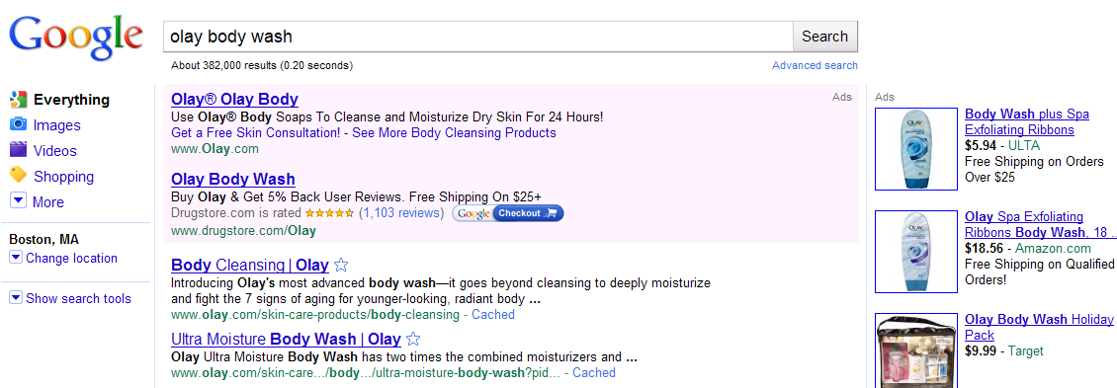
Ad Copy
28%
56%
16%
Relate to Users
Search Engines Tips/Tricks
Ad Copy should be written in a language that appeals to the target based on what they are searching | Ad Copy should be written to be relevant to all keywords within an Ad Group, as relevancy is key for Quality Score
Calls to Action need to be employed to create a sense of urgency to entice the user to click on the ad | Use of High Traffic Gold Keywords in the ad will help quality scores, which will in turn lower CPCs
Include Product attributes or price points that differentiate the product form its competitors | Using Site Links to increase Links for users to see/click. Site links will also increase the amount of space the ad takes up making it more visually appealing to users
The use of the searched keyword in the ad copy makes the ad more relatable to the user and increases their willingness to click the ad | Dynamic Keyword Insertion should be used to insert users search terms into the headline of the as. This will increase the relevancy to the search

Slide 111
Ad Copy Best Practices
Monitoring and Testing Ad Copy
A/B Testing
(Rotate ads evenly)
4-5 Pieces of Copy per Ad Group
Balance Ads With and Without Dynamic Keyword insertion
Use a Strong Call to Action
Have a Message Tailored to the Intended “WHO”
Notes:
Beauty Searcher – a consumer who used search to navigate to a beauty
related website

Slide 112
Ad Copy Best Practices
Olay US Ad Copy Test Example
Notes:
Beauty Searcher – a consumer who used search to navigate to a beauty
related website

Slide 113
Landing Page Best Practices

Slide 114
Who Should Know About Landing Pages?
The Search Agency: The search agency is responsible for understanding landing page best practices , how to engage the WHO with relevant landing pages, and how to test landing pages to gain insight into how users interact with different content.
P&G ABM/DMM: The P&G brand contacts should understand landing page best practices and how testing landing pages affects the performance of the paid search campaign.
Notes:
Beauty Searcher – a consumer who used search to navigate to a beauty
related website

Slide 115
Olay Paid Search Landing Pages
Determining Where to Send Users
Landing Page Best Practices
Notes:
Beauty Searcher – a consumer who used search to navigate to a beauty
related website

Slide 116
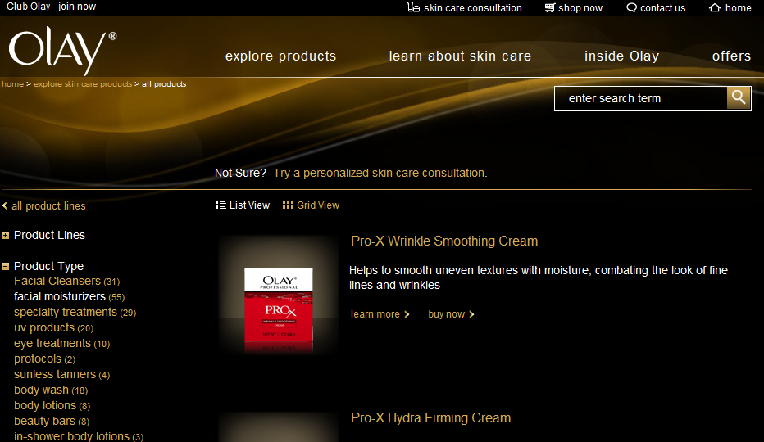
Landing Page Best Practices
Determining Where to Send the User
Olay users should be sent to the most relevant landing page to the users query
Notes:
Beauty Searcher – a consumer who used search to navigate to a beauty
related website

Slide 117
Landing Page Best Practices
Testing Landing Pages
Olay users should be sent to the most relevant lading page to the users query.
User’s search queries do not always indicate the intent
Is the user looking for general skin care information?
Is the user looking for information on skin care products?
Or is the user looking to purchase a specific skin care product?
For this reason, it is often necessary to test landing pages for certain keywords.
Landing Page A: All Boutiques
Landing Page B: Specific Anti-Aging Boutique
Notes:
Beauty Searcher – a consumer who used search to navigate to a beauty
related website

Slide 118
Budgeting Best Practices

Slide 119
Who Should Know About Budgeting/Bidding?
The Search Agency: The search agency is responsible for determining budgets and adjusting keyword bids in the paid search campaign. It is imperative that they understand budgeting and bidding best practices and are fully aware of how adjustments to campaign budgets and keyword bids will affect the paid search campaign performance.
P&G ABM/DMM: The P&G brand contacts should understand budgeting best practices.
Notes:
Beauty Searcher – a consumer who used search to navigate to a beauty
related website

Slide 120
Olay Paid Search Budgeting
Determining Paid Search Ad Budgets
Budgeting Best Practices
Always On vs. Initiative Budgeting
Budgeting for Search & Content Networks
Notes:
Beauty Searcher – a consumer who used search to navigate to a beauty
related website

Slide 121
Budgeting Best Practices
Determining Ad Budgets
Get Traffic and CPC Estimates from the Google Keyword Tool
Use Historical data to derive an appropriate CTR
Multiply the Estimated Traffic (per keyword) by the CTR
Multiply each quotient by the Estimated CPCs to receive the estimated monthly spend per keyword
Add all the estimated expenditures to receive the estimated account spend for one month
Set monthly budget by this amount at the campaign level
Notes:
Beauty Searcher – a consumer who used search to navigate to a beauty
related website

Slide 122
Budgeting Best Practices
Make sure There is Enough to Go Around
Monitor
Monitor spend closely to avoid going over budget
Adjust
If the account is over spending keywords, ad groups or whole campaigns can be paused or bid down
If the account is under spending keywords can be added from Google Opportunities Tab or bid up
Repeat
If changes are made to the budget then continue to watch carefully and make further adjustments as needed
Budget should be set so ads will show all through out the day
Other optimizations may be more appropriate depending on the condition of the account and will be discussed later
Allocate budget for ads to show all month
Consider day parting or evenly displaying ads for campaigns spending too quickly
Notes:
Beauty Searcher – a consumer who used search to navigate to a beauty
related website

Slide 123
Budgeting Best Practices
Always On vs. Initiative Budget Break
Search budgeting breakouts can vary from month to month depending on the keywords, size, and importance of the new initiatives. A standard in the U.S. budget has been 75% of the budget to “Always On” campaigns and 25% to Initiatives.
16%
Always On
Initiatives
General Skin Care Boutique Keywords General Product Terms General Branded Terms Skin Care Advice and Tips Skin Care Concerns
New Product Launches Spokesperson Reveals Contests and Sweepstakes PR Initiatives
Notes:
Beauty Searcher – a consumer who used search to navigate to a beauty
related website

Slide 124
Budgeting Best Practices
Search Network vs. Campaign Network
Content and Search budget breakdowns should be based off of the engine’s market share in the country
Search/Content Budget Allocation
In markets where the engine has a high market share, such as Google’s 80% market share in the US, more investment should be allocated to the search network
In the US, 80% of budget is allocated to Search and 20% is allocated to Content
In markets where the engine has a small market share, such as Google’s 20-30% market share in Asia, more investment will need to be allocated to the Content Network
Because the Search Network generally has higher CTR and higher conversion rate, allocate budget the search network when deciding between search and content
Notes:
Beauty Searcher – a consumer who used search to navigate to a beauty
related website

Slide 125
Bidding Best Practices

Slide 126
Bidding Best Practices
You Get What You Pay For
Initially set keyword bids high so the ads will show, making sure that it still fits within the budget
When a new campaign is started bids may need to be set higher and CPCs may be higher for a period of time while the new ads and keywords are gaining history with the search engine
Determine a good starting CPC by using the traffic estimator tool in Google Reporting and Tools Tab
Once keywords begin to accrue data bids need to be optimized to performance and average position. Lower position keywords require higher bids to be more competitive
It is Important to remember that the max bid is not always going to be the amount paid for a placement
Google’s automatic discounter lowers the bid to an amount slightly higher than the next highest bidder
The higher the bid the higher the position of the ad will be, However there are other contributing factors to ad position than just the max bid. Quality Score being another big factor. Increasing relevancy and CTR will lower the amount needed to pay for high positions
Notes:
Beauty Searcher – a consumer who used search to navigate to a beauty
related website

Slide 127
Success Metrics

Slide 128
Who Should Know About Success Metrics?
The Search Agency: The search agency is responsible for measuring, reporting, and optimizing for paid search success metrics. It is imperative that the search agency understand each metric, why each is important, where to look for each metric, and how to optimize for paid search success.
P&G ABM/DMM: The P&G brand contacts should understand each success metric and why they are important to the paid search campaign.
Marketing: Understanding success metrics will provide the marketing team with insight into who is finding the Olay Website relevant, what content on the Olay Website they are finding relevant, how they interact with the Olay Website, and how the Olay Website performs in comparison to direct and indirect competitors.
Notes:
Beauty Searcher – a consumer who used search to navigate to a beauty
related website

Slide 129
Olay Paid Search Success Metrics
Measuring Paid Search Success
Analyzing Paid Search Quality of Visitor
Notes:
Beauty Searcher – a consumer who used search to navigate to a beauty
related website

Slide 130
Success Metrics
How to Measure Campaign Success
There are certain metrics that paint the best picture a search campaigns performance. These metrics can be found in the AdWords account for Google and the AdCenter account for Bing. Examples of where to find campaign success metrics for can be found on the Google AdWords slide and the Microsoft AdCenter slide.
CTR: Click Through Rate- this is the amount of clicks divided by the total amount of impressions
A CTR goal is set between 1-3% on the Search Network and 0.02-0.1% on the Content Network and varies based on how broad the keywords are or where the searcher is on the purchase funnel
CPC: Cost Per Click- this is the total cost divided by the total clicks
This can be calculated per keyword, ad group, and/or account level
A CPC goal can be set according to benchmarks from the Google Keyword Tool
Notes:
Beauty Searcher – a consumer who used search to navigate to a beauty
related website

Slide 131
Success Metrics
Measuring the Quality of Traffic
Quality of Visitor Metrics: Bounce Rate, Time on Site, and Pages per Visit all contribute to quality of visitor. If the metrics are showing good number this indicates that the site is engaging to the user. Further details on how to analyze quality of visitor metrics can be found in Helpful Tools - Google Analytics.
Bounce Rate: The amount of “bounces” divided by the total number of visits to the site
A “bounce” is a visit in which the user leaves the site from the landing page without navigating to any other pages on the site.
Custom tailoring landing pages to keywords is a great way to lower bounce rates.
A benchmark has been set to 50% for Olay’s bounce rate.
Time on Site: The average amount of time visitors spend on the site
The more time spent on the site means that users are finding content they are looking for and engaging with the site.
A good time on site is above 1.5 - 2 minutes on average.
Pages per Visit: The average number of pages a user navigates to per visit
The more the user navigates through the site is a good indication to whether or not the site is engaging to users.
A good pages per visit metric could be considered 3.5 plus pages per visit on average.
Notes:
Beauty Searcher – a consumer who used search to navigate to a beauty
related website

Slide 132
Optimization Best Practices

Slide 133
Who Should Know About Optimizing?
The Search Agency: The search agency is responsible for optimizing for paid search success. It is imperative that the search agency understand how to analyze the paid search account, what tools to use, what to look for, and how optimizations will affect the performance of the paid search campaign.
P&G ABM/DMM: The P&G brand contacts should understand optimization best practices and how optimizing the account will affect paid search performance.
Notes:
Beauty Searcher – a consumer who used search to navigate to a beauty
related website

Slide 134
Paid Search Optimization
Optimizing Campaign Performance
Optimizing for Quality of Visitor
Notes:
Beauty Searcher – a consumer who used search to navigate to a beauty
related website

Slide 135
Optimization Best Practices
Optimizing Campaign Performance
A flighted implementation of optimizations must be utilized
If too many different optimizations are implemented all at once there is no way to tell what change made had what effect
Each change should be given between 1-2 weeks minimum (depending on the size of the change) to show its effect on the account before further optimizations are made.
Optimization Based on CTRs
Pause keywords and ads with low CTRs
If CTR is low run a query report to see if ads are showing on unqualified searches, if so, add terms as negatives
Optimizations Based on CPCs
Lower max bids
Take steps to increase Quality Score (see optimizations based on CTR)
Increase max bids to get higher positions, historically the higher the position the higher the CTR. This is worth testing, however some ads do perform better or just as well in lower positions for lower CPCs
Implement different bids per match type (bid higher on exact match, lower on phrase match, and even lower on broad match)
Low CTR can also be contributed to irrelevant ad copy. Looking at current ad copy performance and write new ads based on best performers.
Notes:
Beauty Searcher – a consumer who used search to navigate to a beauty
related website

Slide 136
Optimizations Best Practices
Optimizing for Better Quality of Visitor
Quality of Visitor Metrics: Bounce Rate, Time on Site, and Pages per Visit are the first thing to look at when optimizing for quality of visitor. More information can be found in the Helpful Tools Slides – Google Analytics Quality of Visitor.
High Bounce Rates, Low Time on Site and Low Pages per Visit means that the User is not finding what they are looking for or not engaged in the content provided
Possible Solutions:
New Ad Copy**
More relevant landing page to what the user is searching
Stronger call to action to entice the user
New content for the search term
Stronger CTR that informs the user of the designed action of the landing page
**If CTR is strong then the ad copy should NOT be the problem.
Notes:
Beauty Searcher – a consumer who used search to navigate to a beauty
related website

Slide 137
Olay Best Practices

Slide 138
Who Should Know About Olay Best Practices?
The Search Agency: The search agency is responsible for managing paid search and therefore, must understand the best practices for managing the Olay account. It is imperative that the paid search agency understand how to manage overlapping keywords across multiple boutiques within the paid search account, how to drive strategy for initiatives, how to leverage keyword seasonality and trends, how to compete effectively with e-retailers, and how to use paid search in breakthrough ways.
Marketing: The marketing team should be cognizant of Olay best practices because they present insight into how new products and initiatives perform, how each Olay boutique performs, the difference in performance for each Olay Website, how Olay and e-retailers compete, breakthrough ways for Olay to use paid and organic search, and insight into user search seasonality, including historical user search trends.
P&G ABM/DMM: The P&G brand contacts should be aware of Olay best practices and understand why they are important to the success of the paid search campaign.
Notes:
Beauty Searcher – a consumer who used search to navigate to a beauty
related website

Slide 139
Olay Paid Search Best Practices
Initiative vs. Always On Campaigns
Managing Multiple Boutiques
Managing Multiple Olay Accounts
Olay vs. e-Retailer
Breakthrough Ways to Use Paid Search
Monitoring Keyword Seasonality
Notes:
Beauty Searcher – a consumer who used search to navigate to a beauty
related website

Slide 140
Olay Paid Search Best Practices
Initiative Campaigns
Examples:
New Products
Sales
Seasonal Promotions
Strategy:
Flight Initiatives take precedent over existing campaigns as they are short term with solid goals that aggressively aim to drive awareness to a particular product or promotion.
VS.
Always On
Examples:
Olay products
Olay Regenerist
Crows Feet
Eye Cream
Oil of Olay
Strategy:
The “Always On” Campaigns Contain important keywords that are optimized based on performance. In the case a flight initiative comes up the “Always On” campaigns that contain overlapping keywords will be paused and allow the flight initiatives to take place.

Slide 141
Olay Best Practices
Managing Multiple Boutiques
There is a simple strategy for dealing with two or more campaigns that contain the same or similar keywords for multiple boutiques. For example, the keyword “olay skin care” can be a part of Regenerist or Total Effects campaigns and ad groups
Implement Sitelinks for High Level Terms – Google AdWords
Sitelinks allow for multiple boutiques to show for generic branded terms with boutique links in the ad
Track which boutique gets more clicks for the keyword to determine which boutiques should be in the ad
Rotate Ad Copy
Separate generic keywords in ad groups where ad copy for different boutiques can be rotated
Monitor performance of the best performing boutique/ad copy for a keyword to see what boutique should win on the keyword
Day Part and Flight Keywords
Separate keywords into different campaigns and run boutiques at different times of the day to share high volume keywords

Slide 142
Olay Best Practices
Managing Multiple Olay Accounts
The strategy for managing multiple Olay domains from different adword accounts. One example in the US is Olay.com, Olayforyou.com and Olay Body
Decide which properties should “win” for different keyword groups
This can be determined by priority or by content
For example, Olay.com “wins” on skin care terms and Olayforyou.com “wins” on skin care routine terms
Test keyword performance in different accounts to help determine “right to win”
Adjust keyword bids accordingly, so the higher priority campaign will appear in a higher ad position
The highest priority gets the highest max bid then the next in line get a slightly lower (and so on if more than two campaigns are involved)
This allows the brand to extend its share of shelf by taking up multiple positions for the same search query. At the same time the flighted bidding tactic makes it so the properties aren’t bidding against each other and driving up CPCs

Slide 143
Olay Best Practices
Managing Multiples
For Example:
Overlap Examples:
olay com
oilofolay com
SkinCare Advice
skin advice
Skin Care Information
About Wrinkles
Information About Skin
Care Info About Skin
Treatment For Fine Lines
Non-Surgical Treatment For Wrinkles
Advanced Skincare
skin care basics
Strategy
For overlapping keywords , Olay is allowed to “win” with Olay.com for top position. This is done by having a slightly higher bid on Olay.com then Olayforyou.com. Keywords that are more advice focused “belong” to Olay 4 you, where as general product terms “belong” to Olay.com. Overlapping bids allow Olay to take up more space on the digital shelf. Where the tiered bidding strategy allows for the two domains to coexist without bidding up each others CPCs.
Olay.com
Versus
Olay 4 You

Slide 144
Olay Best Practices
Olay vs. eRetailer
The strategy for driving traffic to either an Olay domain or an eRetailer domain is a mix of the strategies for managing multiple sites and landing page best practices.
Olay.com houses a buy now page for all the products on the site. For this reason, any user queries that show purchase intent can be sent to the Olay “buy now” pages
If special initiatives involve sending traffic to a particular eRetailer it can be done by changing landing pages in ad copy. It is best to tag the URL so paid search visits can still be tracked.
Whether or not users are landed on the buy now or eRetailer pages is mostly dependent on the relevancy to the users query.
If the users query does not show purchase intent, the users should not be sent to these landing pages.

Slide 145
Olay Best Practices
Using Paid Search in Breakthrough Ways
Awards Campaign
Search engines do not allow claims in ad copy that are not verified by a third party source on the landing page
Placing all of the awards won by Olay and Olay products on one landing page allows Olay to state its superiority in ad copy
Try Award Winning Olay®
Get Olay® Regenerist Cream, Voted
Best New Anti Aging Moisturizer!
www.Olay.com
Key Take-Aways: Ad Copy with “Try Award Winning Olay” and “Award Wining Olay” Saw the best response from internet users. In two weeks after the “award” ad copy was implemented 7 of the top 10 ad copy were “award” ad copy. “Award” ad copy owns the top 3 positions in terms of CTR.
Award Winning Olay®
Try Award Winning Olay® Anti Aging
Eye Roller to Reduce Eye Wrinkles.
www.Olay.com

Slide 146
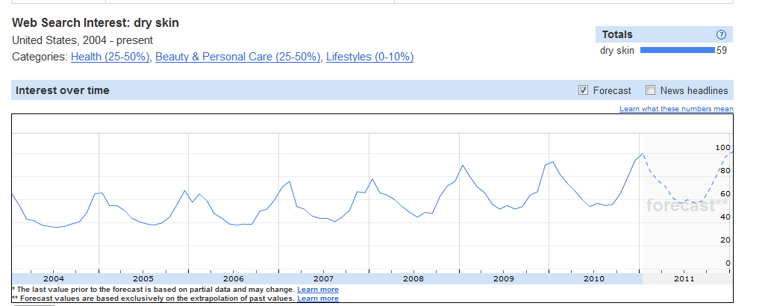
Olay Keyword Seasonality
Monitoring Seasonality for Keywords and Terms
“Dry Skin” Example
According to Google Insights, the term “dry skin” has higher search volume around cold weather months. Many skin conditions such as “dry skin” or “oily skin” have higher searches according to weather. Monitor seasonality of keywords ad adjust budget to capture increase in clicks. More information can be found on Google Insights slide.

Slide 147
Olay global paid search example

Slide 148
Paid Search: Chinese keyword test in Canada
The Chinese Keyword Test was launched to test Olay’s opportunity for skin care related keyword searches in the Chinese Canadian Market
Targeted users with the following browser language settings:
Chinese Browsers – Simplified and Traditional Chinese
English to Chinese Browsers
Chinese to English Browsers
Chinese searchers were served English ads and driven to the English Olay Canada Website
CONSUMER INSIGHTS:
While the Chinese market is small in comparison to the English speaking market, the Chinese market space is much less competitive with a 59% lower average CPC
Chinese searchers are more engaged with the Olay Canada Website as quality of visitor metrics were significantly stronger than English quality of visitor metrics
Chinese searchers visited 40% more pages on the site and bounced off the site 36% less than English searcher
Search Results | Imp | CTR | CPC
Olay CA English | 173,871 | 0.31% | $2.16
Olay CA Chinese | 3,251 | 1.47% | $0.89
Quality of Visitor | Bounce | Pages/Visit | Time on Site
Olay CA English | 58% | 3 | 304
Olay CA Chinese | 37% | 5 | 310

Slide 149
Organic search (SEO) best practices

Slide 150
Who Should Know About Organic Search?
The Search Agency: The search agency is responsible for managing organic search and therefore, must understand the best practices and the SEO process. It is imperative that the search agency understand how to set goals, research and create a gold keyword list, map gold keywords to relevant preferred landing pages, provide recommendations for performance and technical optimizations, tools to use, success metrics and how to optimize for them, how to use SearchMart, and how to report on the success of the organic campaign.
P&G ABM/DMM: The P&G brand contacts should understand what organic search is and the steps in the SEO process. The brand contacts should also be aware of the best practices of organic search, how organic search affects the Olay brand, performance and technical optimization best practices, and how to define success for the Olay organic search campaign.
Notes:
Beauty Searcher – a consumer who used search to navigate to a beauty
related website

Slide 151
Olay Global Toolkit Table of Contents
SEO Process: High level list of all that is involved in the SEO process.
Gold Keywords: Best practices for selecting gold keywords, tools to use and detailed keyword selection steps.
Preferred Landing Pages (PLPs): Best practices for PLP selection and example PLP mapping process.
Website Content: Best practices, content creation strategies, and examples of optimized content.
Meta Data: Best Practices and a checklist for writing and implementing meta data.
URL Naming: Best practices for naming and leveraging an optimized global template hierarchy.
Global URLs: Best practices for In-Country extensions, Olay examples and recommendations.
Internal Linking: Best practices, types of internal links, formats, Olay examples and recommendations.
Technical Best Practices: Best practices for all crawlability and navigation issues on the Global Template.
Olay Global Template Recommendations: Recommendations for optimization of the Global Template.
Digital Assets: Best practices for on-site and off-site image and video hosting.
SearchMart: Detailed steps for using SearchMart to monitor, track and optimize the Olay SEO campaign.
Olay Helpful Tools: Detailed steps for using Google Analytics, Google Keyword Tool, Google Insights and Xenu
for SEO campaign monitoring, tracking and optimizing.
Olay US Baseline: Measure of success metrics for Olay US and benchmarks for Olay Global Websites.
Appendix: Further information on all SEO topics not applicable to the toolkit.
Notes:
Beauty Searcher – a consumer who used search to navigate to a beauty
related website

Slide 152
SEO Process

Slide 153
Olay SEO Process
SEO Process
Define Olay Website SEO Goals & Expectations
Create Gold Keyword List
Map Gold Keywords to Relevant Landing Pages (Preferred Landing Pages – PLPs)
Optimize PLPs for the Gold Keyword
Meta Data
Content Strategy
Internal Linking Strategy
Technical Audit
Measure & Monitor Organic Success Metrics
Revisit Gold Keyword List & Mapped PLP’s Based on Strengths & Weaknesses
28%
56%
16%

Slide 154
Gold keyword phrases

Slide 155
Who Should Know About Gold Keywords?
The Search Agency: The search agency is responsible for researching and defining gold keywords for the Olay organic search campaign. It is imperative that the search agency understand why gold keywords are important, how to research gold keywords (where to look, how to look, what to look for, tools to use), and how to define the gold keyword list. The search agency is also responsible for revisiting and refining the gold keyword list when necessary.
Creative Agency: The creative agency should understand what gold keyword are, best practices, and how they are used within the content of each Preferred Landing Page.
Marketing: Gold keywords are important to marketing because they represent the Olay Website equity and Olay priorities. These are the keywords that the Olay WHOs are searching, seeking helpful information and products. The marketing team should understand the importance of gold keywords selection and be aware that gold keywords define the success of the Olay organic search campaign.
P&G ABM/DMM: The P&G brand contacts should understand gold keyword selection best practices, the importance of gold keywords, and how to use gold keywords to define the success of the Olay organic search campaign.
Notes:
Beauty Searcher – a consumer who used search to navigate to a beauty
related website

Slide 156
Olay Gold Keywords
US Gold Keyword List
Localized Gold Keywords
Gold Keyword Research Tips
Gold Keyword Dependencies
Things to Keep in Mind
Gold Keyword Creation – Steps & Tools
Google AdWords Keyword Tool
Google WebMaster Tools
Google Analytics
Competition
Keyword Effectiveness Indicator
Notes:
Beauty Searcher – a consumer who used search to navigate to a beauty
related website

Slide 157
Olay Gold Keywords
Olay US Current Gold Keyword List
The gold keyword list represents the most appropriate and relevant keyword phrases to optimize and track, based on the Olay Website content, goals, and audience
High Level Gold Keywords
skin care
skin health
skin care routine
skin care products
Product Gold Keywords
Skin Type Gold Keywords
body cleansing
body lotion
facial moisturizers
facial cleansers
anti aging products
oily skin care
sensitive skin care
dry skin care
anti aging skin care
eye skin care
Notes:
Beauty Searcher – a consumer who used search to navigate to a beauty
related website

Slide 158
Olay Gold Keywords
Creating Localized Gold Keyword Lists
It is important to rank on keyword phrases in all stages of the purchase funnel. This means that the gold keyword list should include a variety of broad, specific, and branded keyword phrases.
Broad
Skin Type/ Product Specific
Branded
High Search Volume
Extremely Competitive
Hard to Rank on Organically
“skin care”
High to Mid Search Volume
Competitors Present
Better Chances of Ranking
“anti aging skin care”
“olay products”
Low Search Volume
Low Competition
High Chance of Ranking
Notes:
Beauty Searcher – a consumer who used search to navigate to a beauty
related website

Slide 159
Olay Gold Keywords
Selecting appropriate gold keyword phrases is the most important phase of the SEO strategy. Factors such as search volume and brand equity must be considered during the gold keyword selection process.
Creating a Gold Keyword List
Look at Google Webmaster Tools, Google Analytics & Google Insights for gold keyword ideas. Look at Competitor Websites, specifically in each pages meta data, navigation, and content, for gold keyword ideas. Use Keyword Tools for gold keyword ideas.
Look at Current Organic Rankings to find variations of possible gold keywords. Look at the High Level Navigation for gold keyword ideas.
Brainstorm a basic list of keywords that Olay would like to rank on organically. Non-branded Keyword Phrases should make up the majority of the keyword list.
Relevant, High Search Volume keyword phrases should be included in the keyword list.
User Search Language should be used instead of corporate language.
All Keyword Variations should be considered.

Slide 160
Olay Gold Keywords
Once a list of possible gold keywords is created, Olay needs to consider the following dependencies in order to refine the list even further.
Gold Keyword Dependencies
Look at Current Organic Rankings for each gold keyword. Are the top ranking sites in line with the Olay Website? More information on organic rankings can be found in this document in the section titled SearchMart Gold Keywords. Is the Keyword Phrase Supported by what is offered on the Olay Website?
Is the Keyword Phrase in Line with Olay Goals? The keyword phrase should be themed around the desired action of each page.
Is the Keyword Phrase Already Ranking Organically? Olay should focus on keyword phrases that are not currently in the top three organic positions.

Slide 161
Olay Gold Keywords
Things to Keep in Mind
While researching and brainstorming for keywords, it is important to judge each keyword’s value, relevance, and potential conversion rate.
A keyword strong in all three of these areas is a keyword that Olay will want to include in the final gold keyword list.
Relevance
Conversion
Value
Notes:
Beauty Searcher – a consumer who used search to navigate to a beauty
related website

Slide 162
Olay Gold Keywords
Creating Gold Keyword Lists - Steps
Define Olay goals
Begin keyword research based off of the Olay Website and Olay goals.
Look at the content on the Olay Website and identify themes for individual high-level pages.
e.g., Pages Within: Explore Products, Articles, Product Lines, Product Type, Skin Type, Skin Concern
Create a list of the most relevant keyword phrases based off of the content themes
Example Themes:
Explore Products: “skin care product,” “skin product,” “products for skin”
Articles: “skin care information,” “anti aging skin,” “skin care routine,” “healthy skin”
Product Lines: “professional skin care,” “moisturizing skin care,” “anti aging skin care”
Product Type: “eye cream,” “face wash,” “body lotion,” “body wash,” “facial cleanser”
Skin Type: “dry skin,” “oily skin,” “sensitive skin,” “anti aging skin products”
Skin Concern: “dull skin care,” “age spots,” “black heads,” “acne”
Notes:
Beauty Searcher – a consumer who used search to navigate to a beauty
related website

Slide 163
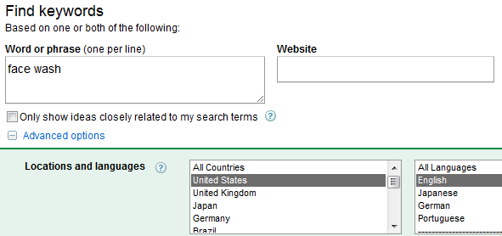
Olay Gold Keywords
Creating Gold Keyword Lists - Steps
Use the Google Keyword Tool to find keywords related to the content theme.
Example Keyword: Face Wash
Sign into Google AdWords (US: http://www.adwords.google.com)
Click on the Opportunities tab and follow the Keyword Tool link on the left side of the page.
Enter the keyword in the Word or Phase Box
Click Advanced Options
Specify Language & Location
Click the Search button
Notes:
Beauty Searcher – a consumer who used search to navigate to a beauty
related website

Slide 164
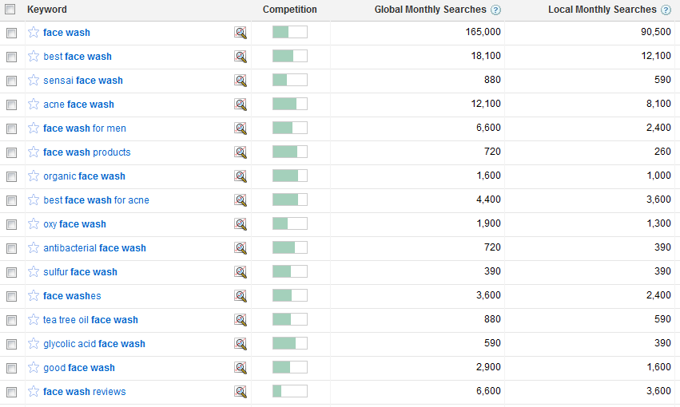
Olay Gold Keywords
Click Download to Export Related Keywords (example below)
Look for keywords that are related to the theme and Olay, with high local monthly searches
Look for different versions of the keyword (e.g., “face washes)
Notes:
Beauty Searcher – a consumer who used search to navigate to a beauty
related website

Slide 165
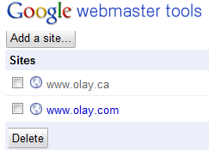
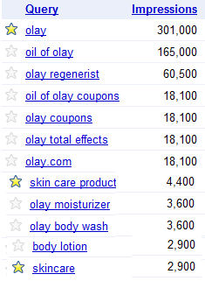
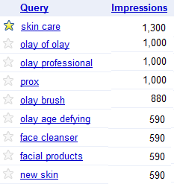
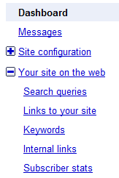
Olay Gold Keywords
Creating Gold Keyword Lists - Steps
Log Into Google Webmaster Tools Account* (US: https://www.google.com/webmasters/tools/home)
Click on the Olay Website URL
Under Dashboard in the Left Navigation, Click Your Site on the Web
Click on Search Queries
Resulting Report Shows the Top Search Queries
The keywords users search that drive the most traffic to the Olay site
Scroll to the Bottom of the Page to Download the Report
Look for Related Keyword Phrases with High Impressions
* More Google Webmaster tools information located in Helpful Tools slides.
Notes:
Beauty Searcher – a consumer who used search to navigate to a beauty
related website

Slide 166
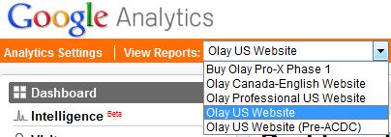
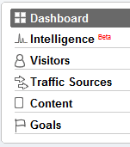
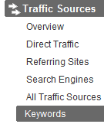
Olay Gold Keywords
Creating Gold Keyword Lists - Steps
Log Into Google Analytics (US: www.google.com/analytics)
Select the Correct Profile (US: Olay US Website)
Select Date Range (longer time period = more results)
Under Advanced Segments Select Non-Paid Search Traffic
Select Traffic Sources in the Left Side Navigation
Under Traffic Sources, Select Keywords
Change the view to show 500 keywords
Scroll to the bottom of the page
Click Export at the Top of the Page
Choose CSV for Excel
Only able to export 500 keywords at a time
Click Arrow at Bottom to Export Next 500 keywords
* More Google Analytics information located in Helpful Tools slides.
Notes:
Beauty Searcher – a consumer who used search to navigate to a beauty
related website

Slide 167
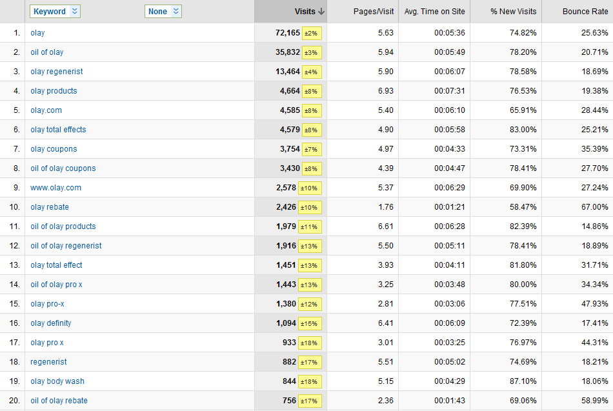
Olay Gold Keywords
Look for Keywords That:
Drove significant traffic
Have high pages per visit, time on site, and low bounce rate
Notes:
Beauty Searcher – a consumer who used search to navigate to a beauty
related website

Slide 168
Olay Gold Keywords
Creating Gold Keyword Lists - Steps
Look at Competitors Websites
Example: Dove.us
What themes are used for the high-level pages?
Products: Bar Wash, Body Wash, Lotions, Body Lotion, Hand Lotion
Community: Beauty Blogs, Beauty Topics, Beauty Discussion, The Beauty Editors
Expertise: Skin Care Articles, Skin Care Advice, Expert Skin Care, Skin Care Tips
Features: Skin Care Articles, Skin Care Videos, Interactive Experiences, Skin Care Quizzes
Offers: Skin Care Samples, Sweepstakes, Skin Care Coupons, Exclusives
Are any themes relevant to Olay?
Are they supported in the content on the Olay Website?
Create a final list of all relevant, high volume keyword phrases.
The list should encompass all keywords that:
Olay feels defines the brand equity
Have high search volume
Are relevant to the brand
Consumers would use when searching
* More Google Analytics information located in Helpful Tools slides.
Notes:
Beauty Searcher – a consumer who used search to navigate to a beauty
related website

Slide 169
Olay Gold Keywords
Creating Gold Keyword Lists - Steps
Look at Keyword Competition in Relation to Search Volume
Keyword Effectiveness Indicator (KEI)
Compares the number of searches for a keyword with the number of search results.
KEI will be between 0 (low volume/high competition) and 1 (high volume/low competition).
A KEI above 1% is typically a high volume/low competition keyword.
Pinpoints which keywords are most effective for an SEO Campaign.
The higher the KEI, the more popular the keyword is, and the less competition the keyword has.
High KEI means that the keyword has a better chance of ranking in the top organic positions.
Example Gold Keyword: Face Wash
Face Wash US Local Search Volume: 90,500
Face Wash Google Results: 2,310,000
Find Google Results by performing a search on the gold keyword
The number of results will appear below the search query bar
Divide the Local Search Volume (90,500) by the Google Search Results (2,310,000)
The KEI for “face wash” is 3.92%, which means that Olay has a good chance of ranking in the top organic positions for the gold keyword.
Olay should use KEI as a final decision maker after determining that there is sufficient content on the website to support the gold keyword and it is in line with brand equity.
Notes:
Beauty Searcher – a consumer who used search to navigate to a beauty
related website

Slide 170
Preferred landing pages

Slide 171
Who Should Know About Preferred Landing Pages?
The Search Agency: The search agency is responsible for understanding Preferred Landing Page (PLP) best practices and mapping gold keywords to relevant PLPs. It is imperative that the search agency understand why PLP mapping is important, and how to map gold keywords to PLPs(where to look, how to look, what to look for, tools to use). The search agency is also responsible for revisiting and refining mapped PLPs when necessary.
Creative Agency: : The creative agency should understand the importance of preferred landing page content optimization in relation to the mapped gold keyword.
Marketing: The Marketing team should understand the best practices for mapping gold keywords to preferred landing pages and the importance of providing supportive, relevant content on the Olay Website that fulfills a users search intent.
P&G ABM/DMM: The P&G brand contacts should understand the best practices of mapping gold keywords to relevant preferred landing page and how PLP selection affects the success of the Olay organic search campaign.
Notes:
Beauty Searcher – a consumer who used search to navigate to a beauty
related website

Slide 172
Olay Preferred Landing Page
Keyword Mapping Process
Preferred Landing Pages Best Practices
Preferred Landing Page Selection Steps
Preferred Landing Page Selection Example
Notes:
Beauty Searcher – a consumer who used search to navigate to a beauty
related website

Slide 173
Olay Preferred Landing Pages
Keyword Mapping Process
The next step in the SEO process is to match each gold keyword phrase to relevant, content-rich page on the Olay Website that defines the theme of the gold keyword phrase.
Home Page
Sub-Category Pages
4th Level Category pages
Category Pages
“skin care”
“skin care products”
“skin health”
Generic Keywords
“anti aging skin care”
“body cleansing”
“facial moisturizers”
Specific Keywords
Notes:
Beauty Searcher – a consumer who used search to navigate to a beauty
related website

Slide 174
Olay Preferred Landing Pages
Mapping gold keyword phrases to appropriate, relevant landing pages is a very important phase in the SEO process. Mapped gold keyword phrases make the basis of optimization efforts on the page.
Mapping Gold Keyword Phrases to Preferred Landing Pages
28%
Map High Volume Keyword Phrases to High Level Pages. High level pages tend to be more general.
Map Only One Gold Keyword Phrase per Page to prevent two pages competing against each other for a gold keyword phrase. Ensure Accurate Representation - Ensure the keyword phrase accurately represents the theme of the page. Keyword Phrase Density – Ensure that the gold keyword phrase is at least once every 30-40 words (2-3% density). Fulfills User Search Intent – Ensure that the landing page fulfills the intent of the users search query and was chosen with user expectations in mind.
Ensure No Other Gold Keyword Phrase would be better suited for the landing page. Content is Located in Users Line of Vision – All important content should be above the fold.
Easy Navigation to Other Olay Pages- Ensure that the user can easily reach other pages on the website. Look at the Content of Top Ranking Pages for Gold Keyword Phrase – Does Olay have similar content? Crawlability of Landing Page – Ensure that the landing page is crawlable from a search engine spider perspective. Crawlability Information found in Technical Best Practices.
16%

Slide 175
Olay Preferred Landing Pages
Selecting PLP’s to Map to Gold Keywords - Steps
Begin with list of URLs and gold keywords
Run a search in the top search engine for all gold keywords
Determine if Olay pages are already ranking for the keyword phrase. Look at the content of Web pages that are ranking in the top positions for that keyword and determine if Olay has a page that provides similar, relevant content.
Start with high level pages of the Olay Website
High volume gold keywords, such as skin care products, should be mapped to high level pages such as the page that showcases all Olay products.
Look at each pages content theme and map the gold keyword that is the most relevant to the page
Once completed, look at each PLP’s content and mapped gold keyword
Is the gold keyword mapped to the most relevant PLP? Would any other gold keyword be a better fit? Is the PLP content similar to the content on pages ranking organically for the gold keyword?
Notes:
Beauty Searcher – a consumer who used search to navigate to a beauty
related website

Slide 176
Olay PLP Selection Process
Example Gold Keyword: Face Wash
Possible PLPs:
Page Strengths
Page Weaknesses
6% Keyword Phrase Density
No Current Mapped Gold Keyword
Supportive Content
Similar to Top Organic Results
“facial cleansers” appears more often
“face wash” not in Meta Data
Other face products appear on page
All Face Wash Products
(/facial-cleansers/facial-cleansers)
4.06% Keyword Phrase Density
No Current Mapped Gold Keyword
Supportive Content
Appears in Meta Title
“deep cleaning face wash” is more relevant
“face wash” not in Meta Description, Headers, or URL
Other pages are more relevant
Deep Cleansing Face Wash
3.45% Keyword Phrase Density
No Current Mapped Gold Keyword
Supportive Content
Appears in Meta Title
“foaming face wash” is more relevant
“face wash” not in Meta Description, Headers, or URL
Other pages are more relevant
Foaming Face Wash
Notes:
Beauty Searcher – a consumer who used search to navigate to a beauty
related website

Slide 177
Olay PLP Selection Process
Gold Keyword Face Wash Mapped PLP Selection
6% Keyword Phrase Density
All Face Wash Products Page
Supportive Content
Fulfills User Intent
Text-based Content
Easy Navigation
Thematic Hierarchy
Similar to Top Ranking Pages
Content in Users Line of Sight
Notes:
Beauty Searcher – a consumer who used search to navigate to a beauty
related website

Slide 178
Website Content

Slide 179
Who Should Know About Website Content?
The Search Agency: The search agency is responsible for providing PLP content analysis and optimization recommendations to ensure that each PLP is optimized for the mapped gold keyword. It is imperative that the search agency understand content best practices, what to recommend to the brand, and how optimized content affects the success of the Olay organic search campaign.
Creative Agency: : The creative agency should be well versed in content creation best practices, where to incorporate the gold keyword on each Olay Web page, how to optimize current content, and how to write content targeted to the Olay WHO.
P&G ABM/DMM: The P&G brand contacts should understand content creation best practices and how optimized content affects the success of the Olay organic search campaign.
Notes:
Beauty Searcher – a consumer who used search to navigate to a beauty
related website

Slide 180
Olay Website Content
Content Optimization Factors
Content Creation Strategies
Gold Keyword Placement Checklist
Notes:
Beauty Searcher – a consumer who used search to navigate to a beauty
related website

Slide 181
Olay Website Content
Content is King
Content is critical to the overall effectiveness of the search engine optimization campaign. Page content is the glue that holds the keyword phrase relevancy together. Content optimization involves all aspects of on-the-page optimization:
Keyword Phrase-Rich Content on Each Page
Incorporation of Keyword Phrase in Page Structure
Keyword phrase-centric, theme enhancing content
Keyword Phrase Density in Meta Data
Short & thematic content
Throughout the page’s HTML source
Repeat keyword phrase once every 30 – 40 words of copy (2-3% keyword phrase density)
In the Header tags of the page
Place in first position of the Title Tag
As the anchor text for all links pointing to the page.
Include in the Description Tag
Keep the keyword phrase intact (i.e. if the keyword phrase is “skin care products” do not use “products for dry skin care”
Include in the URL
Use as the ALT Tag for all images on the landing page
Other keyword phrases should not be more prominent on the page
Notes:
Beauty Searcher – a consumer who used search to navigate to a beauty
related website

Slide 182
Olay Website Content
Page Content Should Answer the Following Questions:
A Web pages content represents the biggest area of opportunity and the most significant need in order to establish relevancy for the mapped gold keyword phrase. Below are some strategies for creating content that will not only establish keyword phrase relevancy and lead to improved visibility, but help establish Olay as an authority on a topic.
What is Available on This Page? What benefit does the landing page’s content provide the user? What Does a User Need to Know About the Mapped Gold Keyword of the Page? Does the content provide the information a user expects for when searching for the page’s mapped gold keyword phrase?
What Makes Olay Special? Does the content provide insight into how Olay differs from/ other beauty brands?
Why Should a User Buy Olay? Does the content provide details of the benefits of using Olay? Are There Any Special Offers for Olay Products? Does the content include any giveaways, coupons or contests that Olay might be running? Can Search Engines Determine a Content Theme for Each Page? Are all elements of the page optimized for search engine spiders?

Slide 183
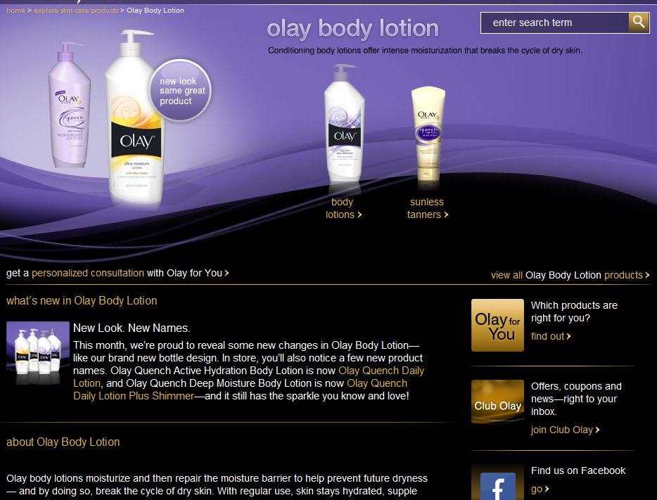
Olay Website Content
Users are actively seeking out information and content that will help them meet their needs. Olay is ranking in the first organic position in Google for the keyword phrase “body lotion” due to the inclusion of the keyword phrase throughout the content of the page.
Keyword Phrase Appears in Title Tag
Keyword Phrase Appears in Description Tag
Organic Ranking Example: “body lotion”
Keyword Phrase Appears in Breadcrumb Link
Keyword Phrase Appears in Header Tag
28%
16%
Other Keyword Phrases Appear as Anchor Text for Olay Internal Links
Multiple instances of the gold keyword phrase both on and off-the-page make the PLP well optimized for the gold keyword phrase “body lotion.”
Keyword Phrase Appears in Page Content

Slide 184
Olay Content Checklist
Gold Keyword Placement Checklist
The gold keyword for each PLP should be included in:
Text-Based Body Copy Repeated once every 30-40 words (2-3% density), without negatively impacting readability. The URL e.g., olay.com/skin-care-products/body-wash The Title Tag Located in the first position of the title tag. The Description Tag Located within the description tag. The ALT Tag Used as the ALT Tag of all images on the PLP. The Header Tags (H1, H2, etc) Located in the first position of the Header Tags. Breadcrumb Links e.g., Olay > Skin Care Products > Body Wash The Anchor Text of All Links Pointing to the Page Internal Links Such as Embedded Links, Contextual Links, Navigational Links, & Site Map Links External Links
Notes:
Beauty Searcher – a consumer who used search to navigate to a beauty
related website

Slide 185
Meta data

Slide 186
Who Should Know About Meta Data?
The Search Agency: The search agency is responsible for writing optimized Meta Tags for only the gold keyword mapped PLP. It is imperative that the search agency understands the best practices and requirements for each Meta Tag, the importance of each, and is aware of where each is within the content or code of the Olay Website.
Creative Agency: : Once the search agency recommends the optimized Meta Tags for the PLPs, the creative agency should begin writing the remaining Olay Web page Meta Tags. It is imperative that the creative agency understand the best practices and requirements for each Meta Tag, the importance of each, and is aware of where each is within the content or code of the Olay Website.
Technical Agency: The technical agency is responsible for implementing the optimized Meta Data and understanding the best practices for Meta Data placement within the HTML code of each Olay Web page.
P&G ABM/DMM: The P&G brand contacts should understand content creation best practices and how optimized content affects the success of the Olay organic search campaign.
Notes:
Beauty Searcher – a consumer who used search to navigate to a beauty
related website

Slide 187
Olay Meta Data
Meta Data Descriptions: Why each tag is important, where they appear, and examples of each.
Meta Data Best Practices: How to write Meta Data and where to implement in the PLP source code.
Meta Data Checklist: Resource to ensure correct writing and implementation of Meta Data.
Notes:
Beauty Searcher – a consumer who used search to navigate to a beauty
related website

Slide 188
Olay Meta Data
Meta Data
Meta tags are a critical part of any search engine optimization campaign, acting as markers to help search engine spiders determine the overall theme of a page. Meta tags consist of:
Title Tags
Description Tags
Most important Meta tag for SEO. They help search engines determine the theme of a page.
Do not directly influence SEO efforts, but increase click through rates for organic listings.
They appear as a listing title link in the organic results, as well as in the title bar of a browser.
They appear as the text snippet in search engine organic results.
ALT Tags
Header Tags
Describe image content for text browsers and spiders.
Important to SEO because they reinforce the page theme.
Appear when a text browser or spider visits the site, or when a user hovers over the image.
Defines HTML headings. <H1> defines the largest and <H6> defines the smallest.
Example <H1> Tag: <H1> Body Lotion from Olay </H1>
Notes:
Beauty Searcher – a consumer who used search to navigate to a beauty
related website

Slide 189
Olay Meta Tags Best Practices
Meta tags have strict requirements, in terms of length and keyword position, when it comes to optimization
Title Tags
Description Tags
Primary Keyword Phrase Should be Used as ALT Tags e.g. the ALT tag for an image on the body lotion landing page should be body lotion. Not All Images Need to Contain an ALT Tag. Focus on important images that live on the landing page.
If the Image Contains Text, Replicate the Text in the ALT Tag if the Text Includes the Gold Keyword Phrase.
Primary Keyword Phrase Should Always be First. e.g. Body Lotion from Olay® The Brand Name Should Always Be Included at the End (far right). e.g. Body Lotion from Olay®
Title Tags Should be 10 Words or Less. Any longer and they will be truncated by search engines with an ellipisis (…) which can eliminate the desired “call to action.”
Primary Keyword Phrase Should be Included in the Description. e.g. Find out more about all the body lotion products from Olay®. The Brand Name Should Always Be Included. e.g. Find out more about all the body lotion products from Olay®.
Description Tags Should be 20 Words or Less. Should be written to entice users to click on the listing Use language containing call to actions, such as “Find Out More,” and “Learn More About.”
ALT Tags
28%
16%

Slide 190
Olay Meta Data
Olay Meta Data Checklist
All important Olay Web pages should include the following:
Title Tag
Gold keyword phrase in the first position, and 10 words or less.
Include the primary branded term at the end of each title tag:
“Body Lotion from Olay”
Placed in the Header code at the top of the page.
Description Tag
Include the gold keyword phrase in the description.
Enticing content with a call to action in 20 words or less.
Placed in the Header code at the top of the page.
ALT Tag
Images (especially image links) should have an ALT tag to describe the content of the image.
Including the gold keyword phrase where possible.
Header Tags
Each page should include at least one text-based header tag, reinforcing the theme of the page.
The gold keyword phrase should be in the first position of each header tag.

Slide 191
URL Naming

Slide 192
Who Should Know About URL Naming?
The Search Agency: The search agency is responsible for recommending optimized preferred landing page URLs – the creative agency is responsible for the remaining Olay Web page URLs. It is imperative that the search agency understand URL naming best practices, how the hierarchy of the Olay Website influences URL naming, and how optimized URLs affect the success of the Olay organic search campaign.
Creative Agency: The creative agency is responsible for recommending optimized URLs for all non-PLPs. It is imperative that the creative agency understand URL naming best practices and how the hierarchy of the Olay Website influences URL naming.
Technical Agency: The technical agency is responsible for implementing the optimized URLs for each Olay Web page. It is important for the technical agency to understand why keyword phrase-rich directory names for each level of the Website and an optimized URL naming convention are imperative to the success of the Olay organic search campaign.
P&G ABM/DMM: The P&G brand contacts should be aware of URL naming best practices, how the hierarchy of the Olay Website impacts URL naming, and why optimized URLs are important to the success of the Olay organic search campaign.
Notes:
Beauty Searcher – a consumer who used search to navigate to a beauty
related website

Slide 193
Olay URL Naming
URL Naming Best Practices
URL Naming & Hierarchy
Notes:
Beauty Searcher – a consumer who used search to navigate to a beauty
related website

Slide 194
Olay URL Naming
The URL is the address where a page lives but it also contains markers that help search engine spiders generate a theme for a page. A keyword phrase-rich URL is an important on-the-page factor in ranking well in search engine organic results.
URL Naming – Olay Best Practices
Keyword Phrase-Rich URLs e.g. body lotion is mapped to the all Olay body lotions so the optimized URL for the page should include body lotion. Each Keyword in the URL Should be Separated by a Hyphen (-). e.g. www.olay.com/skin-care-products/body-lotion The URL Name Should Follow the Hierarchy of the Olay Website. The recommended Olay Global Template hierarchy can be found in the Global Template Recommendations section.
The URL Should be Static Not Dynamic. Dynamic URLs generally contain a data string preceded by a question mark that describes a session, user, or product identification. e.g. http://www.olay.com/skin-care-products/anti-aging-products/facial-moisturizers?pid=075609034558 Users are much less likely to share a dynamic looking URL. Avoid Writing URLs That: Include too many directories (e.g. olay.com/skin-care-products/body-wash/regenerist/regenerist-body-wash/exfoliate) Are longer than 50 characters Use multiple redirects (e.g. A URL that utilizes a 302 redirect to a page that is a 301 redirect)
Notes:
Beauty Searcher – a consumer who used search to navigate to a beauty
related website

Slide 195
Olay URL Hierarchy
The URL hierarchy, or structure of directories with similar content grouped in each, can help search engines determine secondary themes for groups of pages, provided the directories incorporate keyword phrases in URL naming convention. For example, the figures below not only tell search engines that the pages are about skin care or skin care products, but also more broadly about anti aging:
http://www.olay.com/skin-care-products/anti-aging-products
http://www.olay.com/skin-care/anti-aging-skin-care
Therefore, it is important to use keyword phrases in directory names, and to group similar content together in directories. Typically websites are designed with a hierarchical structure so matching up URLs with sections on the site is usually straightforward. More information on the current Olay hierarchy can be found in the Global Template Recommendations section.
Notes:
Beauty Searcher – a consumer who used search to navigate to a beauty
related website

Slide 196
Global Urls

Slide 197
Who Should Know About Global URLs?
The Search Agency: The search agency should understand the SEO benefits of implementing in-country extensions for the Olay Website and be able to communicate these benefits to the brand contacts and technical agencies.
Creative Agency: The creative agency should understand the SEO benefits of implementing in-country extensions and how to write optimized Global URLs.
Technical Agency: The technical agency should understand Global URL best practices and is responsible for implementing optimized Global URL in-country extensions for the Olay Website.
P&G ABM/DMM: The P&G brand contacts should be aware of best practices for Global URL in-country extensions and how their Olay Website utilizes in-country extensions.
Notes:
Beauty Searcher – a consumer who used search to navigate to a beauty
related website

Slide 198
Olay Global URL Naming
SEO Benefits of In-Country Extensions
Olay Top 6 Country Extensions
Notes:
Beauty Searcher – a consumer who used search to navigate to a beauty
related website

Slide 199
Olay Global URLs: In-Country Extensions
When naming URLs for different countries, it is important to use in-country extensions as opposed to country sub-directories of a main US site. For example, the Olay UK site domain should be: http://www.Olay.co.uk
SEO Benefits of Utilizing In-Country Extensions
Higher Importance and Relevance Search engines place higher importance and relevance on content written in the language of the country. Visibility as A Separate Website Search engines view sites with different country extensions as separate websites – dividing the site from the US and prevent penalties for duplicate content, e.g., olay.com vs. olay.com/en-us/ Shorter URLs URLs are shorter when using in-country extensions, placing more importance on keywords by promoting them in the URL structure in the country’s language.
Increased External Links External websites and users are more likely to link to a website that utilizes their country’s in-country extension. More Directory Listings In-country extensions make it easier for a site to be listed in directories within each individual country.
Notes:
Beauty Searcher – a consumer who used search to navigate to a beauty
related website

Slide 200
Olay Global URLs – Top 6 Country Extensions
Current Extension
Optimized Extension
Olay China
Olay.com.cn
Olay.cn
Olay Russia
Olay.ru
Same
Olay India
Olay.co.in
Same
Olay UK
Olay.co.uk
Same
Olay Mexico
Olay-la.com/es-mx/
Olay.mx
Olay Brazil
Olay.com.br
Olay.br

Slide 201
Internal linking

Slide 202
Who Should Know About Internal Linking?
The Search Agency: The search agency is responsible for providing an optimized internal linking strategy that focuses on links to and from the gold keyword PLPs. It is imperative that the search agency is well-versed in internal linking best practices, understands the types of internal links and how to optimize each, and understands the SEO benefits of optimized internal links. The search agency must also be able to communicate the importance of an optimized internal linking strategy and implementation directions to the technical agency, creative agency, and brand contacts
Creative Agency: The creative agency is responsible for writing optimized anchor text for non-PLP links. It is imperative that the creative agency understand the best practices and SEO benefits for Internal Link Naming optimization and how to incorporate keyword phrase-rich Embedded Links within the content of Olay Web pages.
Technical Agency: The technical agency is responsible for implementing optimized internal linking recommendations. The technical agency should understand the SEO benefits of text-based, keyword phrase-rich internal links, typical recommendations for each link type, and how to implement Workarounds for rich media links.
P&G ABM/DMM: The P&G brand contacts should be aware of how an optimized internal linking strategy affects the success of the Olay organic search campaign.
Notes:
Beauty Searcher – a consumer who used search to navigate to a beauty
related website

Slide 203
Olay Internal Linking
Internal Linking Primary Functions
Internal Linking Basics
Ensuring Effective Internal Linking Strategy
Internal Linking & Navigation Best Practices
Internal Linking & Rich Media Best Practices
Internal Linking & Breadcrumb Linking Best Practices
Internal Link Types & Olay Examples
Internal Link Naming Best Practices & Olay Examples
Embedded Linking Best Practices & Olay Examples
Notes:
Beauty Searcher – a consumer who used search to navigate to a beauty
related website

Slide 204
Olay Internal Linking
Internal linking is what makes a website work, being inextricably linked with spider accessibility, search engine visibility, and visitor usability. A website with a well-formed internal linking structure that appeals to both search engines and to users is one that is likely to perform well in search engine results.
Internal Linking Primary Functions
28%
To Make Pages Accessible to Search Engine Spiders and Users
(Technical Crawlability & Usability)
To Build and Reinforce the Internal Link Popularity of the Most Important Pages on a Website
(Performance Optimization)
56%
16%
To Create Context and Reinforce Keyword Phrase Themes
(Performance Optimization)

Slide 205
Olay Internal Linking
Each of the pieces – technical crawlability, performance, and usability – are related, as illustrated in the figure below.
Internal Linking: The Basics
28%
56%
16%

Slide 206
Olay Internal Linking
A holistic, comprehensive internal linking strategy is the most effective way to ensure that all significant pages of a website are accessible by search engine spiders and users alike. Common places for internal links include the global navigation, the web page text, and the site map.
Internal Linking
28%
Consistency
Format
56%
Quantity
16%
Websites should contain a consistent internal linking strategy to allow for clear navigation throughout the site.
The primary navigation should be supplemented by text-based links with gold keyword phrases as the anchor text.
Internal links must be relevant and functional, but not too numerous. Google recommends that the links on a Web page be 100 or fewer.

Slide 207
Olay Internal Linking
Internal Linking - Navigation
Consistency in navigation helps visitors navigate the website naturally and guides them through various stages of the purchasing funnel. Reliable Repetition of commonly found design features reassures visitors.
The Global Navigation should be present and include a uniform design across all pages of a website.
Embedded Links should be included in the content of a web page where appropriate.
<Nofollow> Attributes should be used when a link leads to a page within a website that should not be indexed. Relative Links are problematic in terms of SEO. Wherever possible, absolute links should be utilized. More information on relative links can be found in the appendix. Rich Media Links should be avoided due to the crawlability roadblocks that make an internal linking structure less effective (JavaScript, Flash-encoded, Image, and Non-Contextual Links – e.g. “Click Here”). Breadcrumb Links should be implemented for all pages on a website.

Slide 208
Olay Internal Linking
Rich Internet Applications (RIAs) and dynamic links contained in Flash, JavaScript or Images pose a challenge to search engine spiders, which are designed to crawl and index HTML or text-based links.
Rich Media Best Practices
Use JavaScript, Flash & Image Links Sparingly Balance the needs of every user against the needs of search engines, which thrive on text-based content. Make Strategic Link Design Decisions Overall Consider both the user and search engine spider when designing links. Use Workarounds for All Links That Need to Use JavaScript, Flash or Images Incorporate one of the workarounds below to ensure spider accessibility and crawlability: SWFObject 2.0 Progressive Enhancement Flash & HTML Hybrid Layer using HTML code and <div> tags For more information see Appendix – Workarounds.
Important Links Should Not Live Within JavaScript, Flash or Images All important links should be text-based HTML and keyword phrase-rich.

Slide 209
Olay Internal Linking
A global breadcrumb trail assists in orienting visitors by offering easy-to-read map of page order and site organizations. Breadcrumb links provide a trail for users to follow back to their starting point or home page.
Breadcrumb Linking Best Practices
Progress From Highest Level Pages to Lowest Level Pages e.g. Olay > Skin Care Products > Facial Cleansers > Facial Scrubs Links Should Use Relevant Anchor Text for Each Level The gold keyword phrase should be used as the anchor text for all breadcrumb links leading to PLPs. The remaining pages should use the most relevant keyword phrase of the resulting page as the anchor text for the breadcrumb link. The Breadcrumb for the Current Page Should Not be Hyperlinked
Each Breadcrumb Link Should Have a Simple, One-Character Separator Between the Levels e.g. “>” Breadcrumb Links Should Follow the Site Hierarchy, Not the User’s History

Slide 210
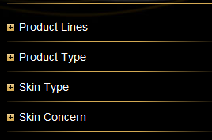
Olay Internal Linking
The most effective way to ensure search engine access to all of the important pages of a website is through a good internal linking strategy. There are many different types of internal links:
Global Navigation
Footer Navigation
Embedded Links
Absolute & Relative Links
Relative Link:
Absolute Link:
Left-Hand Navigation
Contextual Links
Breadcrumb Links
Notes:
Beauty Searcher – a consumer who used search to navigate to a beauty
related website

Slide 211
Olay Internal Link Naming
Search engine spiders monitor the anchor text of all links pointing to a page and associate this anchor text with the page to which it links. Therefore, optimizing anchor text for search engine spiders is imperative. The figure below displays how optimized links can be incorporated on the Olay home page.
All internal links should use the gold keyword mapped to the resulting page as the anchor text of the link.
Pages that are not assigned gold keywords should utilize the most relevant keyword as the anchor text.
buy skin care
skin care products
skin care
skin care offers
All non-contextual links should utilize the most relevant keyword as the anchor text if the resulting page is not assigned a gold keyword.
anti aging skin products
skin care consultation

Slide 212
Olay Internal Linking
Usability testing revealed that users prefer to navigate a website through embedded links woven into copy. The figure below provides an example of Olay content that is appropriate for incorporation of embedded links.
Embedded Linking Example
28%
56%
Link to http://www.olay.com/skin-care
16%
Change content to “Good facial cleansers” and link “facial cleansers” to http://www.olay.com/skin-care-products/facial-cleansers
Change content to “A good body lotion” and link “body lotion” to http://www.olay.com/skin-care-products/body-lotion
Link to http://www.olay.com/skin-care-products/anti-aging-products

Slide 213
Technical Best practices

Slide 214
Who Should Know About Technical Best Practices?
The Search Agency: The search agency is responsible for providing recommendations for optimization of technical issues on the Olay Website. It is imperative that the search agency understand each technical issue, what to look for with each issue, where/how to look at the Olay Website for each issue, what tools to use for each issue, and what to recommend to optimize each issue for organic search.
Technical Agency: The technical agency is responsible for implementing the search agencies optimized recommendations for each technical issue. It is imperative that the technical agency understand how to implement the recommendations correctly to ensure user and spider crawlability and accessibility.
P&G ABM/DMM: The P&G brand contacts should be aware of how technical issues impact how a search engine spider crawls and indexes each page on the Olay Website and the benefits of optimizing each technical issue for organic search.
Notes:
Beauty Searcher – a consumer who used search to navigate to a beauty
related website

Slide 215
Olay Technical Best Practices
Technical Audit Topics: Overview of all important topics in a technical site audit.
URL Redirection: Types of URL redirects and best practices for implementation.
Broken Links & 404 Error Pages: Description and best practices.
404 Error Page: Olay and Dove 404 error page examples.
Rich Media: Overview of rich media tools.
Rich Media Example: Use of rich media on Olay.com.
Rich Media Implications: Effects of rich media on an SEO strategy.
Rich Media Best Practices: List of best practices when using rich media as a design tool.
XML Sitemap Creation Instructions: Steps and useful tools for creating &uploading an XML Sitemap.
Session IDs: SEO implications of utilizing Session IDs.
Robots.txt: Best practices for implementing a Robots.txt file & example of Olay.com Robots.txt file.
User Input Requirements: SEO implications & example of implications on an Olay.com user input requirement.
Duplicate Content: SEO implications & best practices.
Notes:
Beauty Searcher – a consumer who used search to navigate to a beauty
related website

Slide 216
Olay Technical Recommendations
URL Redirection
Broken Links & 404 Error Pages
Rich Media
Site Map Creation
Session ID’s
Robots.txt
Duplicate Content
Notes:
Beauty Searcher – a consumer who used search to navigate to a beauty
related website

Slide 217
Olay – URL Redirection
URL Redirection
The four most commonly used redirect types are 301 permanent, 302 temporary, HTML (also known as the Meta refresh), and JavaScript. Just as each type of redirect is implemented differently, each has a different impact on Search Engine Optimization. The Xenu Link Sleuth Tool can be used to find all redirected URLs on the Olay Website.
URL Redirection Best Practices
Avoid 302 Temporary Redirects Search engines will not drop the old URL from their indices and link popularity is not passed on to the new URL. Only use a 302 Redirect if a page is only temporarily moving. Avoid HTML and JavaScript Redirects HTML Redirects are perceived as spam by search engines and should not be considered as a redirect option. JavaScript Redirects cannot be crawled because search engine spiders do not recognize JavaScript content. Always Use a 301 Permanent Redirect Unless The Page is Only Temporarily Moved A 301 Redirect informs spiders to stop crawling the old URL and to remove it from its indices. All link credibility built up from the former URL is passed on to the new 301 Redirected URL. One-to-One 301 Redirects are Ideal For new top-level and deeper-level pages Top-level pages can be 301 Redirected to the home page as a last resort when no 1:1 relationship is available Avoid Redirect Loops Multiple redirects for one page can confuse spiders and cause them quit crawling and indexing pages on the site.
Notes:
Beauty Searcher – a consumer who used search to navigate to a beauty
related website

Slide 218
Olay – Broken Links & 404 Error Pages
Broken Links & 404 Error Page
Broken links are links that do not resolve to a working URL. A 404 error message is delivered to users and search engine spiders that land on a broken link. The Xenu Link Sleuth Tool can be used to find a list of all broken pages on the Olay Website.
Broken Links & 404 Error Page Best Practices
Fix all Broken Links Immediately Users and search engine spiders will continue to visit broken pages. Use 302 Redirect if it can’t be fixed immediately. Xenu can be used to identify all broken links and links with temporary 302 Redirects. Create a Custom 404 Error Page A generic 404 error page gives no indication of whether the condition is temporary or permanent and does not provide links back to the originating website. The Custom 404 Error Page Should Not Return a 200 OK Status Code Allow Users and Spiders to Easily Navigate Back to the Website The “Back” button should not have to be pressed more than once. Mirror The Site Map Include links to all important pages of the website, using keyword phrase-rich anchor text. Provide a Site Search Function Include the Standard Olay Navigation – global header and footer navigation Serve when any broken or expired page is requested
Notes:
Beauty Searcher – a consumer who used search to navigate to a beauty
related website

Slide 219
Olay – Broken Links & 404 Error Pages
Olay.com Current 404 Error Page
Dove.us Current 404 Error Page
Notes:
Beauty Searcher – a consumer who used search to navigate to a beauty
related website

Slide 220
Olay – Rich Media
Rich Media Overview
Rich Media, such as Flash, JavaScript, and Images, are tools to create visually dynamic formatting and content for websites. They provide developers with an easy way to deliver online content in a visually appealing and interactive manner.
Rich Media can have negative impacts on a website’s organic visibility if used incorrectly. Content located in Rich Media is, for the most part, invisible to search engine spiders.
This does not mean that Rich Media should be avoided altogether. It simply means that any content embedded in these types of files should also be available in text format, or it will not be accessible by most search engine spiders.
Notes:
Beauty Searcher – a consumer who used search to navigate to a beauty
related website

Slide 221
Olay – Rich Media
Rich Media
The images below show how Rich Media is utilized on Olay.com
Image-Based Content on Olay Professional Page
JavaScript Links on All Product Page
Flash-Based Content on Olay Home Page
Notes:
Beauty Searcher – a consumer who used search to navigate to a beauty
related website

Slide 222
Olay – Rich Media
Rich Media Implications
Text-based websites are comprised of separate pieces of information and content, each hosted on their own URL, whereas full JavaScript or Flash-based sites may have many content sections existing on a single URL. Writing a website in full Rich Media poses multiple negative implications to the SEO strategy of the site.
The Website Cannot be Crawled and Indexed by Search Engine Spiders Spiders cannot yet fully understand JavaScript or Flash language. Individual Page Content Cannot be Optimized for a Single Theme When all content or information lives in one file, the ability to target multiple gold keyword for optimization is nonexistent. Links to the Website Can Only Point to the Root URL or Content Section External links are crucial to the overall credibility of a site, impacting its ability to perform well in search engine results. Link Anchor Text Cannot be Customized for Individual Pages Users Cannot Bookmark and Share Individual Pages with other users Unique Title and Meta Descriptions Cannot be Created for Individual Pages The meta title is one of the most important on-the-page elements in term of SEO. Not having unique meta data can have a negative impact on a page’s ability to rank for gold keywords.
Notes:
Beauty Searcher – a consumer who used search to navigate to a beauty
related website

Slide 223
Olay – Rich Media
Rich Media Best Practices
Use Rich Media Sparingly Only use Rich Media when it will significantly enhance a user’s experience. Important Content Should Not Live Within Rich Media. All content should be text-based HTML and keyword-phrase rich. Implement Workarounds if Rich Media is Necessary Workarounds will provide users with text-based browsers and search engine spiders with an HTML version of the Rich Media content. Common Rich Media workarounds are: SWFObject 2.0 Progressive Enhancement Flash & HTML Hybrid Layer using HTML code and <div> tags Create Unique URLs for Important Pages/Sections That Are Rich Media-Based With most Rich Media applications, there is only one URL for all content within the application. The single URL contains the same HTML source (since the browser never refreshes), which contains the same meta data, Header Tags, and body copy. URL Naming Best Practices. Note: Search engines do not see content beyond a hash(#) mark as a distinct URL and do not index these types of URLs.
Notes:
Beauty Searcher – a consumer who used search to navigate to a beauty
related website

Slide 224
Olay – XML Sitemap Creation
XML Sitemaps are an easy way for webmasters to inform search engine spiders about pages on their sites that are available for crawling. The XML Sitemap file lists URLs for a site along with information on when it was last updated, how often it changes, and how important it is relative to other URLs on the site so that spiders can more intelligently crawl the site. XML Sitemaps are not to be confused with on-the-site “site maps.” The
Xenu Link Sleuth Tool can be used to find a list of all links eligible for XML Sitemap submission.
Olay.com XML Sitemap Example
XML Sitemap File
<url>
Parent tag for each URL entry. The remaining tags are children of this tag.
<loc>
URL of the page. Must begin with http and end with a trailing slash, if web server requires it. Must be less than 2,048 characters.
<lastmod>
The date of last modification of the page. Format should be YYYY-MM-DD.
<changefreq>
How frequently the page is likely to change. Valid values are: always, hourly, daily, weekly, monthly, yearly, and never.
<priority>
The priority of this URL relative to other URLs on the website. Valid values range from 0.0 to 1.0. The default priority is 0.5.
Notes:
Beauty Searcher – a consumer who used search to navigate to a beauty
related website

Slide 225
Olay – XML Sitemap Creation
XML Sitemap Creation Instructions
Step 1: Gather All Necessary URLs Tools such as Xenu gather all crawlable URLs from the Olay Website. More information on Xenu can be found in the appendix. Include most URLs Exclude any URL that is not important for indexing: e.g. broken URLs, duplicate pages, etc, external links. Step 2: Check Status Codes of URLs Ensure that the URLs selected are all working (i.e., return 200 status codes) and are not redirected to another URL. Step 3: Add URLs and Page Information Into Excel Template Add all applicable URLs to an Excel Spreadsheet. The screenshot below shows the naming convention required: Step 4: Create the XML File Use a sitemap generator tool to create the XML file. The link below provides a list of acceptable tools to use: http://code.google.com/p/sitemap-generators/wiki/SitemapGenerators Add XML to the Olay Website The XML Sitemap file should be hosted directly off the domain’s root directory. e.g., http://www.domain.com/sitemap.xml The technical contact for the Olay Website will need to upload the xml file. Create Engine WebMaster Tools Accounts – More information in Helpful Tools – WebMaster Tools Use appropriate country extensions: www.google.com/webmasters/tools/
Notes:
Beauty Searcher – a consumer who used search to navigate to a beauty
related website

Slide 226
Olay – XML Sitemap Creation
XML Sitemap Creation Instructions
Step 7: Validate Ownership of the Site Webmaster Tools will ask for website ownership validation. There are two implementation options: Verification Meta Tag Verification File (URL) Each engine requires a separate verification code. Add the verification code in the home page code. Once verified, the Webmaster Tools account will show as Authenticated. Step 8: Submit XML Location to Engines’ Webmaster Tools Programs Login to each Engine Webmaster Tools Programs and submit the location of the XML file e.g. http://www.domain.com/sitemap.xml Google – Go to ‘Site Configuration’ and then ‘Sitemaps.’ Click ‘Submit a Sitemap.’ Enter the XML Sitemap URL. Step 9: Confirm the Engines Are Crawling the Sitemap Check the crawl statistics and error notices in Webmaster Tools to ensure the sitemap is being crawled appropriately.
Notes:
Beauty Searcher – a consumer who used search to navigate to a beauty
related website

Slide 227
Olay – Session IDs
To recognize visitors and deliver customized content, dynamic websites create a unique alphanumeric string representing the users individual information called a Session ID. The Session ID is often stored as cookies on the visitor’s computer, change with every new website visit, and is not retained on the site after the user closes their browser.
Session ID Implication Example
A search engine spider might crawl and index the same page from a website twice in one week.
First Visit The Spider Returns:
http://www.domain.com/;sessionid=RL32UXVR1UZG2RL32UXVR1UZG2CQQANUSFEQKCABWKIV0?_requestid=6934
Second Visit The Spider Returns:
http://www.domain.com/;jsessionid=4GPY?_requestid=4765
Search engines may index the same page under two different URL Session IDs and notice that the content on both is the same, despite the different URLs. Avoid implementing Session IDs as search engine spiders might consider two sessions as duplicate content and classify the Olay Website as engaging in spam practices.
Notes:
Beauty Searcher – a consumer who used search to navigate to a beauty
related website

Slide 228
Olay – Robots.txt
Robots.txt allows website owners to declare certain parts of the site off-limits to specific or all search engine spiders. This is an excellent tool for blocking spiders from crawling and indexing duplicate content or parts of the site that Olay does not want indexed.
Robots.txt Best Practices
What to Avoid: Using Robots.txt to block all search engine spiders entirely or to prevent them from crawling content-rich pages. Do not add any pages to the Robots.txt file that Olay wants crawled or indexed. Place Pages on The Development Server in Robots.txt File This will prevent spiders from crawling new pages that are not live yet or detecting duplicate content. During a Redesign Remove All New Content From Robots.txt File Post Redesign – Allow Spiders to Crawl All Content on Olay Website Unless there is a business, security, or SEO reason to prevent the indexing of content for public use.
Notes:
Beauty Searcher – a consumer who used search to navigate to a beauty
related website

Slide 229
Olay – Robots.txt
Olay Robots.txt File
The screenshot below is the Robots.txt file for Olay.com. All pages included in the Robots.txt file are either development pages or pages where users have to input information, both of which are recommended by iProspect. The Robots.txt file can typically be found by adding robots.txt to the end of the website domain, i.e. domain.com/robots.txt.
Notes:
Beauty Searcher – a consumer who used search to navigate to a beauty
related website

Slide 230
Olay – User-Input Requirements
When a website mandates the submission of information from a user before providing access to a specific section of a website, the request is called a “user-input requirement.” This is very problematic from an SEO standpoint as spiders cannot “interact” with content and do not have the ability to enter information.
Olay.com User-Input Requirement Example
Notes:
Beauty Searcher – a consumer who used search to navigate to a beauty
related website

Slide 231
Olay – User-Input Requirements
Olay.com User-Input Requirement Example
Club Olay User-Input Requirement
Log in for Access to Special Offers, Sweepstakes, Giveaways, and & Write Reviews.
Search Engine Spiders Cannot Crawl or Index Any Important Content Behind the Log In, Therefore the Rebate Below Will Not Have the Potential to Rank Organically.
Rebate Behind User-Input Requirement
Make Content Behind User-Input Requirement Crawlable by Either:
Remove the Requirement
Place All Important Content in Front of the Requirement.
If the User-Input Requirement Cannot be Removed the Page Should be Placed Within the Robots.txt File.
Notes:
Beauty Searcher – a consumer who used search to navigate to a beauty
related website

Slide 232
Olay – Duplicate Content
Duplicate content is problematic because it may be viewed by search engine spiders as a manipulative way for the domain to gain additional organic rankings in the search results. There are many different ways duplicate content can exist:
Mirroring a Web pages content on Different Domains
Identical Content Repeated on More Than One URL
Printer-Friendly Versions of HTML Pages
Multiple URL Versions
http://www.domain.com, http://domain.com, http://www.domain.com/index.jsp, http://domain.com/index.jsp
Duplicate Content Best Practices
Avoid Duplicate Content In extreme cases, search engines can ban a website that uses duplicate content from their search indexes altogether. Use 301 Permanent Redirects Implementing a 301 Redirect to one URL will eliminate any chances of being flagged by search engines as well as pass on link credibility from all duplicate URLs to the main URL. Implement Canonical Tags Canonical tags allow website owners to specify their preferred version of a duplicate page to be indexed by spiders. Instructions on how to implement: http://googlewebmastercentral.blogspot.com/2009/02/specify-your-canonical.html
Notes:
Beauty Searcher – a consumer who used search to navigate to a beauty
related website

Slide 233
Recommended changes to the olay global template

Slide 234
Who Should Know About Global Template Recommendations?
The Search Agency: The search agency is responsible for understanding each issue within the Global Template Recommendations, how each issue applies to their countries Olay Website, what is recommended for optimizing each issue and why, and the SEO benefits of implementing the optimized recommendations on the Olay Global Template.
Creative Agency: The creative agency is responsible for implementing the Olay Global Template navigation and hierarchy Link Naming and Embedded Linking recommendations.
Technical Agency: The countries technical agency is responsible for implementing their respective search agencies recommendations for the Olay Global Template.
P&G ABM/DMM: The P&G brand contacts should be aware of the current technical issues on the Olay Global Template that have a negative impact on what content user experience and search engine spider accessibility and crawlability.
Notes:
Beauty Searcher – a consumer who used search to navigate to a beauty
related website

Slide 235
Olay Global Template Recommendations
Global Navigation: Current status and recommendations for optimization.
Olay Hierarchy: Implications of the current hierarchy and example of CoverGirl's optimized hierarchy.
Olay Hierarchy Example: Current Olay Global Template hierarchy & a users/spiders navigation on Olay.com.
Olay Hierarchy Recommendations: Optimized Olay Global Template hierarchy.
Rich Media: Implications of rich media use on Olay.com and recommendations for optimization.
Olay “Wish List”: Overview of all technical issues that impact SEO & how they affect each Olay Website.
Wish List Recommendations: Global template technical issues and recommendations for optimization.
Notes:
Beauty Searcher – a consumer who used search to navigate to a beauty
related website

Slide 236
Olay – Global Template Recommendations
Global Navigation Template
The current Olay global navigation is not optimized for search engine spiders and provides users with very few links to other Olay pages. In order to ensure that the global navigation is search and user-friendly Olay should implement the recommendations below:
The drop down links in the global navigation are written in JavaScript, and therefore not crawlable.
Should be written in CSS, which offers the same visually appealing graphics and is crawlable by spiders.
If CSS is not an option, a workaround should be implemented to serve an HTML, text-based version.
The anchor text of each link is not optimized for search.
Use keyword phrase-rich anchor text for all links in the global navigation.
The global navigation does not include all high-level, important Olay pages.
Additional text-based, keyword phrase-rich links should be added to the global navigation.
Current Olay Global Navigation
Notes:
Beauty Searcher – a consumer who used search to navigate to a beauty
related website

Slide 237
Olay – Technical Site Audit Recommendations
Olay Global Template Hierarchy
The current Olay Global template hierarchy is not optimized for search. The hierarchy should be built on the basis of page importance, with high-level priority pages in the first and second directory and lower-level pages in the remaining directories. Each directory should use a keyword phrase-rich naming convention which should be utilized when naming URLs. Below is an example of the hierarchy of CoverGirl.com, which provides a clear navigational path for both users and search engine spiders.
Products are divided into thematic categories, Each with its own grouping of related sub-categories.
Collections (Boutiques) are still included in the Global Navigation.
The Hierarchy allows users to choose either a specific product or a collection, without having to navigate elsewhere on the CoverGirl Website.
Notes:
Beauty Searcher – a consumer who used search to navigate to a beauty
related website

Slide 238
Olay – Global Template Recommendations
Olay Global Template Hierarchy
The Body Lotion page is the one of the only page within the Olay Global template that is optimized for search in terms of hierarchy, as well as the only gold keyword PLP that is ranking in the first organic position in Google. The page directory follows the navigation of the Global template, from homepage (olay.com) to category page (skin-care-products) to sub-category page (body-lotion).
A majority of the remaining product pages do not follow the hierarchy and instead are categorized by Boutique. The pages do not provide a clear navigation for users to orient themselves with, and provide little insight into how users and spiders alike arrived at the page. An example of the navigation is provided below:
Olay Homepage
Olay.com
Explore Products
Olay.com/skin-care-products
Product Type
Olay.com/skin-care-products
Breadcrumb: home > explore products
Breadcrumb: home > explore products > all products
Facial Moisturizers
Olay.com/Pages/Boutiques/Products.aspx?f_producttype=facial%2bmoisturizers
Breadcrumb: home > explore products > all products
Notes:
Beauty Searcher – a consumer who used search to navigate to a beauty
related website

Slide 239
Olay – Technical Site Audit Recommendations
Olay Global Template Hierarchy
A majority of the Olay product pages do not follow the hierarchy, instead they are categorized by Boutique. The pages do not provide a clear navigation for users to orient themselves, and provide little insight into how users and spiders alike arrive at a page. An example of how the Olay Global template hierarchy should be set up is below.
Skin Care Products
Face
Facial Cleansers
Facial Moisturizers
Facial Scrubs
Facial Toners
Facial Treatments
Make-Up Removers
Cleansing Cloths
Lip Treatments
Body
Body Lotions
Body Moisturizers
Body Cleansers
Body Soaps
In-Shower Body Lotions
Body Treatments
Body Cream
Sunless Tanners
Eyes
Eye Creams
Eye Rollers
Eye Treatments
Eye Serums
Eye Concealers
Boutique
Olay Professional
Regenerist
Definity
Total Effects
Age Defying Series
Complete
The Olay Global template navigation should use each category (Face, Body and Eyes) as a first directory, ensuring directory names are keyword phrase-rich, letting users and spiders know what to expect. For example the navigation below depicts optimized navigation and URL naming from the homepage to the Olay Regenerist Regenerating Body Lotion page.
Homepage
Olay.com
Skin Care Products
Olay.com/skin-care-products
Body Products
/skin-care-products/body
Body Lotions
/skin-care-products/body/body-lotions
Hydrating Body Lotion
/skin-care-products/body/body-lotions/hydrating-body-lotion
Notes:
Beauty Searcher – a consumer who used search to navigate to a beauty
related website

Slide 240
Olay – Technical Site Audit Recommendations
Olay Rich Media
A significant amount of content on Olay.com lives in Rich Media. Search engine spiders do not have full capability to crawl content that lives in Flash, JavaScript or Images. The screenshots below provide examples of content that lives in Rich Media on Olay.com. All content on the Olay Website should be text-based HTML. If this is not possible, a workaround such as an SWFObject2.0, Flash & HTML Hybrid, or Progressive Enhancement should be implemented by whomever is in charge of the technical development of the Olay Website. Further information on workarounds is provided in the Appendix under Workarounds.
Image-Based Content on Olay Anti Aging Skin Care
JavaScript Links in Olay Global Navigation
Notes:
Beauty Searcher – a consumer who used search to navigate to a beauty
related website

Slide 241
Olay Global Template “Wish List”
The Olay “Wish List” on the next slide is comprised of all technical and performance issues that iProspect has identified on the Olay Global Template. These issues impact user experience on the Olay Website as well as search engine spider accessibility and crawlability, which influence the Olay Web pages that are indexed in organic search results.
The “Wish List” is important to each Olay Country Website:
The technical and performance issues apply to each countries Olay Website
Important for each country to be aware of global templates impact on user experience and spider accessibility and crawlability.
The recommendations apply to the template for each country.
Important for each country to understand what optimizations are necessary to ensure a good user experience and spider accessibility and crawlability.
Each country has the opportunity to optimize the Olay Website as they see fit.
Important for each country to be aware of the opportunity to optimize the current technical and performance issues on the Olay Global Template.
Notes:
Beauty Searcher – a consumer who used search to navigate to a beauty
related website

Slide 242
Olay Global Template Recommendations
Global Template Navigation
Text-based HTML Links
If not, implement workaround for Rich Media
Keyword Phrase-Rich Anchor Text
Links to Important, High-Level Olay Pages
Global Template Hierarchy
Intuitive Hierarchy, Not Boutique-Based
Mimic How Users Search: Homepage → Category → Sub-Category
Category Directories Should be Keyword Phrase-Rich (gold keyword)
Page Load Time
Decrease Page Load Time
Google has recently added this to their algorithm as a significant factor in determining organic rankings.
Article Pages
Include content that recommends Olay products related to article.
Implement embedded links with the product gold keyword as the anchor text.
Internal Linking
Remove all Rich Media and non-contextual links.
Ensure all links are text-based with keyword phrase-rich anchor text
Implement keyword phrase-rich embedded links within page content
Rich Media
Remove all Rich Media.
Ensure all content is text-based and keyword phrase-rich
Implement workarounds if Rich Media necessary.
Notes:
Beauty Searcher – a consumer who used search to navigate to a beauty
related website

Slide 243
Digital Assets

Slide 244
Who Should Know About Digital Assets?
The Search Agency: The search agency is responsible for providing recommendations for optimizing Olay digital assets. The search agency should understand best practices for on-the-page and off-the-page optimization of digital assets and how optimized digital assets affect the success of the Olay organic search campaign. The search agency should know how to communicate digital asset recommendations to the creative agency, technical agency, and P&G brand contacts as well as communicate the importance of digital assets to the Olay ER team.
Creative Agency: The creative agency is responsible for writing optimized content for digital assets living on-the-page and off-the-page. The creative agency should also understand digital asset best practices and how images and video optimizations affect the success of the Olay organic search campaign.
Technical Agency: The countries technical agency is responsible for implementing optimized digital asset recommendations. It is imperative that the technical agency understand on-the-page and off-the-page requirements for Olay digital assets.
ER: ER should understand the importance of leveraging Olay digital assets, the importance of utilizing third-party websites, and how digital assets affect the success of the Olay organic search campaign and in turn, increasing brand awareness and “buzz” on the Internet.
P&G ABM/DMM: The P&G brand contacts should understand why digital assets are important, the benefit of using third-party websites as an optimization tool, and how digital assets affect the success of the Olay organic paid search campaign.
Notes:
Beauty Searcher – a consumer who used search to navigate to a beauty
related website

Slide 245
Olay Digital Assets
Blended Search: Overview of blended search and how it applies to Olay.
Blended Search Example: Skin care related search results within blended search.
Videos & Search Results: Importance of optimizing videos and YouTube user statistics.
Video Priority List: Methods for optimizing videos for organic search.
On-Site Video Hosting: Content best practices for hosting videos on an Olay Website.
On-Site Video Hosting: Technical best practices for hosting videos on an Olay Website.
Off-Site Video Hosting: Best practices for hosting videos off-site.
YouTube Video Hosting: Requirements for hosting videos on YouTube.
Yahoo! Video Hosting: Requirements for hosting videos on Yahoo!.
Image Content: Images in search results and examples of images ranking for skin care related queries.
Image Hosting: Overview of third-party websites that host images.
On-Site Image Hosting: Best practices for hosting images on an Olay Website.
Off-Site Image Hosting: Best practices for hosting images on third-party websites.
Digital Assets Next Steps: Overview of video and image hosting best practices and implementation.
Notes:
Beauty Searcher – a consumer who used search to navigate to a beauty
related website

Slide 246
Olay – Blended Search
2007: Google, Yahoo!, and MSN launched blended search
Organic Blended Search results include:
Video Results
Image Results
News Releases/Press Releases
Local Search Results
2009: Google began including real-time content into organic search results – Twitter feeds, blog posts, etc.
Blended Search made digital assets more important than ever from an SEO standpoint. Blended search provides an opportunity for Olay’s content to occupy more real estate within organic search results.
Olay Blended Search Status
Google & Yahoo!: Only text content appear in organic search results for all gold keywords
Two news results appear in Bing Web Results when the keyword phrase “olay” is searched
Notes:
Beauty Searcher – a consumer who used search to navigate to a beauty
related website

Slide 247
Olay Blended Search Example
Video Results are in position one for “skin care routine.”
Image Results are in position five for “dry skin.”
News Results are in position ten for “skin care.”
Places Results are in position three for “skin care.”
Notes:
Beauty Searcher – a consumer who used search to navigate to a beauty
related website

Slide 248
Olay – Videos & Search
YouTube is the Second Largest Search Engine and Should Not be Ignored by Advertisers
YouTube is a Valuable Resource Within the Beauty/Skin Care Category
“skin care” has over 31,600 monthly searches in YouTube in the US
“beauty tips” has over 110,400 monthly searches in YouTube in the US
“oily skin,” “skin care routine,” and “olay” all have over 12,000 monthly searches in YouTube in the US

Slide 249
Olay – Video Content
In order for videos to be indexed by search engines and returned in search results, Olay videos must be optimized for organic search. There are two methods of optimizing for video search:
Optimizing the Olay pages that host video files (hosting), or
Optimizing individual video files for third party hosts (e.g., YouTube) that accept video file uploads (channel distribution)
Video Optimization Priority List
Meta Tags and URLs (hosting) – Optimize for priority keyword phrases on each video host page. Meta Tag Best Practices Page Content (hosting) – Optimize body copy for each video host page. Website Content Best Practices Upload Videos to Distribution Channels – YouTube, Yahoo! Video, Bing Video, etc. Tagging (channel distribution) – Provide tags using priority keyword phrases. Descriptions (channel distribution) – Provide keyword phrase-rich descriptions. Linking (channel distribution) - Provide links to the Olay Website. Link Naming Best Practices.
Notes:
Beauty Searcher – a consumer who used search to navigate to a beauty
related website

Slide 250
Olay – Onsite Video Hosting
Onsite Video Hosting Best Practices - Content
Host URL - Create an individual, optimized Web page for each video. Implement keyword phrase-rich directory names within the URL of the page hosting the video (e.g. olay.com/skin-care-routine/videos/). Meta Tags – Populate the meta tags of the page hosting the video with relevant keyword phrases. Follow meta tag best practices guidelines. Headers – Implement keyword phrase-rich headers. e.g., <h1>Skin Care Routine Videos from Olay.com</h1> Implementing a 301 Redirect to one URL will eliminate any chances of being flagged by search engines as well as pass on link credibility from all duplicate URLs to the main URL. Transcripts – Olay should provide text-based transcripts of the video dialogue on the page that hosts the video. Since textual content is the only language spiders can crawl this will help boost visibility in organic results. Internal Linking – Link to and from other Web pages of relevant content within Olay.com Place keyword phrases in the anchor text of text-based HTML links that point to the videos host page.
Notes:
Beauty Searcher – a consumer who used search to navigate to a beauty
related website

Slide 251
Olay – Onsite Video Hosting
Onsite Video Hosting Best Practices - Technical
File Formats – The videos should be created in traditional video formats such as .wmv, .asf, .qt, .mov, .mpg, and .avi. Flash is not recommended for video files. Search engine spiders have the ability to crawl more content when the video is in traditional format. File Name – Implement keyword phrase-rich file names. Remove unnecessary words or number from file names. Separate keyword phrases by a dash (“-”) or an underscore (“_”). Ex. Skin-care-routine.wmv. Closed Captioning – Requires a video editing or encoding program that allows the creator to overlay text onto the video. Closed captioning greatly enhances a videos accessibility. Watermark Content – Olay should provide text-based transcripts of the video dialogue on the page that hosts the video. Since textual content is the only language spiders can crawl this will help boost visibility in organic results. The figure below shows an example of a good watermark from Wondershare.
Notes:
Beauty Searcher – a consumer who used search to navigate to a beauty
related website

Slide 252
Olay – Offsite Video Hosting
Offsite Video Best Practices
There are several things to keep in mind when submitting videos to third party sites:
Meta Tags – Ensure title tags include the keyword phrase. Follow Meta Data best practices guidelines. Track the number of views the video receives to measure the popularity of the video. This information is provided by the video search engines and can be used to refine Olay’s strategy for developing video content. Create a Media RSS Feed and submit it to the engines to allow them to easily and quickly find any new videos. Google: http://video.google.com/videouploadform Yahoo!: http://search.yahoo.com/mrss/submit Use MRSS tags – <media:text> and <media:category> to add relevant information about the video such as a text transcript. Provide the URL of the Hosting Web page containing all information about the video when the video is submitted to the search engines. Ensure Language in Actor Contract does not restrict the video from being submitted to external websites.
It is important to note that the video submission process will vary by video host. Videos are typically indexed anywhere from one hour to six days after submission. When creating new videos, Olay should review each host’s instructions carefully to ensure all the requirements are met. Included below are recommendations specific to the top three video hosts. A list of additional popular video hosting sites is -provided in the Appendix.
Notes:
Beauty Searcher – a consumer who used search to navigate to a beauty
related website

Slide 253
Olay – Offsite Video Channels
YouTube Requirements
Time & Size Limits – Videos are limited to 10 minutes and 1 GB iProspect research indicates that videos lasting more than seven minutes tend to not rank as well as shorter videos. Settings – Videos saved with the following settings convert the best: MPEG4 (DivX or Xvid) format 320x240 resolution MP3 Audio 30 Frames per second Meta Data - Provide keyword phrase-rich title and descriptions. Tags– Provide up to 54 characters using priority keyword phrases. Separate tags with space. Categories – Choose up to three categories under which the video will be listed. Language – Choose the language of the video.
Notes:
Beauty Searcher – a consumer who used search to navigate to a beauty
related website

Slide 254
Olay – Offsite Video Channels
Yahoo! Requirements
Size Limits – Videos are limited to 150 MB. File Format – The following formats are accepted: .wmv, .asf, .qt, .mov, .mpg, .avi, .mod, .3GP, and .3GP2. Audio Settings – Video without audio will not be processed. Title - Keyword phrase-rich, limit 80 characters Description - Keyword phrase-rich, limit 1,000 characters Tags– Provide tags using relevant keyword phrases and separate tags with commas. Categories – Choose the most appropriate category. Language – Choose the language of the video.
Notes:
Beauty Searcher – a consumer who used search to navigate to a beauty
related website

Slide 255
Olay – Image Content
Places Where Image Search Results Appear
Major search engines - either within blended search or image search
Photo sharing sites (Flickr, Photobucket)
Social image sharing sites (Facebook, MySpace, Twitter)
Images in Search Results
Web Search Results:
“skin care routine”
Flikr Search Results:
“oily skin care”
Twitter Search Results :
“skin care products”
Notes:
Beauty Searcher – a consumer who used search to navigate to a beauty
related website

Slide 256
Olay – Image Content
Third Party Image Hosting Websites
With the popularity of social media and the sharing of information, it is intuitive that there has been a large increase in the popularity of image hosting and sharing websites. Flickr (Yahoo!-owned), Photobucket, Picasa Web Albums (Google-owned) and ImageShack are just a few. These sites give images another chance at ranking in the search engines and also reach the large volume of people visiting these sites directly.
The example below shows how Urban Outfitters users Flirckr effectively. For examples on non-brand driven uses of Flickr, see the next slide.
Flickr Incoming Traffic | Percent of Traffic
Yahoo! U.S. Image Search | 26.9%
Google Image Search | 16.2%
According to comScore, almost half of Flickr’s November traffic came from vertical search in Yahoo! and Google.

Slide 257
Olay – Onsite Image Optimization
When optimizing images for search, Olay should focus on high-level, priority images on landing pages mapped to gold keywords. Implementing the following best practices will increase the possibility of Olay images ranking organically.
Onsite Image Best Practices
Image URLs – Create an individual, optimized host Web page for each image The host Web page URL should be keyword phrase-rich (e.g., olay.com/images/skin-care-routine.jpg) Optimized Content – Include keyword phrase-rich, text-based content that describes the theme of the image on the host Web page. Website Content Best Practices. File Format – Save all files as .jpg. Meta Data – Include keyword phrase-rich meta data on each individual image host URL. Meta Data best practices ALT Tags – Use ALT tags for pages that have a mapped gold keyword phrase. Use the gold keyword phrase as the ALT tag of each image. File Name – Use the priority keyword phrase in the image file name. Ex. skin-care-product.jpg Keyword Placement - Place the primary keyword phrase towards the beginning of the file name. File Size – Ensure all high-level, priority images have a dimension of over 400 pixels. Linking – Use the priority keyword phrase as the anchor text for all links pointing to the image.
Notes:
Beauty Searcher – a consumer who used search to navigate to a beauty
related website

Slide 258
Olay – Offsite Image Optimization
Similar to submitting videos to third-party sites, when submitting images to sites like Flickr and Photobucket it is important to understand what users are looking for within specific categories when they search. Below are best practices for submitting images to third-party sites.
Offsite Image Submission Best Practices
Title & Descriptions – Incorporate keyword phrase-rich titles and detailed descriptions of each image submitted. Tags – Include keyword phrase-rich tags for each image submitted. The more accurate the tags are to the theme of the image, the easier it is for users to find what they are looking for. Flickr has a 75 tag maximum per image. File Format – Save all files as .jpg. Website Guidelines - Follow the guidelines of each file sharing website Flikr has limits on image file size unless utilizing a pro account (paid account) The largest an image can be is 500 pixels Pro account holders can use the original size of the image
Notes:
Beauty Searcher – a consumer who used search to navigate to a beauty
related website

Slide 259
Olay – Digital Asset Next Steps
By leveraging images and videos, Olay could potentially gain rankings, and therefore traffic, from images and videos appearing alongside search results in the major search engines as well as from vertical search.
Video Asset Optimization
On-Site Optimization Implement individual keyword phrase-rich video host URLs, meta data, text-based content, headers, and file names. Include text-based, keyword phrase-rich transcripts for each video. Link to and from other pages of relevant content within the Olay Website. Utilize watermark content. Off-Site Optimization Incorporate keyword phrase-rich titles, descriptions, and tags. Format the videos at 640 x 480 resolution. Include closed captioning and subtitles. Follow each search engine video guidelines listed in this document.
Image Asset Optimization
On-Site Optimization Implement keyword phrase-rich images, image host URLs, and image host URL meta data. Include text-based, keyword phrase-rich content that describes the image – Saved as a .jpg. Include the keyword phrase in the image file name and ALT tag. Ensure all high-level, priority images have a dimension of over 400 pixels. Off-Site Optimization Incorporate keyword phrase-rich titles, descriptions, and tags for each image. Follow guidelines set by each file sharing website.
Notes:
Beauty Searcher – a consumer who used search to navigate to a beauty
related website

Slide 260
Search Mart

Slide 261
Who Should Know About SearchMart?
The Search Agency: The search agency is responsible for managing the Olay SearchMart account. It is imperative that the search agency understand how to use SearchMart for monitoring the effectiveness of the organic search campaign, providing recommendations for optimizing the organic search campaign, and analyzing performance of the organic search campaign. The search agency should also understand how to set up a SearchMart account, how to upload gold keywords & PLPs, how to upload the Olay sitemap.gz file, and who to contact for SearchMart uploads, questions, or concerns.
P&G ABM/DMM: The P&G brand contacts should understand why SearchMart is important, what reporting metrics come from SearchMart and how they apply to Olay, and what value SearchMart provides to the Olay organic search campaign success.
Notes:
Beauty Searcher – a consumer who used search to navigate to a beauty
related website

Slide 262
Olay SearchMart
SearchMart: SearchMart homepage, where to look, and how to begin.
Getting Started: Steps for uploading the gold keyword/PLP list, the Sitemap.gz file, & who to contact.
Audit Events: Overview of the Audit Events Tab & how it applies to Olay.
Trend Reporting: Overview of the Trend Reporting Tab & how it is helpful to the Olay SEO campaign.
Site Metrics: Overview of the Site Metrics Tab & how it is helpful to the Olay SEO campaign.
Site Metrics: How to analyze Organic Traffic & PLP Ranking by Engine with Olay US examples.
Site Metrics: How to analyze Audit Score, Site Rank, & Gold Keyword Rank with Olay US examples.
Audit Score: Overview of the Audit Score Tab & how it is helpful to the Olay SEO campaign.
Technical Audit Score: Overview of Technical Audit Score & how it is helpful to the Olay SEO campaign.
Content Audit Score: Overview of the Content Audit Score & how it is helpful to the Olay SEO campaign.
Link Audit Score: Overview of Link Audit Score & how it is helpful to the Olay SEO campaign.
Notes:
Beauty Searcher – a consumer who used search to navigate to a beauty
related website

Slide 263
Olay SearchMart
Page Audit Score: Overview of the Page Audit Score Tab & how it is helpful to the Olay SEO campaign.
PLP Audit Score: Example of the Olay US skin care PLP Overall Audit Score.
PLP Link Audit Score: Skin care PLP Link Audit Score example, key takeaways, & next steps.
PLP Content Audit Score: Skin care PLP Content Audit Score example, key takeaways, & next steps.
PLP Technical Audit Score: Skin care PLP Technical Audit Score example, key takeaways, & next steps.
Gold Keywords: Overview of the Gold Keywords Tab & how it is helpful to the Olay SEO campaign.
Gold Keywords Example: How to analyze & gain insight from the Gold Keywords Tab.
Olay Global SearchMart: How Olay US scores compare to P&G and other Olay Websites. Provides insight
into why the Olay US SearchMart scores are high and why some Olay Websites have below-average scores.
Notes:
Beauty Searcher – a consumer who used search to navigate to a beauty
related website

Slide 264
Olay – SearchMart Platform
Select Date Range
Select Olay Country Website (e.g. Olay.com-US EN)
Notes:
Beauty Searcher – a consumer who used search to navigate to a beauty
related website

Slide 265
Olay – SearchMart
How To Upload Gold Keywords & PLPs
Request a SearchMart Change Order Sheet from Covario (support@covario.com).
Fill Out the Form with Appropriate Brand and Contact Information.
Copy and Paste all Gold Keywords in the Keyword Column.
Define a Classification for Each Keyword in the Classification Column
Branding, Product, Services, Advertising
Fill in the Correct Mapped Preferred Landing Page for Each Gold Keyword.
Since the Gold Keywords are New Additions, “Add” Should be the Action for Each Gold Keyword in the Action Column.
If gold keywords were being removed, “Remove” Should be the Action.
Fill in the Current Date in the Date Stamp Column.
Save the File as “Olay (Country)_Change Order Form_Current Date”
Send as Attachment to support@covario.com, Include the Website, Country, and Request for Gold Keyword Upload in the Body of the Email.
How To Upload Sitemap.gz File
Save the Sitemap.xml File (used for Webmaster Tools) as a .gz File. Use Xenu for XML file.
Prepare email with .gz file as attachment to support@covario.com.
Include the Website, Country, and Request for Sitemap.gz Upload in the Body.
Notes:
Beauty Searcher – a consumer who used search to navigate to a beauty
related website

Slide 266
Olay – SearchMart Audit Events
Select Audit Events Tab
Organic Traffic: Blue Line
Audit Score: Orange Bars
Ability to see if changes in the audit score or organic traffic can be attributable to an audit event.
Notes:
Beauty Searcher – a consumer who used search to navigate to a beauty
related website

Slide 267
Olay – SearchMart Trend Reporting
Select Trend Reporting Tab
How Trend Reporting is Helpful to the Olay Organic Search Campaign
Campaign
Gold Keyword Ranking Trends
Provides Insight Into Olay Gold Keyword Ranking Trends
Provides Insight Into Olay Gold Keyword Ranking Trends by Search Engine & Date
Helpful Measurement Tool When Analyzing Effectiveness of Optimizations
Notes:
Beauty Searcher – a consumer who used search to navigate to a beauty
related website

Slide 268
Olay – SearchMart Site Metrics
Select Site Metrics Tab
How Site Metrics is Helpful to the Olay Organic Search Campaign
campaign
Percentage of Organic Traffic by Search Engine Chart
Provides Insight into which search engines drive the most organic traffic from Olay gold keywords
Shows strengths and weaknesses in terms of search engine traffic from Olay gold keywords
Audit Score Graph
Provides insight into how well the Olay Website is optimized for spiders and the gold keywords
Gold Words Graph
Provides insight into how many gold keywords ranked in one or more of the top 30 organic positions
Shows strengths and weaknesses in terms of gold keyword selection
PLP Graph (same as Gold Words, just PLP option)
Provides insight into how many PLPs are ranking for Olay gold keywords
Shows strengths and weaknesses in terms of PLP mapping
Average PLP Rank Graph
Provides insight into the search engines with the most Olay PLPs ranking
Shows strengths and weaknesses in terms of PLP by search engine
Notes:
Beauty Searcher – a consumer who used search to navigate to a beauty
related website

Slide 269
Olay – SearchMart Site Metrics
Insights: Olay.com receives 63% of its organic traffic from Google. Yahoo! & Bing drive minimal traffic. The organic strategy should place more focus on optimizing for the search engines with poor organic performance.
Insights: The majority of Olay.com PLPs rank in Google. Not one Olay.com PLP ranks in Bing. The organic strategy should place more focus on optimizing PLPs for Bing.
Notes:
Beauty Searcher – a consumer who used search to navigate to a beauty
related website

Slide 270
Olay – SearchMart Site Metrics
Gold Words Insights: Olay gold keywords are only ranking 16 times and Olay PLPs are only ranking 7 times in positions 1-30 in all three engines. Olay gold keywords and PLPs that are not ranking should be re-evaluated for optimization opportunities (Gold Keywords Tab).
Audit Score Insights: The Olay.com overall Search Mart Audit Score is an 89 which is well above average. The Audit Score will be discussed in further detail on the next slide.
Notes:
Beauty Searcher – a consumer who used search to navigate to a beauty
related website

Slide 271
Olay – SearchMart Audit Score
Select Site Audit Tab
How Site Audit is Helpful to the Olay Organic Search Campaign
campaign
Overall Audit Score – Olay.com Score is 89
A number that represents the Olay Website’s adherence to SEO best practices for technical, content, and link audits
90-100: The site is doing well
75-89.9: There are areas of the site that could be improved
0-74.9: The site needs significant improvement
Technical Audit Score – Olay.com Score is 96
A number that represents how accessible each page of the Olay Website is by search engine spiders (1-100)
Shows strengths and weaknesses in terms of technical performance of the site and provides recommendations
Content Audit Score – Olay.com Score is 82
A number that represents how optimized the content of each Olay PLP is for their mapped gold keywords
Shows strengths and weakness in terms of how optimized the content of each Olay PLP and provides recommendations
Link Audit Score – Olay.com Score is 6
Covario product team developed a link audit update that will more accurately represent the linking efforts – launch 1/1/11
A number that represents the count of external and internal links directed to the Olay PLPs
Shows strengths and weaknesses in terms of the quantity and quality of all inbound links
Notes:
Beauty Searcher – a consumer who used search to navigate to a beauty
related website

Slide 272
Olay – SearchMart Audit Score
How Technical Audit is Helpful to the Olay Organic Search Campaign
The Technical Audit Represents the adherence of the Olay Website to Technical best practices. The current Technical Audit Score for the Olay Website is 95, which is higher than P&G benchmarks.
Key Takeaways:
The Olay Website is in adherence to almost all technical best practices, with an exception to the use of Dynamic Parameters in URLs, and PLP proximity to the root directory.
Next Steps:
Replace dynamic URLs with static URLs, wherever possible. Implement an optimized global template hierarchy that all high-level, important pages are close to the root directory.
Notes:
Beauty Searcher – a consumer who used search to navigate to a beauty
related website

Slide 273
Olay – SearchMart Audit Score
How Content Audit is Helpful to the Olay Organic Search Campaign
The Content Audit Represents the adherence of Olay Website to Content best practices. The current Content Audit Score for the Olay Website is 79, which means that some improvements are necessary in order to improve the score.
Key Takeaways:
The Olay PLPs content optimization strategy should be revisited to ensure sufficient page keyword phrase density.
The Meta Data for a majority of Olay PLPs are not optimized for the gold keyword phrase.
Next Steps:
Implement unique meta data on all Olay PLPs that includes the gold keyword phrases.
Include the gold keyword phrase in each Olay PLP at least once every 30-40 words.
Notes:
Beauty Searcher – a consumer who used search to navigate to a beauty
related website

Slide 274
Olay – SearchMart Audit Score
How Link Audit is Helpful to the Olay Organic Search Campaign
The Link Audit Represents a count of internal and external links that are directed to the Olay Website. The current Link Audit Score for the Olay Website is 4, which means that significant improvements need to be made to the internal linking strategy.
Key Takeaways:
A majority of inbound links fail to use Olay gold keywords in the anchor text of the link
Next Steps:
Reach out to the owners of the external links to request the anchor text of the link be changed to “skin care”
Implement optimized internal links to all PLPs on the Olay Website using gold keywords as the anchor text
Navigation, Embedded Links, Contextual Links, Site Map, etc.
Notes:
Beauty Searcher – a consumer who used search to navigate to a beauty
related website

Slide 275
Olay – SearchMart Page Audit
Select Page Audit Tab
How Page Audit is Helpful to the Olay Organic Search Campaign
campaign
Overall Audit Score for Each Olay Page in the Sitemap.gz File & Each Gold Keyword PLP
Overall Page Audit Score
Page Technical Audit Score
Page Content Audit Score
Page Link Audit Score
Individual Page Insights
Provides in-depth analysis and detailed information on the strengths and weaknesses of each individual page.
Individual Page Recommendations
Provides recommendations for optimizing each page in an effort to improve each audit score
Notes:
Beauty Searcher – a consumer who used search to navigate to a beauty
related website

Slide 276
Olay – SearchMart Page Audit
Skin Care PLP Overall Audit
Page Details: Gold Keyword, PLP, Meta Data, & Compliance
Skin Care Page Audit Scores
Notes:
Beauty Searcher – a consumer who used search to navigate to a beauty
related website

Slide 277
Olay – SearchMart Page Audit
Skin Care PLP Link Audit
The Link Audit Represents a count of internal and external links that are directed to only the Skin Care PLP. The current Link Audit Score for the Skin Care PLP is 5, which means that significant improvements need to be made to the internal linking strategy.
Key Takeaways:
A majority of external links fail to use the gold keyword “skin care” in the anchor text of the link
The Olay Website does not incorporate any links to the Skin Care PLP
Next Steps:
Reach out to the owners of the external links to request the anchor text of the link be changed to “skin care”
Implement internal links to the Skin Care PLP on the Olay Website using the gold keyword as the anchor text
Global Navigation, Embedded Links, Contextual Links, Site Map, etc.
Notes:
Beauty Searcher – a consumer who used search to navigate to a beauty
related website

Slide 278
Olay – SearchMart Page Audit
Skin Care PLP Content Audit
The Content Audit Represents the adherence of only the Skin Care PLP to Content best practices. The current Content Audit Score for the Skin Care PLP is 84, which means that some improvements are necessary in order to improve the score.
Key Takeaways:
The Skin Care PLP has an impressive gold keyword density of 4.60%
The Meta Data and Header Tags of the Skin Care PLP are not optimized for the gold keyword phrase “skin care”
Next Steps:
Implement unique meta data on the Skin Care PLP that includes the gold keyword phrase “skin care”
Include the gold keyword phrase “skin care” in all Header Tags on the Skin Care PLP
Notes:
Beauty Searcher – a consumer who used search to navigate to a beauty
related website

Slide 279
Olay – SearchMart Page Audit
Skin Care PLP Technical Audit
The Technical Audit Represents the adherence of only the Skin Care PLP to Technical best practices. The current Technical Audit Score for the Skin Care PLP is 100, which is the best score possible.
Key Takeaways:
The Skin Care PLP has is in adherence to all technical best practices
Next Steps:
Apply what works well for the Skin Care PLP to other Olay pages that do not have an impressive Technical Audit Score
Notes:
Beauty Searcher – a consumer who used search to navigate to a beauty
related website

Slide 280
Olay – SearchMart Gold Keywords
Select Gold Word Tab
How the Gold Word Tab is Helpful to the Olay Organic Search Campaign
Campaign
Provides Gold Keyword Details
Organic Gold Keyword Rankings by Engine
Individual Gold Keyword Listing in Positions 1-30
Organic Gold Keyword Ranking for PLPs
Organic Gold Keyword Ranking for an Olay Page Other Than the PLP
Individual Gold Keyword Insights
Historical Data for Each Gold Keyword – Monitor Increases and Decreases in Rankings
See What Competitor Websites Rank for Each Gold Keyword – Insight Into Trends in Competition
PLP Strengths and Weaknesses – Insight into What PLPs are Successful
Keyword Indicators
Provides Insight Into Each Gold Keywords Potential to Rank Organically (from Low to High)
Provides Conversions and Conversion Rates for Each Gold Keyword
Insight Into How Competitive Each Gold Keyword is in the Overall Search Space
Provides Search Query Volume for Each Gold Keyword
Notes:
Beauty Searcher – a consumer who used search to navigate to a beauty
related website

Slide 281
Olay – SearchMart Gold Keywords
All Gold Keywords, Potential, Conversions, & Competition
Insight Into Individual Gold Keyword Rankings & PLP Rankings
PLP ranking for “facial cleansers”
Non-PLP ranking for “facial cleansers”
Notes:
Beauty Searcher – a consumer who used search to navigate to a beauty
related website

Slide 282
Olay US leads in SEO Optimization, particularly in Content
SearchMart Scores | P&G Norm | US | Germany | Nether-lands | Australia | UK | Spain | Italy | Philippines
Overall Audit | 50 | 89 | 62 | 60 | 53 | 49 | 49 | 48 | 37
Technical Audit | 85 | 96 | 95 | 100 | 100 | 100 | 100 | 100 | 90
Content Audit | 58 | 82 | 58 | 55 | 68 | 46 | 56 | 52 | 55
Link Audit | 3 | 7 | 4 | 4 | 3 | 4 | 4 | 4 | 3
The US Website has impressive audit scores due to the websites compliance with Search Mart standards. The factors below play a large role in the success of the Olay US Search Mart audit scores:
There are over 29,699 links (external and internal) to pages in the Olay Website
Almost 50% of external links to pages in the Olay Website use the gold keyword in the anchor text of the link
Olay.com has 4 listings in the Yahoo! Directory and 1 listing in the DMOZ Directory
Each gold keyword is assigned a preferred landing page that is relevant to the theme of the keyword
The Olay US Website incorporates all requirements in the Content Audit Summary and almost all requirements in the Technical Audit Summary
The remaining Olay Website Search Mart audit scores are falling short due to the following issues:
Olay Australia, Olay Philippines, and Olay UK do not have a sitemap.gz file uploaded into Search Mart. Without this file, Search Mart does not effectively crawl and analyze these websites
Search Mart is only auditing 2 – 3 pages of the Olay Italy, Olay Germany and Olay Spain Websites. All other pages are ignored. Search Mart is ignoring the remaining pages because the preferred landing page for all gold keywords is the home page of each countries site.
Each countries website has very few external and internal links in comparison to the US. The Olay US Website is the only site to have listings in the directories
Most Olay Websites do not incorporate a site map link on the home page

Slide 283
Olay helpful tools

Slide 284
Who Should Know About Helpful Tools?
The Search Agency: The search agency is responsible for understanding how to use each helpful tool for researching, monitoring, analyzing, optimizing and reporting for the Olay paid and organic search campaigns.
P&G ABM/DMM: The P&G brand contacts should understand what each helpful tool is and what value each tool provides for the Olay paid and organic search campaigns.
Notes:
Beauty Searcher – a consumer who used search to navigate to a beauty
related website

Slide 285
Olay Helpful Tools
Google Analytics: What it is used for, how to set up a new account, and how to implement in Olay code.
Google Analytics: How to analyze organic traffic through visitor, traffic source, and content data.
Google Analytics: Overview of quality of visitor metrics; Where to look, how to look & what to look for.
Google Analytics: How to analyze quality of visitor metric through traffic source, visitor and content data.
Google Insights: Overview of how to use it, where to look, and what to look for.
Google AdWords: Detailed steps for using the keyword tool & applying findings from the tool.
Xenu Link Sleuth: Detailed steps for using the tool, where to look, & what to look for.
Google WebMaster Tools: Overview of how to use the tool, where to look & what to look for.
Notes:
Beauty Searcher – a consumer who used search to navigate to a beauty
related website

Slide 286
Olay Helpful Tools
Google Analytics
Google Analytics (google.com/analytics)
Used For Analyzing: Organic Traffic, User Behavior on Olay Website (Quality of Visitor), Top Traffic Driving Olay Web Pages &Top Traffic Driving Keywords
How to Set Up:
Create Google Analytics Account or Create a Profile Within the Existing Olay Analytics Account
Install Profile Specific Tracking Code to the Olay Regional Website
From the Overview page, select the appropriate account profile
From that profile’s Actions column, click Edit
At the top right of the “Main Website Profile Information Box, click Check Status
Tracking code can be copied and pasted from the text box in the Instructions for Adding Tracking Section
Copy and paste the tracking code into the bottom of the content, immediately beofre the </body> tag of each page Olay is planning to track.
Notes:
Beauty Searcher – a consumer who used search to navigate to a beauty
related website

Slide 287
Olay Helpful Tools
Google Analytics - How to Analyze Organic Traffic
Visitors – Who Searched and When?
How does Olay compare to other P&G sites?
Find site weaknesses and room for improvement.
When/Where did users search?
Learnings can be applied to overall search strategy.
How did users search?
Compare new v. old visitors, find loyal visitors, visitor trends.
How did users interact with the Olay Website?
See what type of users spend the most time and visit the most pages.
Traffic Sources – How Do Users Search?
What Search Engines drove the most traffic?
Apply learnings to organic search strategy.
Focus on engine that drives the most organic traffic.
What keywords drove the most traffic?
Apply learnings to organic search strategy.
Are the top keywords in the Olay gold keyword list?
Content – Where Did Visitors Search? What Did Visitors Search For?
Where did visitors start their searches?
Insight into how users navigate the Olay Website
Which pages did visitors find most appealing?
Insight into what content users want.
Apply learnings to Olay pages.
Notes:
Beauty Searcher – a consumer who used search to navigate to a beauty
related website

Slide 288
Olay Helpful Tools
Google Analytics - Analyzing Quality of Visitor (QoV)
Where to Look
Olay Google Analytics Account
Choose the Correct Location Profile in the Account (e.g. Olay US Website)
What to Choose
Enter Time Period
Under Advanced Segments Only Choose Non-paid Search Traffic
What to Look At
Bounce Rate – The percentage of visitors who arrive on an Olay Web page and leave before visiting other pages
Time on Site – The average amount of time visitors spend on the Olay Website
Pages per Visit – The average pages a visitor looks at during their time on the Olay Website
What to Look For
Month-over-Month Increases and Decreases to QoV Metrics
e.g., Organic bounce rate improved (decreased) by 10% from October to November
Notes:
Beauty Searcher – a consumer who used search to navigate to a beauty
related website

Slide 289
Olay Helpful Tools
Google Analytics - How to Analyze Quality of Visitor Metrics
Traffic Sources: How/Where Did Qualified/Unqualified Traffic Arrive?
What Search Engines drove the most/least qualified traffic?
Learn where Olay strengths & weaknesses are.
Apply learnings to organic search strategy.
What keywords drove the most qualified traffic?
Are the top keywords in the Olay gold keyword list?
Does the website have content to support the keywords?
Content: What Pages Drove the Most Qualified/Unqualified Traffic?
Which pages did visitors find most appealing?
Insight into what content users want.
Apply learnings to Olay pages.
Where did visitors start their searches?
Insight into how users navigate the Olay Website
Notes:
Beauty Searcher – a consumer who used search to navigate to a beauty
related website

Slide 290
Olay – Helpful Tools
Google Insights – “Body Lotion Example”
google.com/insights/search
Used For: Comparing Search Volume Patterns Across Categories, Regions, Time Frames and Properties & Finding New Keywords/Rising Keywords.
See interest for “body lotion” over time in comparison to news related to “body lotion.”
See what how searches for “body lotion” compared by region.
See top and rising search terms related to “body lotion.”
Notes:
Beauty Searcher – a consumer who used search to navigate to a beauty
related website

Slide 291
Olay Helpful Tools
Google AdWords
P&G - Olay
Xxx-xx-xxx
P&G - Olay
Campaign Management: Get a summary of your account's performance, find useful tools manage Olay campaigns , and edit Olay campaigns and ads through this tab.
Reports: Create detailed reports (e.g., Campaign Performance) on your account's performance
Analytics: Set up advanced performance tracking reporting for AdWords and other online advertising channels.
My Account: View and edit your billing and account login information (Financial Information)
Notes:
Beauty Searcher – a consumer who used search to navigate to a beauty
related website

Slide 292
Olay Helpful Tools
Google AdWords – Account Snapshot
P&G - Olay
Notes:
Beauty Searcher – a consumer who used search to navigate to a beauty
related website

Slide 293
Olay Helpful Tools
Google AdWords – Campaign Summary Overview
Campaign #1
Campaign #2
Campaign #3
Notes:
Beauty Searcher – a consumer who used search to navigate to a beauty
related website

Slide 294
Olay Helpful Tools
Google AdWords – Campaign Summary Overview
Campaign Summary is usually the first page you see when you log in to AdWords
Campaign Name: A list of your campaigns. Click the name of any campaign to see ad groups within that campaign and other relevant statistics.
Current Status: The status of each campaign. A campaign's status can be Active, Paused, Deleted, Pending, or Ended: Active: Set to run normally
Paused: Temporarily suspended and not currently running
Deleted: Deleted and no longer running
Pending: Not yet started running
Ended: No longer running as end date has already passed
Current Budget: The current daily budget of each campaign
Clicks: The clicks accrued for the ads in each campaign (THESE ARE NOT TOTAL CLICKS BUT INDIVIDUAL CAMPAIGN CLICKS)
Impr. (impressions): The number of times the campaign's ads have been displayed on Google or on sites in the Google Network
CTR (clickthrough rate): The number of clicks divided by the number of impressions that the ads have received. This is expressed as a percentage: 2 clicks for 100 page views equals a 2% CTR. (AT THE CAMPAIGN LEVEL)
Avg. CPC (average cost-per-click): The average cost accrued for clicks on the ads within that campaign.
Cost: The total costs that a campaign has accrued during the time frame you selected
Notes:
Beauty Searcher – a consumer who used search to navigate to a beauty
related website

Slide 295
Olay Helpful Tools
Google AdWords - How to Use Tabs
See all Olay Campaign Performance Metrics; Download Campaign Data
See all Olay Paid Ad Performance Metrics; Download Paid Ad Data
Manage Location, Phone, Product & Sitelink Extensions
Manage Content Campaign Placements
Manage Olay Campaign Settings
Manage Display Network Placements
See all Olay Keyword Performance Metrics; Download Keyword Data; See all Search Queries for Negative Keyword Ideas.
See all Olay Ad Group Performance Metrics; Download Ad Group Data
Notes:
Beauty Searcher – a consumer who used search to navigate to a beauty
related website

Slide 296
Olay Helpful Tools
Edit AdWords Campaign Settings
Basic Settings: Edit your campaign name and end date.
Budget Options: Change your daily budget or delivery method.
Budget: Daily budget helps determine your ad display. To make sure that your daily budget is high enough to show ads whenever possible, click the 'Recommended Budget' link below the daily budget field.
Delivery Method: Choose the 'Standard' option to show your ads periodically throughout the day.
Choose 'Accelerated' to show your ads as possible as until your daily budget is met. (This will drain your budget)
Networks: Edit where your ads are distributed. Keyword-targeted ads are set up to run on Google and the Google Network by default. To modify these settings, select or deselect the checkbox
P&G - Olay
P&G - Olay

Slide 297
Olay Helpful Tools
Edit AdWords Campaign Settings
Ad Serving: Choose how you would like the ads in an each ad group to compete. Either select 'Optimize' to show ads that perform better more often, or select 'Rotate' to display your ads as equally as possible regardless of performance.
Target Audience: Specify the languages and geographic areas you'd like your ads to show for by adjusting your language and location preferences.

Slide 298
Olay Helpful Tools
AdWords Tools

Slide 299
Olay Helpful Tools
Google AdWords: Keyword Tool
Where to Look:
Olay Google AdWords Account
How to Get There:
Opportunities Tab
Under Tools on Left Side of Screen
Click Keyword Tool
What to Choose:
Click Advanced Options
Specify Language & Location
Enter a Keyword Phrase
e.g., “body lotion”
Click Search
What to Look For:
Related Keywords
High Local Monthly Search Volume
Relevance to Olay
Export the Report
Click Download (All Keywords)
Example Report Export on Next Slide
Notes:
Beauty Searcher – a consumer who used search to navigate to a beauty
related website

Slide 300
Olay Helpful Tools
Keyword Tool Output Example
Notes:
Beauty Searcher – a consumer who used search to navigate to a beauty
related website

Slide 301
Olay Helpful Tools – Xenu Link Sleuth
Xenu Link Sleuth (http://home.snafu.de/tilman/xenulink.html) is a free tool that has the capability to run a URL scan on a website and provide a report outlining all broken links, redirected links, and links that can be submitted for a Sitemap.XML file. Detailed steps on how to use the tool are outlined below:
Download Xenu
http://home.snafu.de/tilman/xenulink.html
Open Xenu
Click the Show Tips on Start Up box to disable the Tips & Tricks Pop Up
Xenu Menu
Click File in the upper-left hand corner.
Click Check URL from the File dropdown.
Notes:
Beauty Searcher – a consumer who used search to navigate to a beauty
related website

Slide 302
Olay Helpful Tools – Xenu Link Sleuth
Xenu Report Steps
Enter the Olay domain
(e.g., http://www.olay.com/)
2. OPTIONAL: Exclude any external links on the domain that Olay does not want included in the link report
(e.g., www.bbb)
3. Click OK to run the report
4. When the report is finished running, click ok and the report will be exported into a web page.
5. Copy the entire report and paste it into a new excel document.
6. The Broken URLs, Redirected URLs and Sitemap Submission URLs will be called out before the links appear in the section.
Notes:
Beauty Searcher – a consumer who used search to navigate to a beauty
related website

Slide 303
Olay Helpful Tools
Google WebMaster Tools
Google WebMaster Tools provides detailed reports for organic visibility in Google, insight into the website performance, and suggestions for improving organic performance. Below is a list of the information WebMaster Tools provides:
Top search queries, in Google, with impression and click data – can be filtered by country and date
A list of internal and external links
Spider crawling errors and crawler stats from the last 90 days:
Pages crawled per day
Kilobytes downloaded per day
Time spend downloading a page
The most common keywords Google found when crawling the Olay Website and recommendations for including these keywords within the content.
Ability to submit an XML sitemap to provide Google with a map to crawling the Olay Web pages that should be indexed by Google

Slide 304
Olay Helpful Tools
Google WebMaster Tools – cont’d
The naming convention Google uses for Olay Paid Search Sitelinks as well as the ability to remove Sitelink Names that Olay does not want to appear in search results
Example of Olay Sitelinks:
Malware detection
Ability to inform Google if you move your site to a new domain
Help Google index faster for a smoother transition for spiders and users.
HTML suggestions
Suggestions to fixing issues found in the crawling errors
Ability to see your site exactly how a Googlebot sees it.
Site Performance data – site statistics:
Load time – in comparison to other websites
Individual page load times
Page speed suggestions with example pages and optimization recommendations

Slide 305
Olay Helpful Tools
Google WebMaster Tools – cont’d
The ability to target each Olay country Website to geographic locations:

Slide 306
Analyzing search Metrics Paid & Organic

Slide 307
Who Should Know About Search Metrics?
The Search Agency: The search agency is responsible for understanding what search metrics are important to the paid and organic search campaigns, what tools to use/where to look, how to monitor and analyze, and how to improve of each search metric for Olay paid and organic search campaign success.
P&G ABM/DMM: The P&G brand contacts should understand each search metric and how they affect the success of the Olay paid and organic search campaigns.
Notes:
Beauty Searcher – a consumer who used search to navigate to a beauty
related website

Slide 308
Olay Search Metrics
Organic Search Metrics: How to analyze & ways to improve organic traffic and quality of visitor metrics.
Organic Search Metrics: How to analyze & ways to improve SearchMart organic rankings.
Paid Search Metrics - Daily: How to analyze & ways to improve CTR, CPC, and average position .
Paid Search Metrics: How to analyze & ways to improve share of shelf and quality of visitor metrics.
Notes:
Beauty Searcher – a consumer who used search to navigate to a beauty
related website

Slide 309
Olay Organic Search Metrics
What Metrics to Look At
Organic Traffic (Google Analytics)
Total traffic to Olay.com that arrives through organic search
Why Important: To track monthly in order to measure effectiveness of SEO campaign
Ways to Improve: Look at gold keyword and PLP weaknesses and determine:
Gold keyword relevancy to the content – Consider mapping a new keyword or PLP if it is no longer relevant.
Content support of the gold keyword – Consider building out content if it doesn’t support the gold keyword.
Gold Keyword PLP optimization so far – Consider further optimizations of the PLP.
Bounce Rate (Google Analytics)
Percentage of visitors who arrive on an Olay Web page and leave before visiting other Olay pages
Why Important: to gain insight into what keywords and PLPs are not resonating with users
Ways to Improve: Focus on gold keywords with high bounce rates to determine:
Content support of the gold keyword – Consider building out content if it doesn’t support the gold keyword.
Easy to follow navigation – Consider including additional links on the PLP for users to follow.
Time on Site (Google Analytics)
The average amount of time visitors spend on the Olay Website
Why Important: To gain insight into what keywords and PLPs are driving users to spend time on the site
Ways to Improve: Focus on gold keywords with high bounce rates to determine:
Easy Navigation – Consider including additional links on the PLP for users to follow.
Content support of the gold keyword – Consider building out content if it doesn’t support the gold keyword.
Pages per Visit (Google Analytics)
The average pages a visitor looks at during their time on the Olay Website
Why Important: To gain insight into what keywords and PLPs are driving users to visit multiple pages
Ways to Improve: Focus on gold keywords with high bounce rates to determine:
Easy Navigation – Consider including additional links on the PLP for users to follow.
Content support of the gold keyword – Consider building out content if it doesn’t support the gold keyword.
Notes:
Beauty Searcher – a consumer who used search to navigate to a beauty
related website

Slide 310
Olay Organic Search Metrics
What Metrics to Look At
Total Organic Rankings (Search Mart)
What Olay gold keywords are ranking in the first three pages of the top search properties.
Why Important: To track monthly in order to measure effectiveness of SEO campaign.
Ways to Improve: Focus on gold keywords and PLPs that are not ranking to determine:
Gold keyword relevancy to user intent – Consider a new gold keyword if users search intent changes.
PLP relevancy to user intent – Consider either building out content or finding a new PLP if the current PLP doesn’t support the users intent.
Gold Keyword PLP optimization so far – Consider making further optimizations of the PLP.
Quality of Organic Rankings (Search Mart)
What position and page keywords and PLPs are ranking, in what search engine.
Why Important: To track monthly in order to measure effectiveness of SEO campaign.
Ways to Improve: Focus on gold keywords and PLPs that are not ranking to determine:
PLP relevance to gold keyword – Consider mapping a new gold keyword to the PLP or finding a new PLP for the gold keyword.
Gold Keyword PLP optimization so far – Consider making further optimizations on the PLP.
Notes:
Beauty Searcher – a consumer who used search to navigate to a beauty
related website

Slide 311
Olay Paid Search Metrics
What Metrics to Look At Daily
Keyword Click-through-rate (Google AdWords)
The number of clicks an ad receives for a keyword divided by the number of times the ad was shown for the same keyword.
Why Important: To track effectiveness of individual paid keywords.
Ways to Improve: Look at keyword variables:
Match Type: Consider changing match type if keyword CTR is too low.
Ad Copy: Consider re-writing ad copy to make it more click-enticing.
Search Querires: Consider adding negative keywords if the CTR is too low.
Keyword Clicks (Google AdWords)
The number of clicks an ad receives for a keyword.
Why Important: To track how effective individual paid keywords are.
Ways to Improve: Look at keyword variables:
Average Positions: Consider increasing max bid if keyword is in a low position.
Keyword Impressions (Google AdWords)
The number of impressions an ad receives for a keyword.
Why Important: To track how popular individual paid keyword are.
Ways to Improve: Look at keyword variables:
Average Positions: Consider increasing max bid if keyword is in a low position.
Ad Copy: Consider re-writing ad copy to make it more click-enticing.
Notes:
Beauty Searcher – a consumer who used search to navigate to a beauty
related website

Slide 312
Olay Paid Search Metrics
How to Measure Success of Search
Share of Digital Shelf (Google Analytics)
Percentage of paid clicks and impressions vs. total paid clicks and impressions for the Olay gold keyword list.
What to Look at for Impressions Data: Google Analytics – Total paid impressions vs. Total Olay Website impressions.
What to Look at for Click Data: ComScore* Marketer - Term Destinations Tab; All Organic Clicks vs. Olay Organic Clicks
Ways to Improve: Focus on Gold Keyword List and Ad Copy Language.
Gold keyword relevancy to the ad copy– Consider incorporating the gold keyword in the ad copy language.
Ad Copy Language – Consider re-writing ad copy to make it more click-enticing.
Average Position and CPC – Consider increasing max CPC to improve average position in paid search results.
Quality of Visitor Metrics (Google Analytics)
Bounce Rate: Percentage of visitors who arrive on an Olay page and leave before visiting other Olay pages.
Why Important: to gain insight into what keywords, ad copy and landing pages that are not resonating with users
Ways to Improve: Focus on keywords with high bounce rates to determine:
Ad Copy Language – Consider re-writing ad copy to support landing page content and keyword
Landing Page – Consider testing different landing pages to see what drives users to interact with the site more.
User Intent – Consider adding negative keywords so that Olay ads are not served for unrelated search queries.
Time on Site: The average amount of time visitors spend on the Olay Website.
Why Important: To gain insight into what keywords, ad copy, and landing pages drive users to spend time on the site.
Ways to Improve: Focus on keywords with low time on site to determine:
Landing Page Support – Consider testing different landing pages to see what drives users to spend more time.
Easy Landing Page Navigation – Consider providing intuitive internal links on each landing page.
Pages per Visit: The average number of pages a user visits when they reach the Olay Website through paid search.
Why Important: To gain insight into what keywords, ad copy, and landing pages drive users to visit multiple pages.
Ways to Improve: Focus on keywords with low pages per visit to determine:
Landing Page Support – Consider testing different landing pages to see what drives users to visit more pages.
Navigation – Consider implementing internal links on each landing page to entice users to visit more pages.
Notes:
Beauty Searcher – a consumer who used search to navigate to a beauty
related website

Slide 313
Olay Us paid and organic search baseline

Slide 314
Who Should Know About Olay US Baseline?
The Search Agency: The Olay US Baseline provides a benchmark for all Olay search agencies to measure the effectiveness of their respective Olay paid and organic search campaigns. The benchmarks set a standard for which the Olay search agencies should strive to meet or exceed.
P&G ABM/DMM: The P&G brand contacts should be aware of the Olay US baseline and hold their respective search agencies responsible for reaching or exceeding the Olay US benchmarks.
Notes:
Beauty Searcher – a consumer who used search to navigate to a beauty
related website

Slide 315
Olay US Baseline
Baseline Overview: What it is & how it can be used as a benchmark for other Olay Websites.
Share of Organic Search Digital Shelf: Olay US share of organic impressions and clicks for 2010.
Google Analytics Paid Search Metrics: Olay US quality of visitor and organic traffic data for 2010.
SearchMart: Olay US gold keyword and PLP rankings for December.
SearchMart: Olay US audit scores over a year and a half period of time.
Share of Paid Search Digital Shelf: Olay US share of paid search impressions and clicks for 2010.
Share of Paid Search Clicks: Olay US share of paid search clicks for 2010.
Share of Paid Search Impressions: Olay US share of paid search impressions for 2010.
Google Analytics Organic Search Metrics: Olay US quality of visitor and paid traffic data for 2010.
Notes:
Beauty Searcher – a consumer who used search to navigate to a beauty
related website

Slide 316
Olay US Organic Search Baseline
Olay US 2010 Percentage Share of Digital Shelf
Paid & Organic
Notes:
Beauty Searcher – a consumer who used search to navigate to a beauty
related website

Slide 317
Olay US Organic Search Baseline
Olay US 2010 Organic Share of Digital Shelf
Notes:
Beauty Searcher – a consumer who used search to navigate to a beauty
related website

Slide 318
Olay US Organic Search Baseline
Olay US 2010 Organic Search Google Analytics Metrics
Notes:
Beauty Searcher – a consumer who used search to navigate to a beauty
related website

Slide 319
Olay US Organic Search Baseline
Olay US SearchMart Gold Keyword Rankings
Notes:
Beauty Searcher – a consumer who used search to navigate to a beauty
related website

Slide 320
Olay US Organic Search Baseline
Olay US SearchMart Audit Scores
Notes:
Beauty Searcher – a consumer who used search to navigate to a beauty
related website

Slide 321
Olay US Baseline
Olay US 2010 Paid Search Share of Digital Shelf
Notes:
Beauty Searcher – a consumer who used search to navigate to a beauty
related website

Slide 322
Olay US Baseline
Olay US 2010 Share of Paid Clicks
Notes:
Beauty Searcher – a consumer who used search to navigate to a beauty
related website

Slide 323
Olay US Baseline
Olay US 2010 Share of Paid Impressions
Notes:
Beauty Searcher – a consumer who used search to navigate to a beauty
related website

Slide 324
Olay US Baseline
Olay US 2010 Paid Search Google Analytics Metrics
Notes:
Beauty Searcher – a consumer who used search to navigate to a beauty
related website

Slide 325
Appendix

Slide 326
Appendix
Workarounds: Contains rich media workarounds, how they work, and how to implement them.
Progressive Enhancement: Overview, how it works, how it’s crawled, and additional resources.
Progressive Enhancement Example: A List Apart example of Progressive Enhancement.
Progressive Enhancement: Additional resources.
SWFObject 2.0: Overview, how it works, ways to embed content, and additional resources.
SWFObject 2.0: Additional resources.
Flash & HTML Hybrid: Overview, how it works, and when to use it.
Additional Helpful Resources: Key takeaways from industry expert articles & links to helpful resources.
Notes:
Beauty Searcher – a consumer who used search to navigate to a beauty
related website

Slide 327
workarounds

Slide 328
Who Should Know About Workarounds?
The Search Agency: The search agency should be aware of the possible workarounds and how they apply to the Olay Website. They search agency should also be able to effectively communicate why workarounds are imperative to the success of the Olay organic search campaign to the technical agency and Olay contacts.
Technical Agency: The technical agency is responsible for implementing the workarounds for all content that lives within rich media. It is imperative for the technical agency to understand the function of each workaround, why each workaround is critical to the accessibility of the Olay Website, and where/how to implement each workaround in the Olay Website code.
P&G ABM/DMM: The P&G brand contacts should understand why workarounds are critical to the accessibility of the Olay Website and the success of the Olay organic search campaigns.
Notes:
Beauty Searcher – a consumer who used search to navigate to a beauty
related website

Slide 329
Progressive Enhancement
Progressive Enhancement
Emphasizes accessibility, semantic markup, and external stylesheet and scripting technologies
How Progressive Enhancement (PE) Works:
PE is a series of “layers” that starts with the content and builds out from there.
The “presentation” of that content in the form of stylesheets (CSS) is the next layer.
The next layer is the JavaScript-based functionality, making a website an “experience”.
Google and Progressive Enhancement:
Google refers to progressive enhancement as Scalable Inman Flash Replacement (sIFR) and recommends its use to ensure Flash content is viewable by non-Flash users.

Slide 330
Progressive Enhancement
Progressive Enhancement Example
“The content forms a solid base on which you layer your style and interactivity.”
Source: A List Apart

Slide 331
Progressive Enhancement
Additional Resources for Progressive Enhancement
A List Apart – Understanding PE http://www.alistapart.com/articles/understandingprogressiveenhancement
Key Takeaway: “Progressive enhancement focuses on the content. Note [that] I didn’t even mention browsers. Content is the reason we create websites to begin with. Some sites disseminate it, some collect it, some request it, some manipulate it, and some even do all of the above, but they all require it.
Wikipedia – PE Article http://en.wikipedia.org/wiki/Progressive_enhancement
KeyTakeaways: “The strategy is an attempt to subvert the traditional web design strategy known as "graceful degradation", wherein designers would create Web pages for the latest browsers that would also work well in older versions of browser software. Graceful degradation was supposed to allow the page to "degrade", or remain presentable even if certain technologies assumed by the design were not present…”
“In Progressive Enhancement (PE) the strategy is deliberately reversed: a basic markup document is created, geared towards the lowest common denominator of browser software functionality, and then the designer adds in functionality or enhancements to the presentation and behavior of the page, using modern technologies such as Cascading Style Sheets or JavaScript (or other advanced technologies, such as Flash or Java applets or SVG, etc.) All such enhancements are externally linked, in order to avoid forcing browsers of lesser capability to "eat" data they do not understand and cannot handle, or which would swamp their Internet connection.”

Slide 332
SWFObject 2.0
SWFObject 2.0 offers two optimized Flash Player embed methods (Markup-based approach, JavaScript approach)
How SWFObject 2.0 works:
Embeds a Flash file and layers it with alternate text for people who browse the web without plug-ins
Can point users to the Flash Player download page
SWFObject 2.0 can also help search engines index content that is otherwise invisible or difficult to crawl
The Web page starts with alternative (HTML) content and SWFObject script detects whether the browser supports Flash
If the browser is not Flash-capable, the alternative content is displayed
Things to Consider:
Alternative HTML content must represent the content within the Flash file exactly
Alternative content can be embedded in multiple ways:
<div> tags – This method will get the content to appear in the HTML source. (SWFObject 2 does this automatically.)
<noscript> tags – Place Flash content (links, copy, etc.) into this tag, which will display to browsers and search engine spiders when JavaScript is disabled

Slide 333
SWFObject 2.0
Additional Resources from the Adobe Flash Player Developer Center:
Providing Alternative Content for SWF Files
http://www.adobe.com/devnet/flashplayer/articles/alternative_content.html
Key Takeaways: “Although Flash Player 9 currently has more than a 97% ubiquity, it does not necessarily follow that 97% of all people worldwide can view rich media content created for Flash Player 9.”
Not all devices support content created for the Flash plug-in. “For example, the Apple iPhone does not currently support content created for Flash Player and will display a Lego-like block if you use an outdated embed method. This is probably not something that you would like to show to your visitors.”
“Fallback content (also known as alternative content) offers a best-practice solution to work around this problem.”
Detecting Flash Player versions and embedding SWF files with SWFObject 2
http://www.adobe.com/devnet/flashplayer/articles/swfobject.html
Key Takeaways: “SWFObject 2 offers multiple standards-friendly methods to embed SWF files into web pages. It uses JavaScript to detect Flash Player and avoid broken SWF content, and is designed to make embedding SWFs as easy as possible.”
“It supports the use of alternative content to display content to people that browse the web without plug-ins, to help search engines index your content, or to point visitors to the Flash Player download page.”

Slide 334
Flash & HTML Hybrid
In a hybrid site, Flash is used only to visually enhance a normal HTML site
Each page is a blend of HTML text and Flash elements
All Flash navigation is duplicated with a visible and accessible HTML equivalent
Accessible HTML pages mean that a visitor will have use of the back and forward buttons
Search engine spiders will be able to access the links, improving the credibility of these pages
In cases where only a few elements need to be rendered in Flash, the hybrid model is a good solution
However, this may not be the best solution where more complex Flash is being used.

Slide 335
Additional Helpful Resources
Google’s Webmaster Help Center – Flash and other rich media files
Key Takeaway: “Provide text equivalents for all non-text files. This will not only increase Googlebot's ability to successfully crawl and index your content; it will also make your content more accessible. Many people, for example users with visual impairments, who use screen readers, or have low bandwidth connections, cannot see images on web pages, and providing text equivalents widens your audience.”
“Google can now discover and index text content in SWF files of all kinds, including self-contained Flash websites and Flash gadgets such as buttons or menus. This includes all textual content visible to the user. In addition, we can now find and follow URLs embedded in Flash files. We'll crawl and index this content in the same way that we crawl and index other content on your site - webmasters don't need to take any special action. However, we don't guarantee that we'll crawl or index all the content, Flash or otherwise.”
Best practices according to Google: http://www.google.com/support/webmasters/bin/answer.py?hl=en&answer=72746
Provide text equivalents for all non-text files
Use rich media only where it is needed. Navigation should be HTML
Consider using robots.txt to block rich media if a text version of the content is provided
Adobe Developer Connection – Search optimization techniques for RIAs
“ Considering all the different criteria that need to be considered and prioritized when developing rich internet applications (RIAs) it is very important in the planning stages to outline exactly how your RIA will comply with search. You will benefit in the long run if you spend the time up front to create a search-friendly RIA. The goal of this article is not to add another discipline to juggle, but to provide you with search best practices that can be integrated into the development cycle.” http://www.adobe.com/devnet/seo/articles/techniques_ria_04.html
Adobe Developer Connection – Adobe Flash Player version checking protocol
“A common issue with websites that contain SWF content is that search engine spiders cannot enter the site to crawl its content. It's like the website has a bouncer and the spider doesn't have proper identification to gain entry to the club. To prevent this scenario from happening, you need to ensure that all of your detection scripts for checking browser compatibility and Adobe Flash Player versions follow established best practices. This article walks you through the topics to watch out for and explains techniques you can utilize now to ensure that search engine spiders can walk right in your website's front door.” http://www.adobe.com/devnet/flashplayer/articles/version_checking_protocol.html
Google Webmaster Central Blog – Best Uses of Flash
http://googlewebmastercentral.blogspot.com/2007/07/best-uses-of-flash.html

