Slide 1
2012 Local Submit
Proposal Options

Slide 2
Online Reputation is the New Word of Mouth
Local Listings & Reviews are now more important than ever.
20%
of all Google searches are for local businesses
64%
of consumers made an attempt to search for a review before making a decision.
72%
of consumers trust online reviews as much as personal recommendations
Source: 6S Research study, 2011, Local Consumer Review Survey, 2012

Slide 3
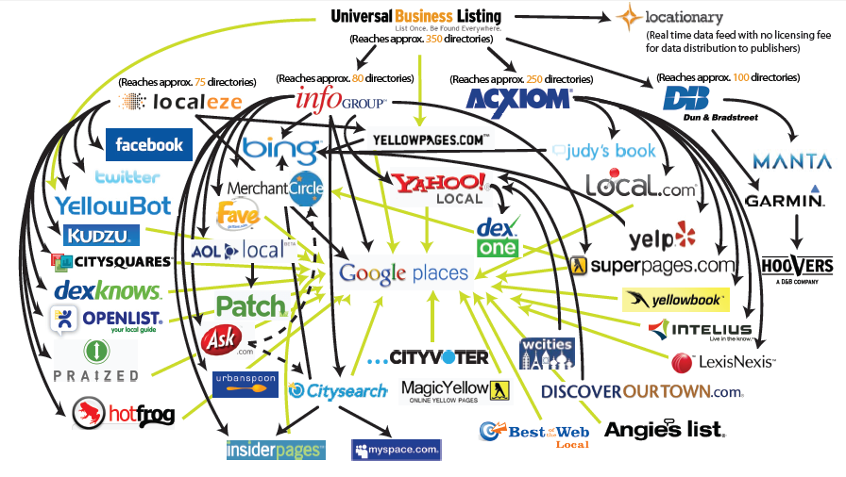
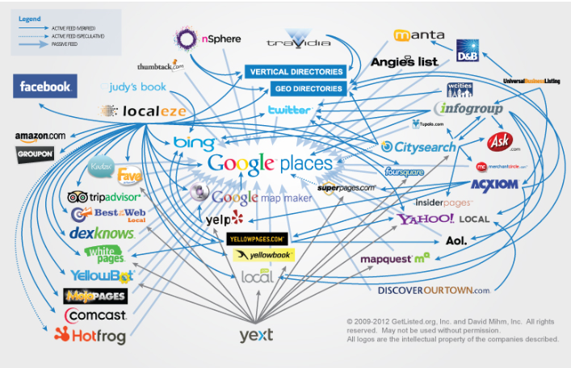
Major Shift in Local Ecosystem
The local database landscape is constantly changing. The process to submit your local business to continues to be complicated.
2009
2012

Slide 4
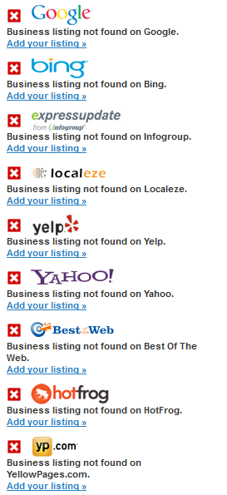
Your Current Local Evaluation
0% Completed Listing
Pull from GetListed.org
Source: GetListed.org, 2012

Slide 5
Sample Reviews
Examples of reviews on Google Places, Yelp, etc.

Slide 6
How We Can Help
Distribution Across Local Websites
Review Management
Qualified Traffic & Sales
Local Submit & Listings Management
  Local Submit pushes out your company business listings to over 80 local search engine directories
  Appear more often in local search results for your products and services
  Update business information across all properties with one monthly submission
  Aggregate and manage reviews quicker and more efficiently

Slide 7
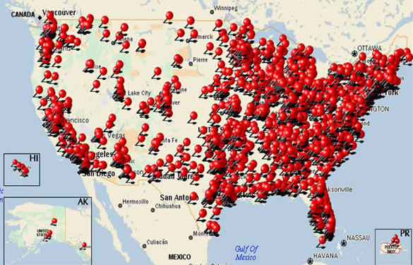
Multi-Location Experts
BFO has experience submitting and managing local listings for multi-location retailers.
  Experience managing 300+ Locations
  Skilled at responding to negative reviews, and setting up processes to maximize positive experiences
  Experience working with customer service teams to encourage best practices and positive brand exposure online

Slide 8

Local Submit & Listings Management
Direct Submission to Google+ Local, Yahoo Local, Superpages.com and Switchboard.com combined with a comprehensive database submission to over 100 Internet Yellow Pages and local search directories & mobile platforms.

Slide 9


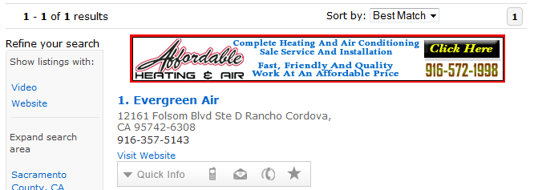
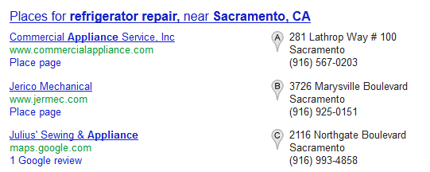
SEO Tactics
We’ll use our SEO expertise to ensure your local listings have the best keywords, categories and product terms to make sure you’re found when people are searching for your business name or your business type.
“Evergreen Air, 95655 ”
“Refrigerator service company, 95655 ”

Slide 10
Customer Service Monitoring & Response
Daily Monitoring and Response on Review Sites
  Watch review sites for negative mentions of the brand and respond accordingly.
  Act as first responder to dissatisfied customers and directing them offline and connecting to your customer service team.
Example of negative review

Slide 11
Review Management Tool Features

Slide 12

Review Management
Whenever your profile receives a new review, you will receive an email. This gives your organization the opportunity to respond and/or resolve any issues.

Slide 13
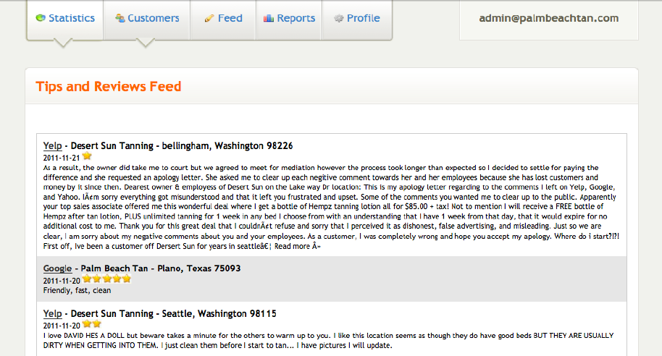
Aggregate Reviews for Quick Reference
Access to an aggregated review section that lists your most recent reviews by location.

Slide 14


Customer Service Integration
Integrate with Salesforce.com, ZenDesk, or other CRMs. This allows you to push the online review to your customer service team for them to evaluate and respond in an efficient manner.

Slide 15
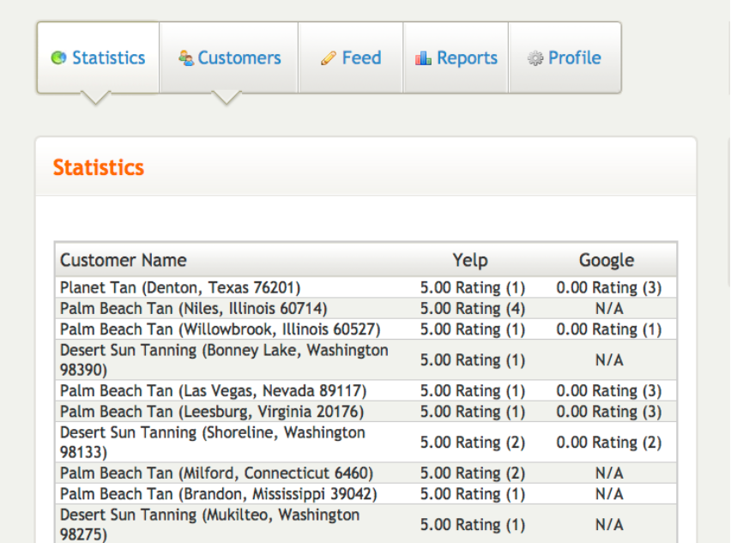
The Stars, The Stars, The Stars
Stay on top of Google+ Local & Yelp ratings.

Slide 16
Our Packages

Slide 17




Basic Package
Basic Submission
Google + Local
Yahoo!
Bing
Quarterly Google reporting

Slide 18


Basic + Database Package
Basic Submission
Google+ Local
Yahoo!
Database Submission
Over 100 directories & local websites
Bing
Quarterly Google Reporting
+

Slide 19



Basic + Profile Claiming
Basic Submission
Google+ Local
Yahoo!
Database Submission
Over 100 Directories & Local Websites
Profile Claiming
Facebook
Twitter
Bing
Foursquare
Google Monthly Reporting
Annual Local Profile Audit
+
+

Slide 20

Basic + Review Management
Basic Submission
Google+ Local
Yahoo!
Directory Submission
Over 100 Directories & local websites
Profile Claiming
Facebook
Foursquare
Review Aggregation & Monitoring
Access to a sophisticated tool that will allow you to aggregate, monitor, and respond to reviews on your own
Bing
Twitter
Google Monthly reporting
Quarterly Local Profile Audit
+
+
+

Slide 21

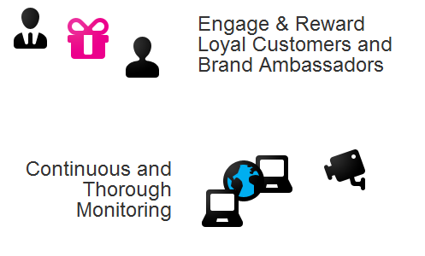

Full Service Package
Basic Submission
Google+ Local
Yahoo!
Directory Submission
Over 100 directories and local websites
Profile Claiming
Facebook
Review aggregation + Monitoring
Access to a sophisticated tool that will allow you to aggregate, monitor, and respond to reviews on your own
Full Service Review Management
Our reputation management analysts will aggregate, monitor, and respond to your reviews for you
Bing
Twitter
Foursquare
Monthly Google reporting
Local Profile Audit & Datafeed
+
+
+
+

Slide 22
Local Business Profile Tiers
Additional billed hours
Social Domain Protection - $500
Additional Services

Slide 23
Process & Timing
(First Half)

Slide 24
Process & Timing
(Second Half)

