Slide 1
Restaurants Collateral
December 8, 2010

Slide 2
Restaurant Objective/Google Platform Alignment
Digital Platform | Objective
Desktop Search | Menu Promos; Holiday/Event Promos; Brand Terms; Competitor Presence; New Store Openings
Desktop Display | Menu Promos; Holiday/Event Promos; New Store Openings; Audience Targeting
Mobile Search | Menu Promos; Loyalty Program; Brand Terms; Competitor Presence; New Store Openings
Mobile Display | Menu Promos; Loyalty Program; New Store Openings; Audience Targeting
YouTube/Video | Menu Promos; Holiday/Event Promos; New Store Openings; Audience Targeting
Online Audio Ads | Menu Promos; Holiday/Event Promos; New Store Openings
Google TV Ads | Menu Promos; Holiday/Event Promos; Audience Targeting; (National Only)
Notes:
Entire slide is customized

Slide 3
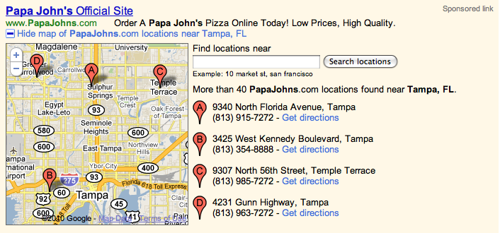
Desktop Search: New Ad Formats Enhance User Experience
Site Links: Increased visibility + more relevancy equals higher engagement & more people who know where to find you
Store Locator Ads: Enhanced User Experience
Your Restaurant Name
Discover our Delicious New Slider Options Starting at Just $4.95!
www.YourRestaurant.com
Ad
Locations Menu
Online Ordering New Flavors

Slide 4
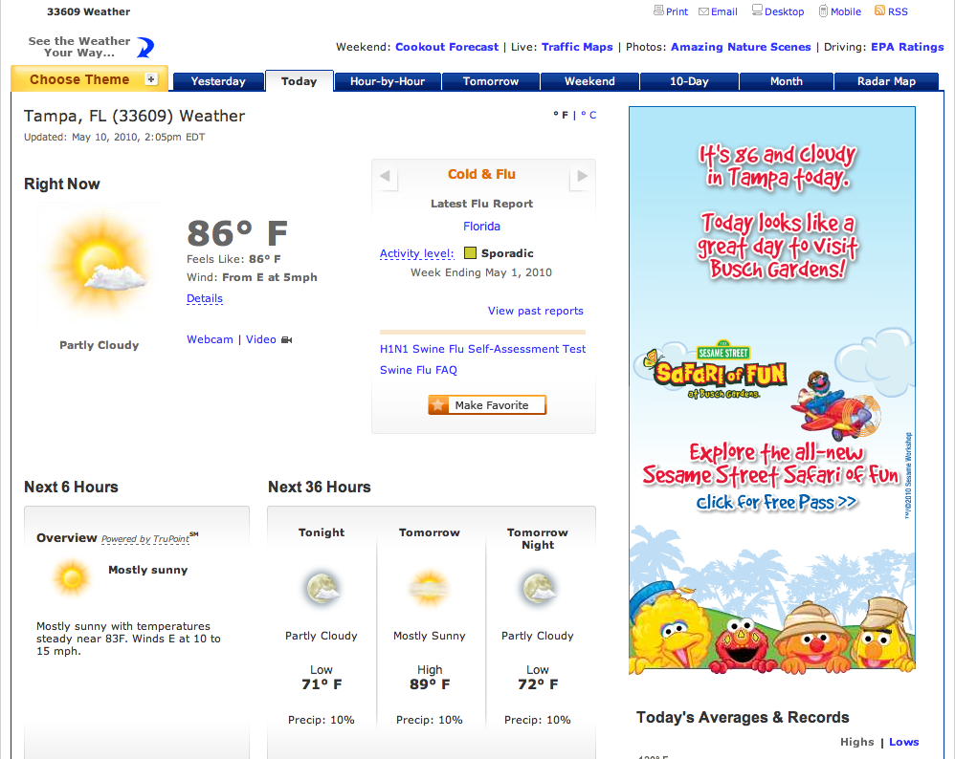
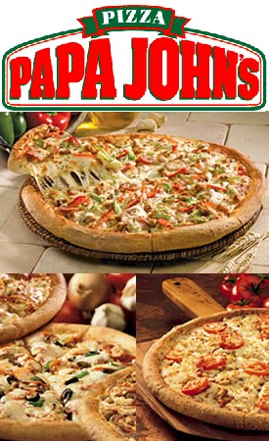
Desktop Display: Targeted Brand Awareness
Locally Targeted for New Openings
Placement Interest – Local/Foodies
Categories to Consider:
Sports Fans
Foodies
Beer Lovers
Location-based
Moms
Grand Opening!
Utilize Display ads to generate brand awareness as well as capitalize on direct response-focused initiatives.

Slide 5
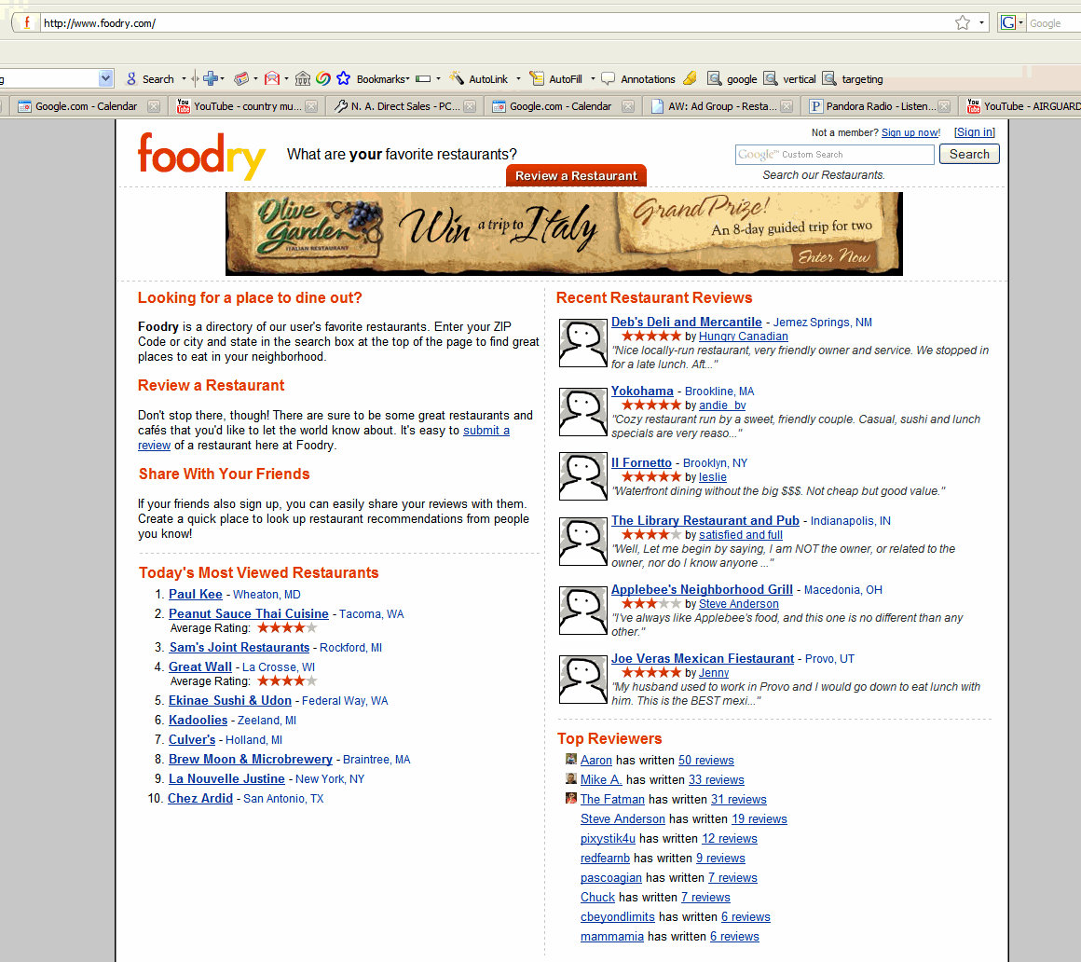
Desktop Display: Example- Olive Garden Complimented TV Ads Online
Ads ran on…
…and many others

Slide 6
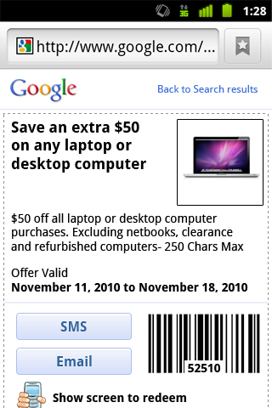
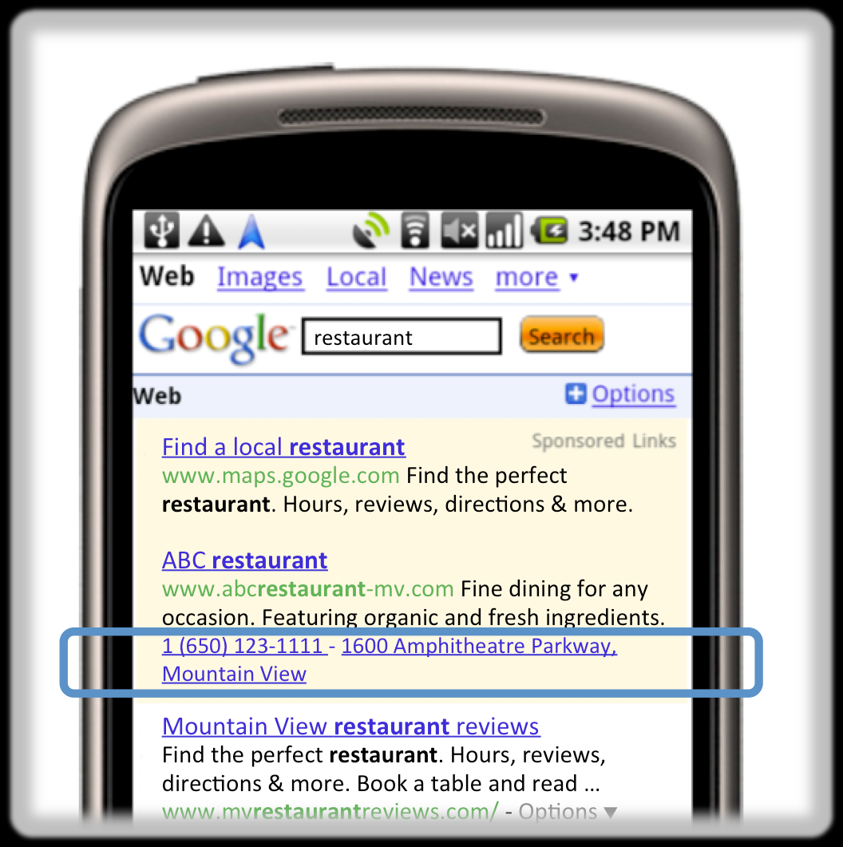
Mobile Search: New Ad Features Customize Campaign Success
Hyperlocal
Offer Ads - Beta
Location Extension & Click-to-Call Feature
papa johns
Papa John’s Official Site
www.papajohns.com Order a Papa John’s Pizza Online Today! Low Prices, High Quality.
(813) 915-7272 - 9340 North Florida Avenue, Tampa
Papa John’s Delivery or Carryout Pizza - Order Online and have ...
Order Papa Johns Pizza online today and have it delivered. Online specials are always available, order at your own pace ...

Slide 7
Mobile Search: Hyperlocal Ads Increase CTR
Hyperlocal Ads
Show users how far away they are from the advertiser’s location
Enable with Location Extensions (map extension)
Up to 7x increase in CTR
Notes:
7

Slide 8
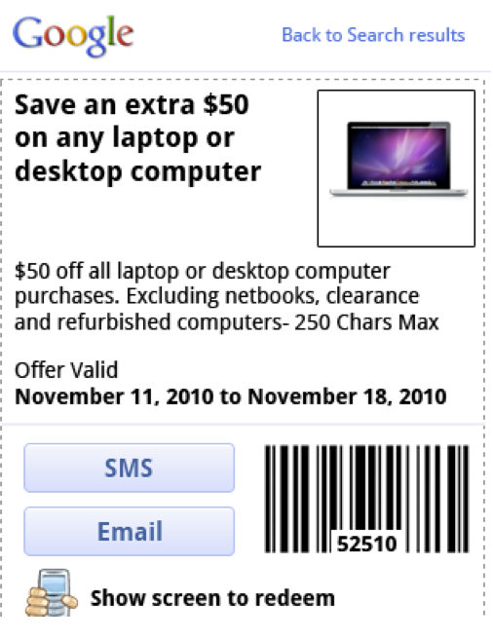
Mobile Search: Offers Beta Drives In-Store
1
2
3
4
Customer searches for a laptop on a mobile device
Ad for company XYZ with an offer is triggered
Offer expands when the customer clicks on the + box
Customer stores the offer via email or SMS

Slide 9
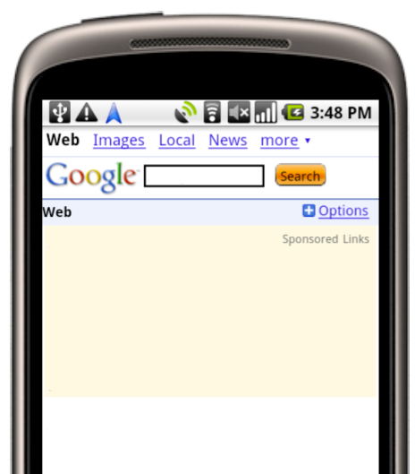
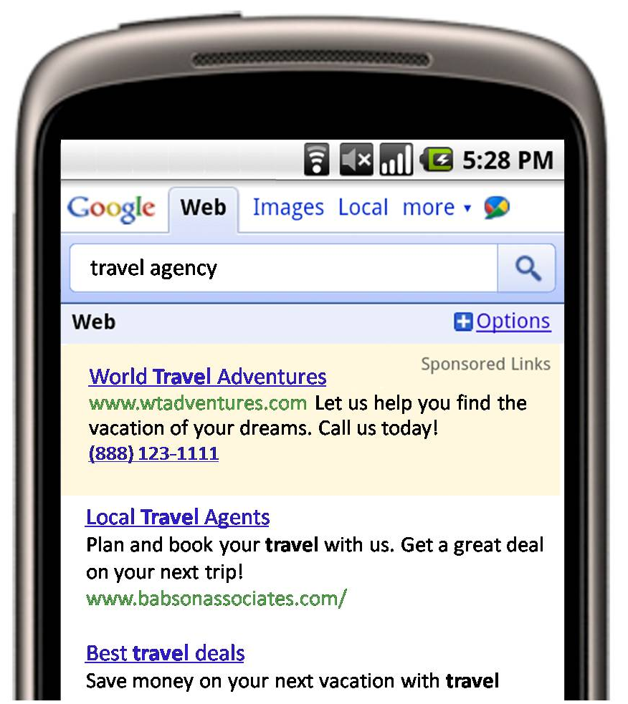
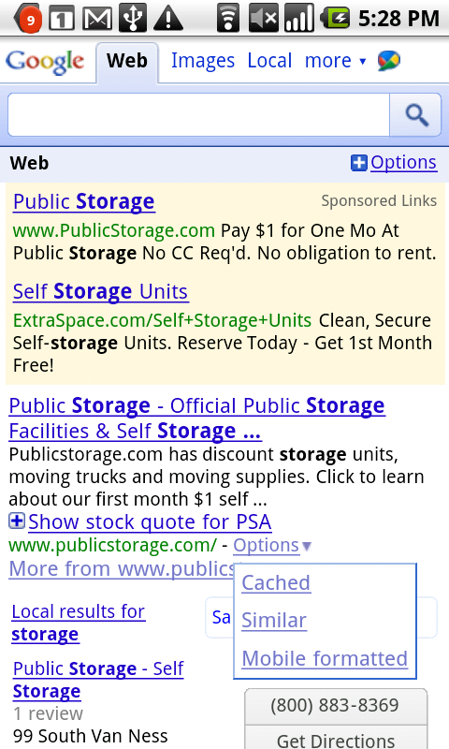
Mobile Search: Click-To-Call Increases CTR
Now customers can click to call your business directly from your ads when they appear in Search and GMM results on mobile devices with full internet browsers.
Advertisers who participated in our click-to-call beta trial saw a
5-30% increase in CTRs,
without cannibalizing URL clicks.
restaurant
restaurant
Lou’s Italian Restaurant
www.lousitalian.com Fine dining for any occasion. Featuring organic and fresh ingredients.
1 (650) 123-1111 - 1600 Amphitheatre Parkway, Mountain View
Mountain View restaurant reviews
Find the perfect restaurant. Hours, reviews, directions & more. Book a table and read …

Slide 10
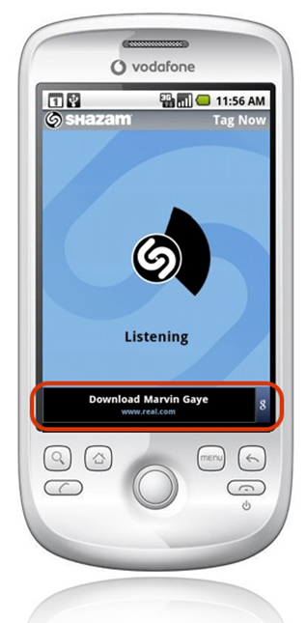
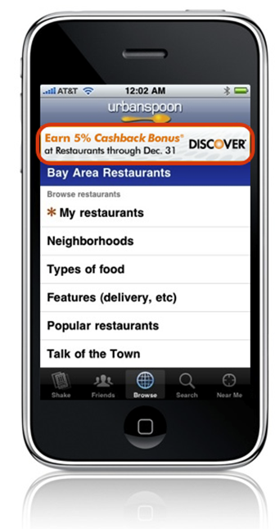
Mobile Display: Engage Users in Apps
Ads for Mobile Applications:
Approx 90M potential daily impressions
Full Reporting
Text and display options (same as desktop display network)
Multiple Display ad formats, including expandable video and maps
Many Targeting Options
Run Of Network
Specific Placements
Category Targeting
Finance
Sports
Entertainment
Billions Of Monthly Impressions
Dining
News
Many More
Shazam
Flixter
Spotify
Pandora
Qik
Urbanspoon
Sports
Tap
Dolphin
Back-
grounds
Big
Oven
Bill
Miinder
Notes:
10
10
Flexibility
Send traffic to mobile or web landing pages, promote your own app by sending clicks directly to the Apple App Store or Android Market or drive traffic to your YT video or brand channel
Targeting
Target specific applications, categories, locations or keywords that fit your target market – and leverage the extensive reach of our network
Familiar platform, familiar process
Google's AdSense for Mobile Apps runs on the Adwords interface,
Standard mobile banner ad formats
What? Banner Display (300x50, 7.5k Max) and Text Ads
Where? iPhone/iTouch or Android Devices
How? Placement Target Specific Apps
Run of App Network
Reach? Est. Impressions- Millions per Day
Pricing? $3-$8 CPM (Varies per Channel/App)
Targeting? Iphone or Android- US based

Slide 11
Mobile Display: Targeting Audiences with Apps
Foodies
FOODIES: All of our top culinary apps.
TOP APPS: Restaurant Nutrition, Calorie Counter by FatSecret, Bartender, BigOvern
Sports
SPORTS: All of our top sports apps.
TOP APPS: Sportacular, Sportstap, The Score, Formula 1 Live Racing
Local
LOCAL: All of our top local apps.
TOP APPS: Craigsphone, WhosHere, FindStarbucks, Yellow Pages, Movies, Weather & Toggle Widget
Notes:
11

Slide 12
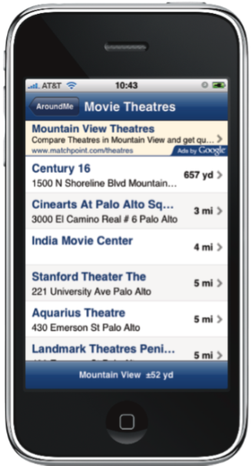
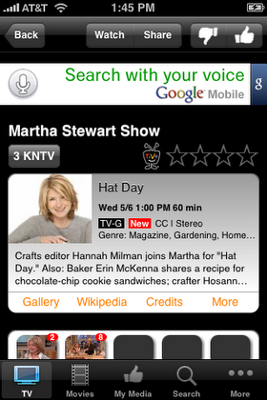
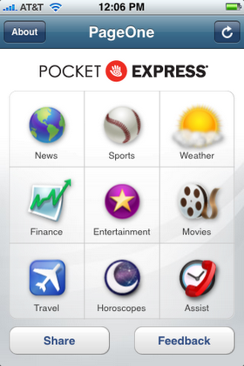
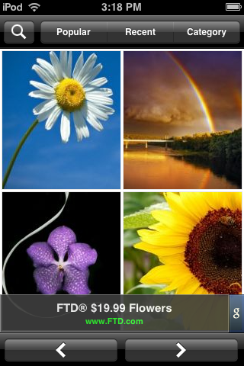
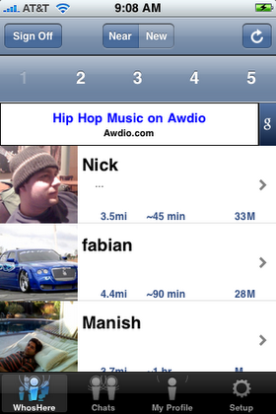
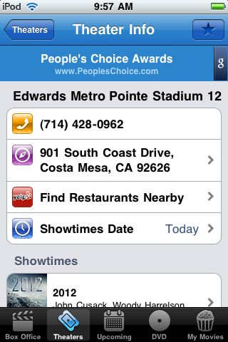
Mobile Display: Example App Placement
i.TV
Backgrounds
Flixster

Slide 13
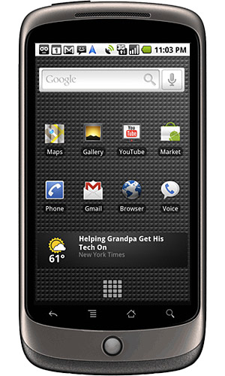
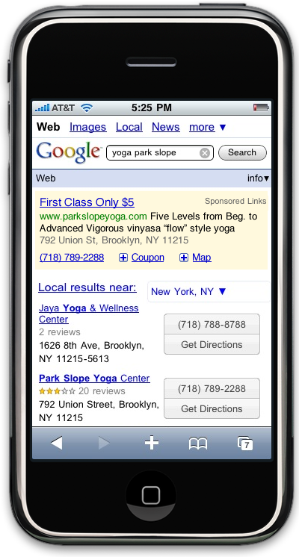
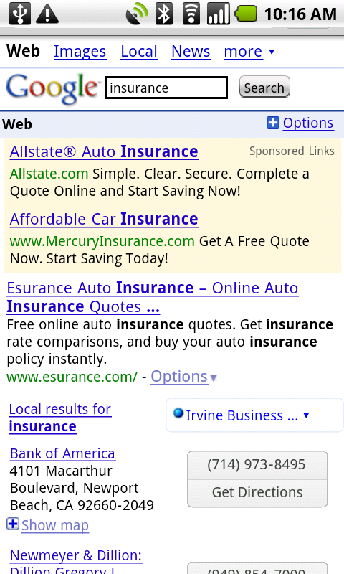
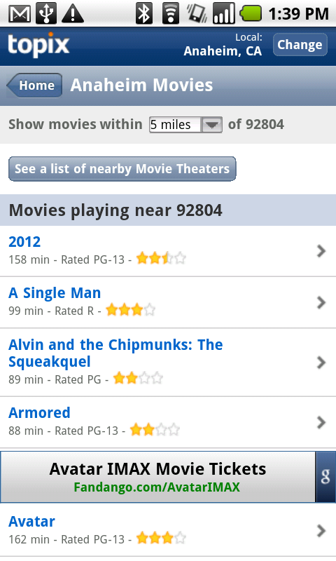
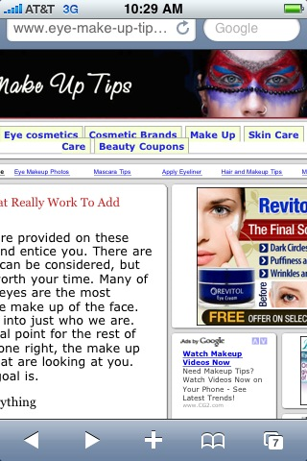
Mobile Display: Reach Diners On-The-Go
Works Just Like Desktop Display
Display Mobile Ads (Text and Image) on:
Optimized Mobile Sites on our Google Mobile Content Network
Desktop Sites Viewed Via High End Device
Targeting /Pricing Options
Bid via CPC or CPM for all Display ads
Placement, Contextually and Enhanced Targeting
Carrier, Platform and Geo-Targeting
Optimized Mobile Page
Desktop Sites Viewed via High End Mobile Devices

Slide 14
Mobile Display: Reach Specific Demos (ex: Moms)
Moms are using their high end mobile devices and the iPad to view these premium sites within our Mom Channel . Reach them using text and image creative!
Income
Featured Display Network Sites
15 million daily impressions
Avg. CPM $1.40
Monthly Cost $21,000
Age
Sources: comScore Media Metrix, February 2008 & Internal Google data.

Slide 15
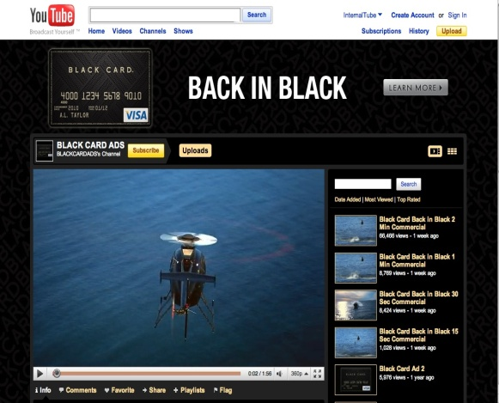
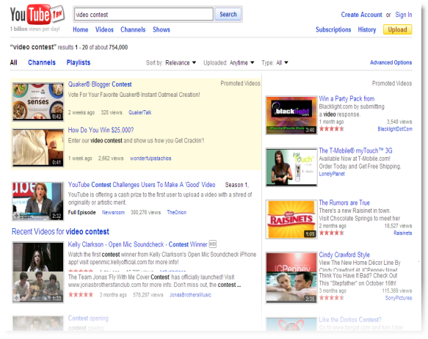
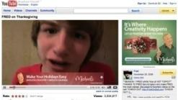
3 Simple Steps to Success on YouTube
1
2
3
Step
Step
Step
Establish a destination for your audience…
Attract Viewers As They Discover Video Content…
Engage Users While they Watch
Promoted Videos with Call-to-Action
InVideo Display Ads with Video Targeting
YouTube Channels
15
Notes:
And the good news is that advertising on YouTube is that it’s simple. There are 3 basic yet effective ways for OSO advertisers to engage their customers on our platform…
Through Establishing a Destination for Your Audience
While they watch videos via Invideo Display Advertising
As they Search for Content through Promoted Videos with Call-to-Action
Let’s walk through each of these methodoglogies now

Slide 16
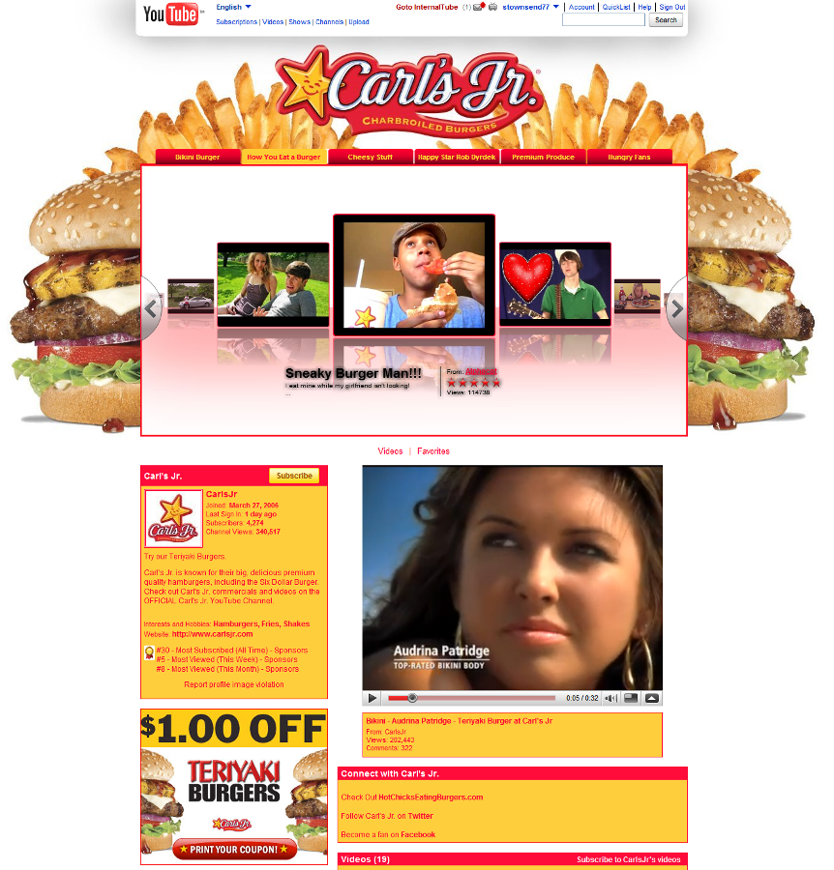
YouTube: 1 – Establish Destination with Channels
A Hub On YouTube
For Use if BJ’s Will create and update video content
A destination to drive traffic, attract subscribers, and enable distribution.
Customize your channel to match your other online properties.
Free!

Slide 17
YouTube: Keys to Success with Channels
Videos: Continually update new content, playlists, and
video logs
Create & Establish a destination on YouTube to send your customers, which hosts all of your videos.
Make a home for all your users to be Entertained or Educated.
Community:
Actively participate. Comment, share, and favorite videos.
Friend others, aggregate content 3rd party
Sustain and Grow Viewers
Syndicating: Embed your videos and/or channel on your
website.
Link to your videos on other social networks
Your Customer Base
Gain Viewers
Notes:
17
17

Slide 18
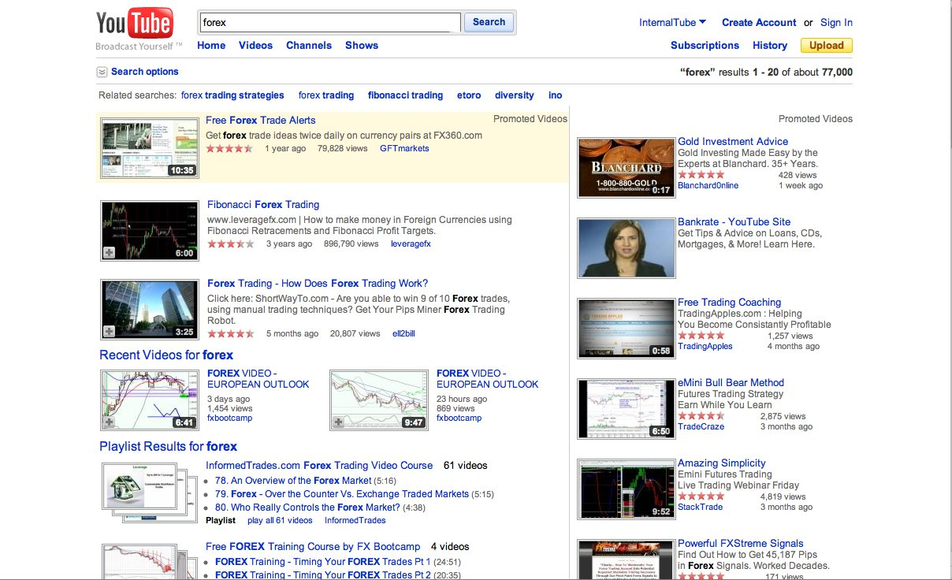
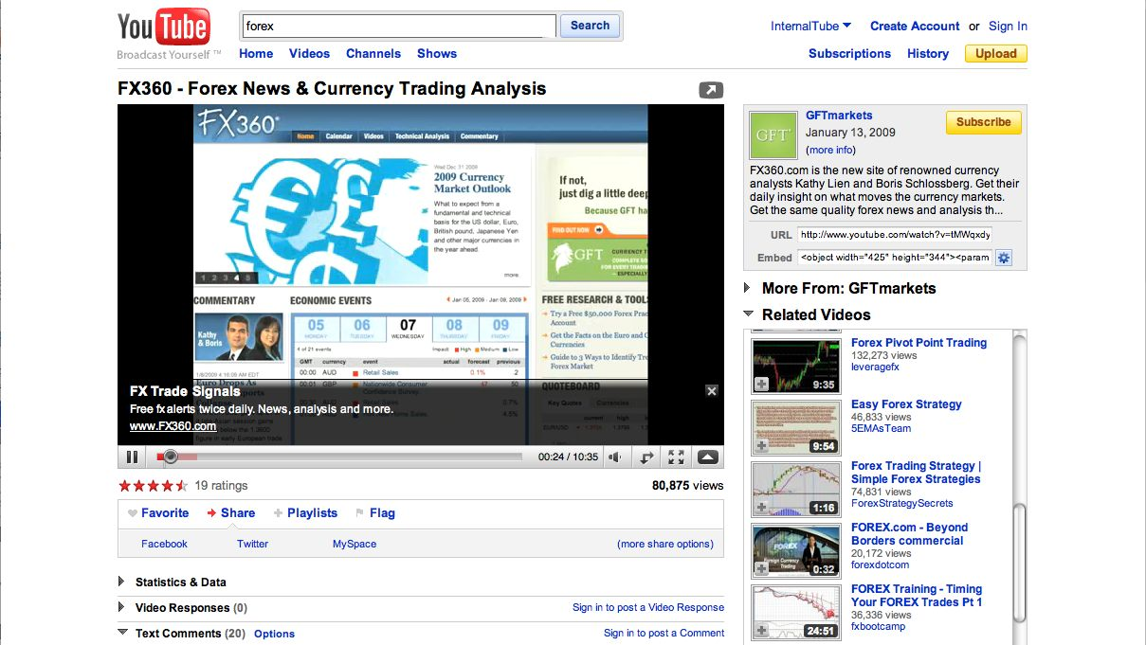
YouTube: Promote Your Videos/Channels
Highlight your video content and win new customers
Use your Promoted Video to drive traffic to your site
Targeted advertising based on keywords
Cost-effective and measurable way to promote your videos
Video Overlay with external click-through URL
Ability to opt your videos into
the GCN for added exposure
18
Notes:
For clients with Video content, engage your clients while they search on YouTube. With Promoted Videos, you can ensure your content is being surfaced and discovered by your target audience during the hundreds of millions of search they perform each day.
Just like AdWords, keyword-based targeting gives you control over the search terms that trigger your video promotion, you only pay when your video is clicked, and campaign performance can be tracked right from your AdWords account.
A new feature that also we’re excited about is Call-to-Action – a free text overlay that allows you to drive traffic right to your site, further increasing your conversion rate. And for maximum exposure, activate your Promoted Video campaign to appear in results for not only YouTube but for Google Search and the GCN a well.
All these features make Promoted Videos a dynamic way to promote your content and win customers.

Slide 19
YouTube: Target Videos, Drive Traffic to Site
Target Videos
Sports
Beer/Brewing
Food/Recipes
Meal Tips
Moms
Engage your customers as they watch partner content
Display or Text Ads
Multiple Ad Formats
19
Notes:
While They Watch….
Invideo Display advertising is the perfect opportunity to engage your customer during their lean-forward moment – right as they watching the video. All campaigns are set up right in AdWords, and come in a variety of formats from our 468X60 Invideo Overaly to our 300X250 Companion ad featured prominently next to the video. Of use the Overlay + Companion template for maximum exposure on our Watch page to really capture the customer’s attention.
And because they’re set up in AdWords, display campaigns in YouTube offer all the same targeting options as any other Display campaign, from Contextual to an Enhanced Online Campaign or Placement-targeted campaign focused on YouTube.
But in addition, with our new Video targeting tool, YouTube gives you more even targeting options to reach your customer. Simply search by keywords or demographics, and the tool returns the videos, channels, and content categories that they’re watching and the potential impressions available. Preview, bundle, and import your selection into any media plan in just minutes allowing you to have full content of the content you show against and the audience you reach.

Slide 20
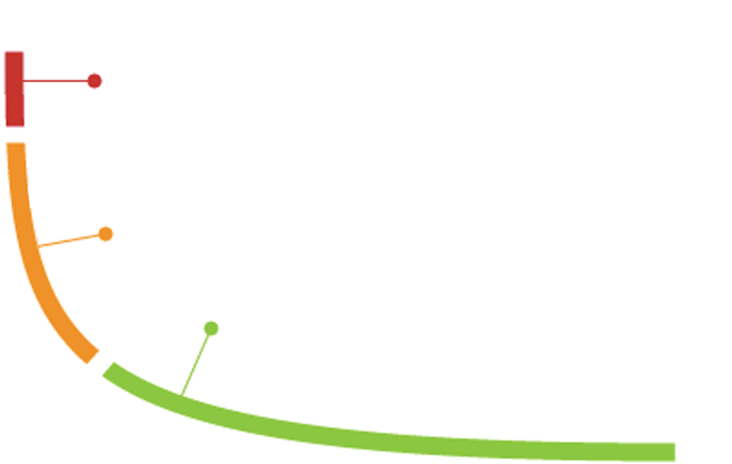
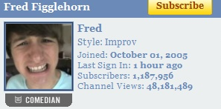
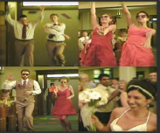
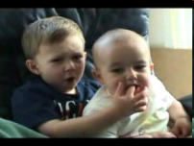
Our Content
MAINSTREAM CONTENT
Universal Music Group
HBO
ESPN
CBS
NY Times
THE “NEW” MAINSTREAM
Fred Figglehorn
EMERGING MIDTAIL
Next New Networks
Jonas Brothers
Howcast
Mondo Media
Over 3,000 content partnerships from established names to YouTube made celebrities
LONG TAIL
JK Wedding Video Dance
Charlie Bit Me
20
Notes:
20
Millions of people tune into their favorite YouTube channels every day. Britney Spears has a much-visited channel on YouTube. So does Beyonce….and Animal Planet… and the President of the US…and the Pope. They’re on YouTube, because that’s where their audiences are.
Online isn’t cannibalizing TV viewing…Rather, the pie is growing. Online video viewing time grew 86% in the same year that saw record television viewing.
Quality matters…in a survey conducted by BrightRoll, 45% of ad buyers said the quality of surrounding content was of utmost importance.
But the definition of “premium” content is what’s changing.
20

Slide 21
Educational Slides

Slide 22
Diners Are Planning Where To Eat In Advance
How far in advance do diners decide which restaurant to go to?
Lunch
Dinner
Always go to the
Always go to the
same place
same place
4%
3%
An hour
or more
28%
Impulse
Impulse
22%
An hour
or more
46%
31%
Less than
1 hour
37%
Less than
1 hour
29%
The Internet is the #1 media used during working hours, when consumers are choosing where to go for lunch & dinner
Source: Online Testing Exchange Restaurant Survey, April 2009
Notes:
Capture audience interest at the moment when they’re doing their research online. Be top of mind!

Slide 23
Casual Diners Spending More Time Online
Restaurant Visitors’ Media Consumption
Casual Dining Restaurants Advertising Investments
$292 Million(Q1-Q3 2008)
Untapped Audience
1% Online
Gap between ad investments and media consumption
15% TV
25% Online
53% Print
40% TV
8% Print
18% Radio
25% Radio
2% Yellow Pages
9% Outdoor
Source: 2008 Spring Mediamark Research & Intelligence weighted to Population (000)

Slide 24
Diners Are Online
90% of Americans go online to research casual dining restaurant information
59% of casual diners go online to look for restaurants in their area
58% of casual diners go online to look for coupons or special offers
47% of casual diners go online to decide where to eat lunch or dinner
38% of casual diners go online to decide what to order for takeout/delivery
Source: Online Testing Exchange Restaurant Survey, April 2009
Notes:
Simply stated, your consumers are online. These stats are US-specific and are from a survey we conducted of US casual dining users last year, but they show the trends we’re seeing, and potentially where the rest of the world is headed…
These may or may not be surprising statistics, but they’re pretty compelling

Slide 25
Online Research is Important to Diners
90% of diners go online for information about restaurants, 80% use search as part of the process, and 70% use the Internet to choose a restaurant.
50% of consumers turn to Search Engines first when looking for local information, 24% to yellow pages and 4% to local newspapers.
47% of casual diners go online to decide where to eat lunch or dinner, and 38% go online to decide what to order for takeout/delivery.
Source: Online Testing Exchange Restaurant Survey, April 2009

Slide 26
Search Is A Developing Part Of Diner Research
Usefulness Of Restaurant Advertising
-
50%
47%
42%
40%
38%
35%
35%
32%
30%
28%
25%
24%
24%
20%
10%
0%
TV Ads
Online Search
Print Ads
Radio Ads
Outdoor Ads
Engine Listings
Is useful
Informative
Source: Online Testing Exchange Restaurant Survey, April 2009

Slide 27
Restaurant Searches are Growing Exponentially
Weekly Searches, 2006 to present
5X growth since 2006
Source: Google Internal Data, May 2010

Slide 28
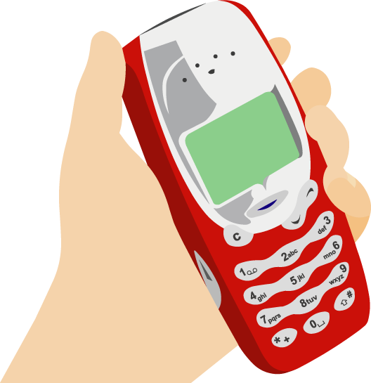
Mobile Is A Developing Part Of Diner Research
Of People Who Go Online Via Their Mobile Device (37%):
63% research restaurant related activities
33% research facility information
46% research locations
29% research food/menu items
15% look for coupons/special offers
Source: Online Testing Exchange Restaurant Survey, April 2009
Notes:
http://www.restaurant.org/pressroom/pressrelease.cfm?ID=1701, Oct 08
http://www.kelseygroup.com/press/pr090224.asp

Slide 29
Restaurant Mobile Query Growth
Mobile has seen over 1000x growth in the last 3 years.
Google Restaurant Query Growth* Compared to Smartphone Launches
* Based on a basket of 10,000 keywords within the restaurant category
Source: Google Internal Data

Slide 30
Being Visible Increasingly Means Mobile
Growth in Restaurant Searches
59% of moms have conducted a restaurant related search on their mobile phone ¹
39% of mobile internet users use their mobile device to find a restaurant ²
*Google Insights for Search, April 2010
1. Google BabyCenter OTX Moms Survey, November 2009.
2. Ruder Finn, ‘Mobile Intent Index,” Feb. 2010
Notes:
Mobile is increasingly important in the Restaurant category. This graph shows the % growth in desktop vs mobile searches during the past two years. While the total number of restaurant related desktop searches still outpace mobile searches, it’s clear that it’s only a matter of time before mobile volume rivals desktop volume.
And based on various studies, it’s clear that your audience, particularly moms, are using their mobile devices to conduct restaurant related searches.
Other Interesting Research:
Mobile searches by moms – mostly in their cars (45%) – suggesting usefulness to find nearby location – and at restaurants (32%) – suggest looking up calorie counts, reviews, etc. Also 27% at work – looking for easy dinner or lunch options?
When we look across a broader population (not just moms), we see similar types of queries pop to the top of mobile searches related to QSR:
39% mobile searches for QSR related to locations
21% related to food / menu items

Slide 31
Mobile Applications: A New Ecosystem of Content
3+ Billion Apps Downloaded
Average Android user downloads 40 apps
25% of iPhone & Android Users Spend 2 hours per day in apps
98% of iPhone users have downloaded at least 1 app
Source: Complete, Inc. 2009, mocoNews 2009

Slide 32
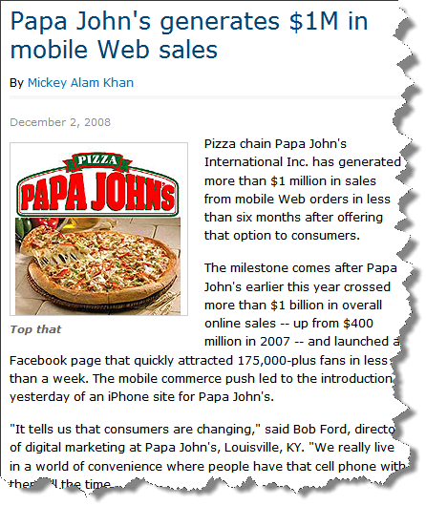
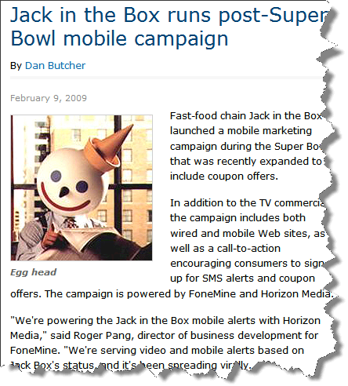
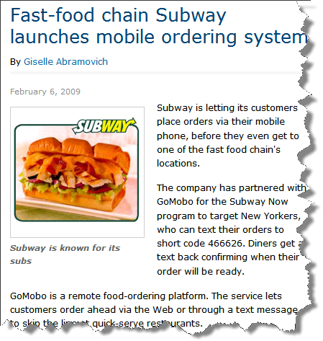
Mobile Is Driving Revenue For Restaurants Today
Mobile advertising drove 17.2% lift in purchase intent
Big restaurants are using Mobile already….
Offering mobile ordering, coupons, locations and more
Source: Insight Express, Mobile Marketing Study 2009
32
Notes:
32
Regarding the 17.2% lift in purchase intent: Earlier this year, insight express set up a controlled study to measure the effect of mobile ads. Some users saw mobile ads, others didn’t. Purchase intent, brand favorability etc... was measured by a survey people completed shortly after seeing ads. They found that restaurant ads show a higher impact and were more effective than mobile ads in general.
32

Slide 33
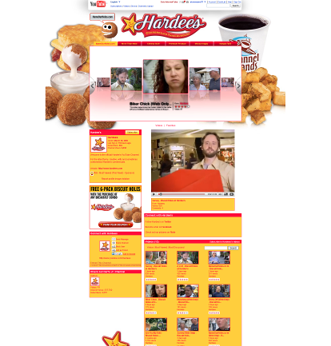
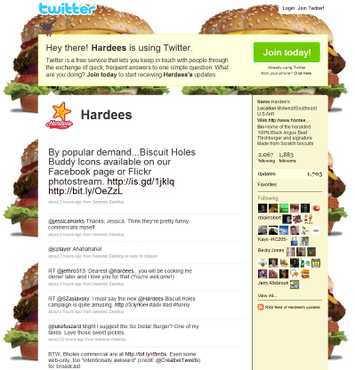
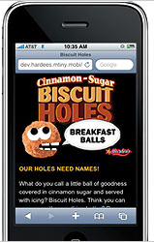
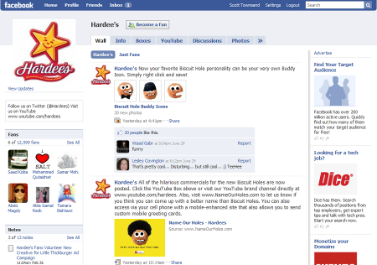
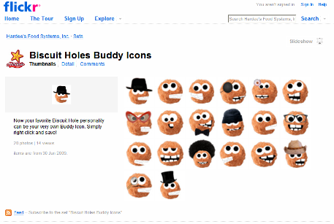
Hardee’s Campaign Is Centered Around Mobile
“Hardee's is diving headlong into mobile as part of an interactive, multi-platform campaign to introduce its newest menu item, Biscuit Holes.”
YouTube
Twitter
Mobile Microsite
Facebook
Flickr
submit name suggestions
watch streaming videos
share the site
send personalized Hardee's mobile greeting cards to friends
view product information
view photos
opt to receive updates from Hardee's
The campaign also encompasses numerous integrated advertising, social media and online components
http://www.mediapost.com/publications/?fa=Articles.showArticle&art_aid=108849
Notes:
33
But the most novel aspect of the campaign is an aggressive, highly integrated mobile component that may cause other QSRs to notice. Consumers with mobile Net access can use a mobile-optimized version of the NameOurHoles site not only to submit their name suggestions, but to watch the commercials on streaming video, share the site, send personalized Hardee's mobile greeting cards to friends, view product information and photos or opt to receive updates from Hardee's.
The mobile site, created by iLoop Mobile, integrates with the microsite through form fields that collect the user's suggested name for Biscuit Holes, as well as other user profile data. Names suggested via mobile actually are inserted into the TV spots after being transmitted to the Web site's database.
The campaign will also deliver geotargeted advertising across Jumptap's ad network through a channel comprising premium sites and applications predominantly frequented by adults 18 to 49, including Boost Mobile, Joker Poker, MocoSpace, LimeLife and Weatherbug. Hardee's will also run display ads on tapMatch, Jumptap's self-service pay-per-click mobile performance marketplace.
33

