Slide 1
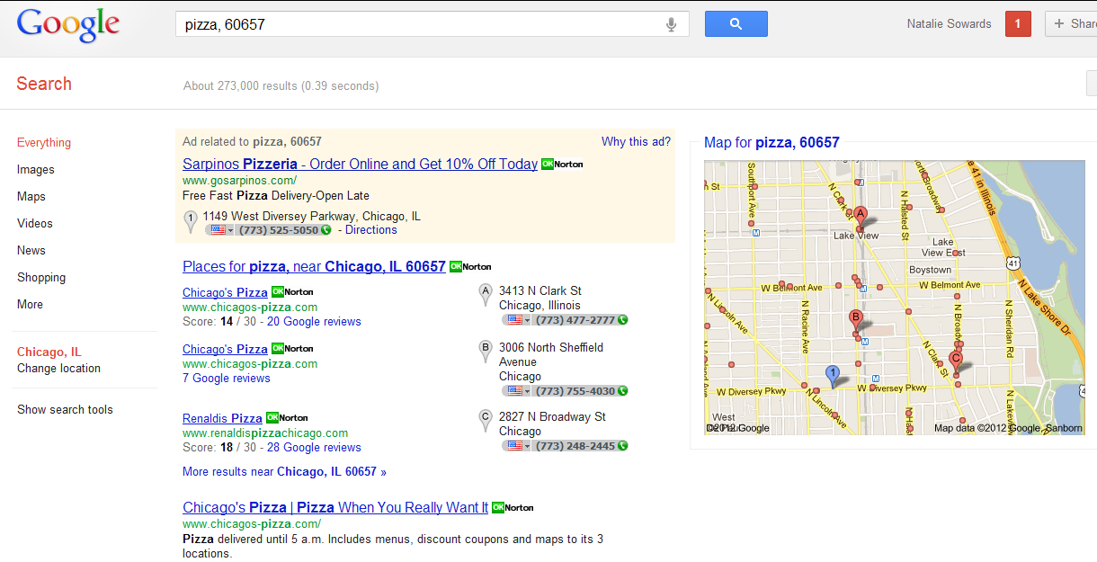
Google+ Local (Google Places)
Opportunity on Google+ Local
Google+ Local is an integral section of Google search results. Make sure you have a presence.
Recent changes allows you to further stand out from your competition with Zagat Ratings & social integration
None of your locations have claimed their page
How We Can Help!
Claim and optimize all of your retail locations so that customers can easily find your information
Show up on key local search results
Respond to negative posts to control the conversation

