Slide 1
Display & Remarketing What You Need to Know

Slide 2
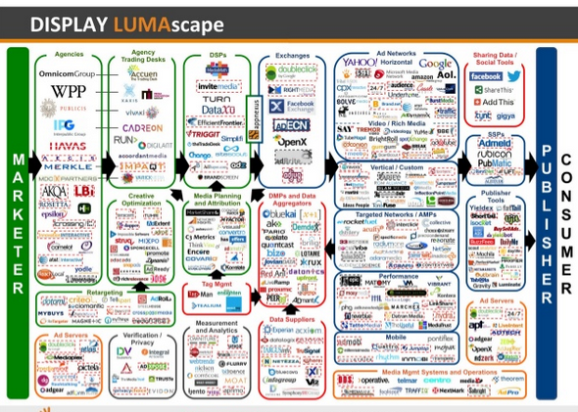
What Is Display?

Slide 3
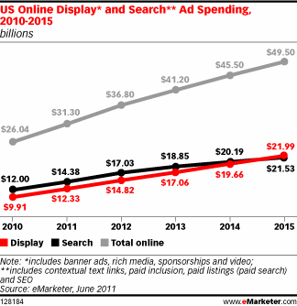
The Display Opportunity
>> Expected to Outpace Search Advertising in 2014

Slide 4
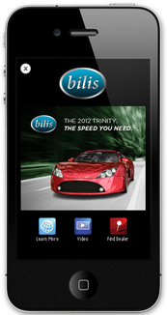
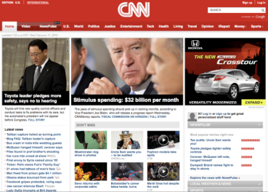
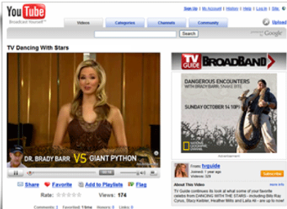
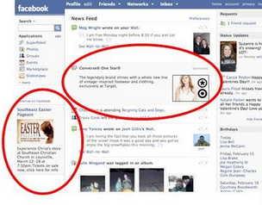
What Are We Selling?
Type of online advertising where an advertiser's message is shown on a destination web page. There are several different targeting techniques and ad formats in order to reach advertiser’s desired audience and boost traffic and conversions.
Sites
Video
Mobile
Social

Slide 5
Why is It Important?
X% of people click on an ad

Slide 6
Who Should Use It?
Brand Awareness
Direct Response
>> New Brand/Product Launch
>> Reach Niche Audience
>> Expand Customer Reach
>> Generate Traffic & Conversions
>> Drive More Paid Search Conversions

Slide 7
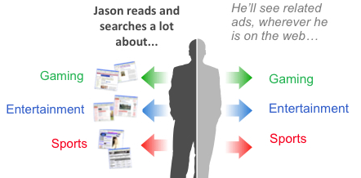
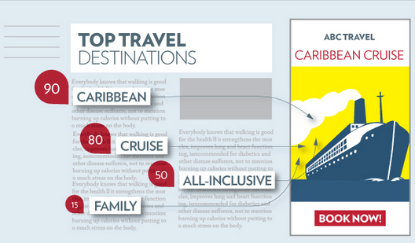
Targeting Techniques
Attract high value users.
Remarketing
Bring back users who have visited your site by serving them a display ad as they traverse the web in the following days and weeks. Expand your remarketing list by targeting lookalike site visitors and site converters on the web.
Find audiences interested in your products and services.
Interest Category Marketing
Find and engage users across the web based on the interests they’ve demonstrated over the recent past. Leverage remarketing lists to learn about the interests and behaviors that align with your key audiences.
Find consumers as the engage in relevant content
Keyword Contextual Targeting
Reach users across the web at the very moment they are engaging in content that is relevant to your product or service.

Slide 8
Targeting Techniques
Where Your Customers Are
Where Your Customers Have Been
Contextual Targeting By Keywords | By Categories
Interest-Category Matching
Placement Targeting
Remarketing
Add: Keywords, demographic bids, geographic and time filtering
Exclude: Undesired sites, keywords, categories

Slide 9
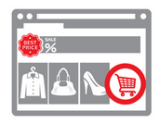
Let’s Talk Remarketing
Start with the most basic form of remarketing.
Site Remarketing
Target individuals based on their specific products views, actions taken or actions not taken — such as abandoning a shopping cart — with custom messages.
Attract ready to convert shoppers with product images and price points.
Dynamic Remarketing Ads
When your remarketing campaigns include dynamic ads the effect of remarketing is amplified. With dynamic remarketing, you can create highly relevant customized ads that remind shoppers of items they've seen or bought in the past on your site and suggest other products they might like.

Slide 10
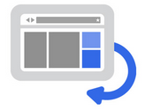
Let’s Talk Remarketing
Expand your paid search campaigns to attract a larger and more valuable audience
Search Remarketing
Target users based on specific searches they conducted on Google, Yahoo! and Bing. Remarketing lists for search ads provides yet another opportunity by letting you tailor your keyword bids and ad text for your highest value prospects — people who have visited your website in the past — when they’re searching for what you sell. Find consumers as the engage in relevant content
Find people similar to your ideal customer
Similar Audiences
Similar Audiences looks at data about your existing remarketing audiences and finds new and qualified consumers who have shared interests with that audience. It’s a powerful, but simple way to reach a much larger audience and drive clicks and conversions among new prospects.

Slide 11
Let’s Talk Remarketing
Get more conversions from your social channels
Facebook Exchange & YouTube Remarketing
Products or services recently browsed — either on third-party sites or the social sites — are displayed on Facebook or YouTube the next time the viewer visits the site.

Slide 12
Ad Networks

Slide 13
YouTube TruView Ads
Engage, inspire, activate. Online videos have transformed the way brands tell their stories.
In-Search Ads
In-Display Ads
KEYWORD
USERTYPE AND UPLOADER
DEMO, GEO
INTEREST CATEGORY
Notes:
An extension of Search ads. Very easy to set up. Great for clients that have how-to videos, client testimonials, complicated products, etc.

Slide 14
Yieldbot

Slide 15
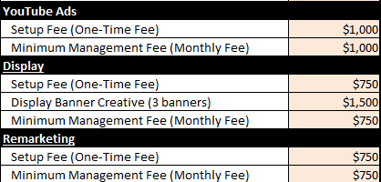
How Much Does It Cost?

Slide 16
What’s The Process
Phase 1 – Identifying Audience Segments
This phase includes developing remarketing lists and any custom targeting that best meets your marketing goals.
Phase 2 – Creative Development
Either the client can provide the creative or text ad, or we can develop them in-house. We’ll test different images and offers as well as what audience segments respond best to ads.
Phase 3 - Optimization & Testing
Real-time bidding with remarketing helps you reach customers across the tens of thousands of sites in the Google Display Network and determines where they will best respond to your ads, and automatically tailor your bids accordingly.
Bidding on remarketing works the same as the rest of paid search so you have full visibility and control over what you bid. Our automated performance optimization combines with your own audience segmentation decisions to help your campaigns reach their potential.
Results & Performance
Key Metrics include incremental impressions, clicks, conversions, and view through conversions.

