Slide 1
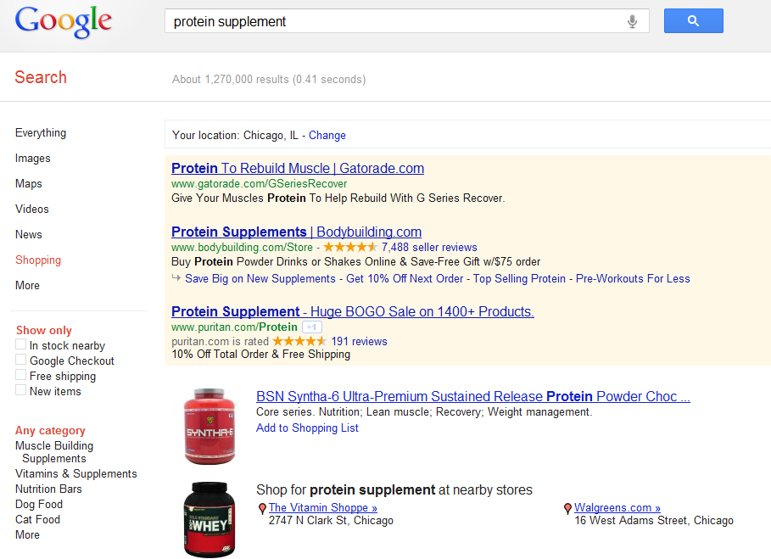
Product Feed Marketing
Distribute product information and images to free shopping search engines like Google Shopping & Bing
CSEs: BizRate, Shopzilla, Shopping.com
1

Slide 2
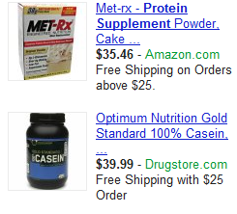
Enable Product Extensions
Link product feed to campaigns so images appear in ads
Show multiple products at one time
You decide what products to display
Leverages Google Shopping
Product images will increase CTR & brand presence on Google.com
2

Slide 3
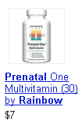
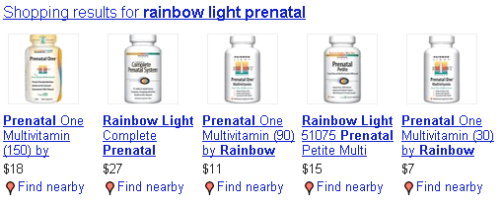
3 Types of Product Extensions
SEM (picture)Product Extensions
SEM (text) Product Extensions
Universal Search (natural listings)

Slide 4
Benefits of Shopping Feeds
Cost-effective way of gaining incremental reach and conversions
Easy to implement
Allows products to get rated and reviewed
Increase visibility in organic search results
Enhances Google Paid Search ads

Slide 5
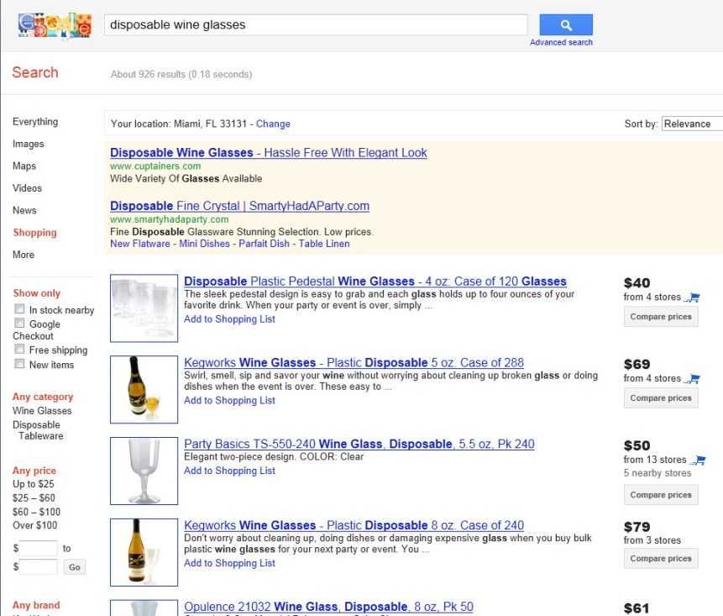
Product Feed Opportunities
Benefits of Listing Products in Google Shopping!
Optimized Titles & Descriptions that use terms your shoppers search for
Product Photos
Product Pricing
Calls to Action: “Add to Cart”

